Slide 2
Anand Desai
Detailee, Patent Pro Bono Program
Patent Pro Bono Program Overview
Notes:
Presentation (3) YouTube Video if needed https://www.youtube.com/watch?v=CZ5CRVNiMzE&embeds_referring_euri=https%3A%2F%2Fhubblecontent.osi.office.net%2F&source_ve_path=Mjg2NjY&feature=emb_logo

Slide 3
Patent Pro Bono Program
Program assists financially under-resourced independent inventors and small businesses.
Section 32 of Leahy-Smith America Invents Act (AIA) – The USPTO Director shall work with and support intellectual property law associations across the country in the establishment of pro bono programs designed to assist financially under-resourced independent inventors and small businesses.
USPTO 2022-2026 Strategic Plan calls for the USPTO to “drive inclusive U.S. innovation and global competitiveness.”
20 regional programs work to match financially under-resourced inventors and small businesses with volunteer practitioners to file and prosecute patent applications.

Slide 4
Benefits to USPTO and inventors
Impact for USPTO
Increased participation in the patent system
Increases patent application filings
Improved patent quality
Supplements pro se (filing on your own) assistance efforts
Impact for inventors
Opportunity to work with experienced patent practitioners
Over $39M in donated legal services provided to inventors from 2015 to present

Slide 5
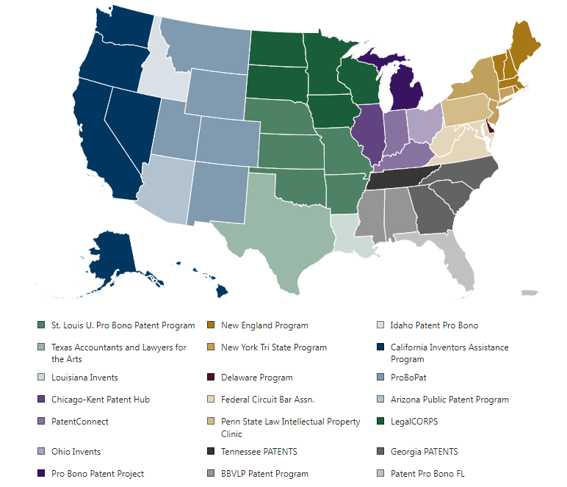
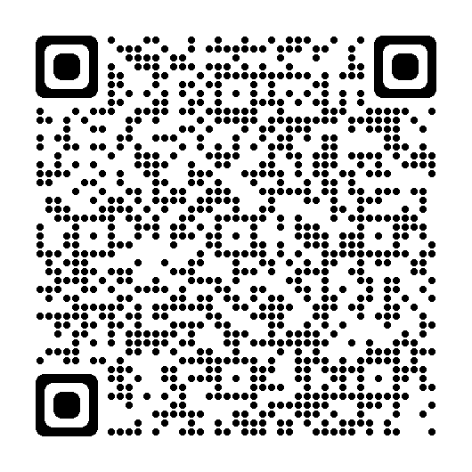
Current nationwide coverage

Slide 6
Regional patent pro bono programs
Regional programs may cover individual or multiple states.
Regional programs are operated by:
Nonprofit organizations focusing on copyright and trademark (e.g., lawyers for the arts)
Universities
Bar associations
Regional programs follow general guidelines but are independent of the USPTO and set their own policies and procedures.
Regional programs are responsible for screening and matching patent pro bono applicants.
Regional programs ensure applicants meet requirements for pro bono assistance.
Regional programs screen for:
Income
Knowledge of the patent system
An actual invention (more than an idea)

Slide 7
General criteria for inventors
Gross household income:
Criteria depends on regional program; can be up to 400% of the federal poverty guidelines.
A single person could have an income of up to $58,320 (see federal poverty guidelines).
The limit increases with additional dependents.
Demonstrate knowledge of the patent system:
Have at least a provisional application on file with the USPTO or have completed a certificate training course (also available in Spanish).
Have an invention: more than an idea
To demonstrate that there is an invention one should be able to describe the invention so that someone could make and use the invention.
Responsible for all USPTO fees
Micro-entity status provides an 80% reduction in USPTO fees.
Regional programs may charge an application fee of $25-$150.

Slide 8
Success stories
Notes:
Discuss: number units sold, marketing, company creation, idea genesis how PPBP changed inventor’s life.

Slide 9
Applying to the Patent Pro Bono Program
To apply, please submit directly with your regional program.
To find the regional program that serves you, see www.uspto.gov/probonopatents for a map of the United States and select your state.
Email probono@uspto.gov if you have any questions.

