Slide 2
Professional responsibility and practice before the USPTO
Office of Enrollment and Discipline (OED)
United States Patent and Trademark Office

Slide 3
Office of Enrollment and Discipline
Discussion of Select Case Law

Slide 4
Trademarks: U.S. counsel rule
Increase in foreign parties not authorized to represent trademark applicants improperly representing foreign applicants in trademark (TM) matters.
Fraudulent or inaccurate claims of use are a burden on the trademark system and the public and jeopardize validity of marks.
Effective August 3, 2019:
  Foreign-domiciled trademark applicants, registrants, and parties to Trademark Trial and Appeal Board proceedings must be represented at the USPTO by an attorney who is licensed to practice law in the United States.
Final rule: 84 Fed. Reg. 31498 (July 2, 2019)
Canadian patent agents are no longer able to represent Canadian parties in U.S. TM matters.
Canadian TM attorneys and agents will only be able to serve as additionally appointed practitioners.
  Clients must appoint U.S.-licensed attorney to file formal responses.
  The USPTO will only correspond with U.S. licensed attorney.

Slide 5
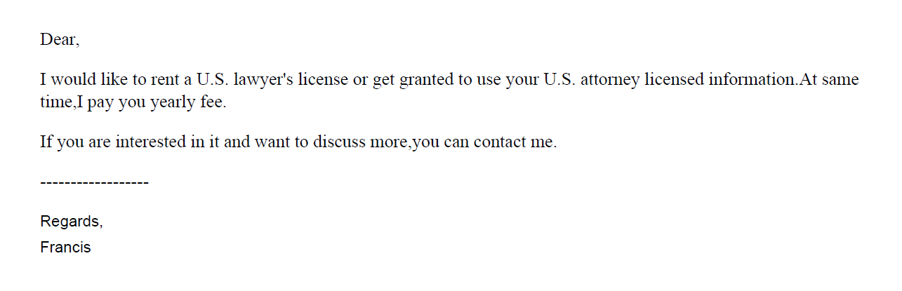
Trademarks: U.S. counsel rule

Slide 6
ID.me
美标源头律师合作，非华人律师
1 message
US_Trademark_Agent <tony.3918253@ddyaopin.com> Sat, Mar 12, 2022 at 2:23 AM
Reply-To: tony@ukvat.cn
To: @gmail.com
您好，
初步沟通后，可提供美国白皮律师（非华人）商标方案如下：
*符合4月9日新规，USPTO律师实人认证；
*可协助OBJ制作（律师助手子账号操作）；
*使用USPTO Payement Account支付商标官费；

Slide 7
Improper signatures/communication
In re Lou, Proceeding No. D2021-04 (USPTO May 12, 2021)
  Trademark Attorney had business relationship with foreign company that provided IP services to merchants.
  Over the course of their relationship, attorney reviewed up to 500 applications per month and received over $10,000 in compensation.
  As of Oct. 12, 2020, all of the attorney’s TM cases were received from the foreign company.
  Attorney impermissibly gave a company employee authorization to enter his electronic signature in the applications and attendant declarations.
    Did not subsequently inform applicants that their applications were impermissibly signed.
  Provided the foreign company’s email address as correspondence address in applications.
    Did not monitor the email address; relied on the foreign company to provide him with updates on USPTO correspondence.
  Did not conduct conflicts checks for clients received from the foreign company.
  Settlement: three-month suspension.
  Rule highlights:
    37 C.F.R. § 11.101 – Competence
    37 C.F.R. §§ 11.104(a) & (b) – Client communications
    37 C.F.R. §§ 11.303(a)(1), (a)(2), (b) & (d) – Candor toward tribunal
    37 C.F.R. § 11.503(b) – Responsibilities regarding non-practitioner assistance
    37 C.F.R. § 11.505 – Aiding UPL

Slide 8
Improper Signature, Informed Consent, Communication and Scope of Representation
In re Hom, Proceeding No. D2021-10 (USPTO Dec. 17, 2021)
Patent Attorney
-Listed as attorney of record in >13k TM apps.
-Before local counsel rule, he was listed in 2k TM apps; afterwards, listed in >11k apps.
-Received instructions from foreign intermediaries
-Failed to review specimens which appeared in more than one application for a different applicant; didn’t speak to applicants; and did not personally enter his signature on most apps.
-Suspension for two years.
Rule Highlights:
37 C.F.R. § 11.101 – Competence
37 C.F.R. § 11.103 – Diligence
37 C.F.R. § 11.104 – Communication
37 C.F.R. § 11.503 – Allowing non-prac assistants to draft TM documents; submit false specs
37 C.F.R. § 11.505 – Assisting UPL
37 C.F.R. § 11.804(d) – Conduct prejudicial to the administration of justice

Slide 9
Improper Signature, Informed Consent, Communication and Scope of Representation
In re Yang, Proceeding No. D2021-11 (USPTO Dec. 17, 2021)
Patent Attorney
-Agreed to allow foreign company to use her name to file TM applications as a domestic representative in exchange for $1500.00 a month for one year
-Failed to review specimens; didn’t speak to TM applicants
-Terminated her business arrangement with company
-Ended company’s access to a joint email address and informed applicants about impermissible signatures and unauthorized filings; informed USPTO about the impermissible signatures
-30-day suspension and probation for 12 mos thereafter
Rule Highlights:
37 C.F.R. § 11.101 – Competence
37 C.F.R. § 11.103 – Diligence
37 C.F.R. § 11.104 – Communication
37 C.F.R. § 11.503 – Allowing non-prac assistants to draft TM documents; submit false specs
37 C.F.R. § 11.505 – Assisting UPL
37 C.F.R. § 11.804(d) – Conduct prejudicial to the administration of justice

Slide 10
Hijacking of U.S. practitioner data
Since the implementation of the local counsel rule, the Office has encountered several instances of co-opting/hijacking of U.S. practitioner’s name, address, and/or bar number.
Referral to state bars and other agencies that address fraud and consumer protection.

Slide 11
Decorum Required in TM Communications
All those who practice TM matters before the USPTO are required to conduct their business with decorum and courtesy. 37 C.F.R. § 2.192; TMEP 709.07.
If a submitted document contains rude or discourteous remarks, it may be referred to the Deputy Commissioner for Trademark Examination Policy for review.
If it is determined that the document is in violation of 37 C.F.R. § 2.192, the document will not be considered and remove the document from the file.

Slide 12
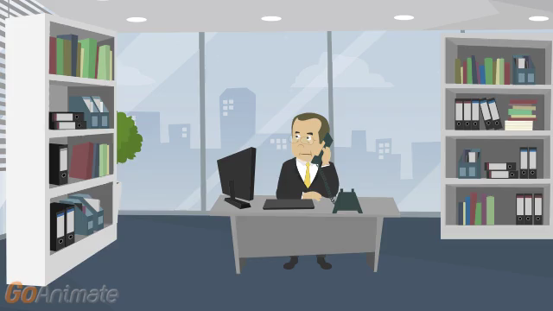

Slide 13
Disreputable or gross misconduct
In re Schroeder, Proceeding No. D2014-08 (USPTO May 18, 2015)
  Patent Attorney:
    Submitted unprofessional remarks in two separate Office action responses.
    Remarks were ultimately stricken from application files pursuant to 37 C.F.R. § 11.18(c)(1).
    Order noted that behavior was outside of the ordinary standard of professional obligation and client’s interests.
    Aggravating factor: has not accepted responsibility or shown remorse for remarks.
  Default: 6-month suspension.
  Rule highlights:
    37 C.F.R. § 10.23(a) – Disreputable or gross misconduct.
    37 C.F.R. § 10.89(c)(5) – Discourteous conduct before the office.
    37 C.F.R. § 10.23(b)(5) – Conduct prejudicial to the administration of justice.
    37 C.F.R. § 11.18 – Certification upon filing of papers.

Slide 14
Disreputable or Gross Misconduct
In re Tassan, Proceeding No. D2003-10 (USPTO Sept. 8, 2003).
  Registered practitioner who became upset when a case was decided against his client, and left profane voicemails with TTAB judges.
  Called and apologized one week later; said he had the flu and was taking strong cough medicine.
  Also had a floral arrangement and an apology note sent to each judge.
  Mitigating factors: private practice for 20 years with no prior discipline; cooperated fully with OED; showed remorse and voluntary sought and received counseling for anger management.
  Settlement: Reprimanded and ordered to continue attending anger management and have no contact with board judges for 2 years.

Slide 15
Disreputable or Gross Misconduct
Referred to patent examiner as “delusional,” that he “will publish examiner’s statements … along with assessment of their adequacy by a certified psychologist/MD, on Internet/Youtube …” and that he will report his “public safety and mental health concerns [about the examiner] to Office of Human Resources of [the] USPTO.”
Accused examiner of “irrational statements, delusions/hallucinations,” and stated that examiner “could become a t[h[reat for himself if such confusions/hallucinations or delusions happen at driving a car, operating an elevator, …”

Slide 16
Disreputable or Gross Misconduct
Left a voicemail message, asking that interlock call him back “so I don’t have to file another identical motion … that you’ll probably kick back again for fear that maybe you’d have to work,” and “[m]aybe that’s too much to ask of a government official but I don’t think so.”
Accused the interlock of “posturing and drama,” and closed his v-m message with “when an examiner sits in an ivory tower and seems to have a greater perception of a case in which she [has] (sic) simply refused to look at the facts or circumstances and rather would like to sling mud, then that gets under my ire,” and stated that “when you’re able to calm down, [then] (sic) you can call me and act respectfully and appropriately instead of mudslinging or otherwise threatening counsel who’s simply trying to do his job ….”

Slide 17
Disreputable or Gross Misconduct
When he spoke to another interloc, he was “in a rage and screamed at him” and to another, he yelled and told the interloc “how awful we all are” and “how terrible all government workers are.”
While yelling at an interloc over the phone, he also claimed to be a friend of Judge Rogers and that he should receive special treatment, and again attacked the character of PTO employees, and demanded that the interloc on his case be replaced. Another instance, after yelling at the interloc, he hung up on her.

Slide 18
Disreputable or Gross Misconduct
Response to Office Action: “We are going to sit down with your [s]upervisor and walk through this. It will take 5 minutes to see you are wrong.”
We either have to abandon or appeal, but before that, we will talk to your management.”
Our effort at cooperation is slapped away with the following text, which is wrong, 100% wrong, and evidence the fundamental misapprehension of how to examine claims.”

Slide 19
Disreputable or Gross Misconduct
Referred to the USPTO as the “Nazi patent and trademark office.”

Slide 20
Decisions imposing public discipline available in “FOIA Reading Room”
foiadocuments.uspto.gov/oed/
Official Gazette for Trademarks:
  www.uspto.gov/learning-and-resources/official-gazette/trademark-official-gazette-tmog

Slide 21
OED
571-272-4097

