Slide 1
Professional responsibility and practice before the USPTO
Office of Enrollment and Discipline (OED)
United States Patent and Trademark Office

Slide 2
Practice before the office
Activities that constitute practice before the USPTO are broadly defined in 37 C.F.R. §§ 11.5(b) & 11.14:
  Includes communicating with and advising a client concerning matters pending or contemplated to be presented before the office (37 C.F.R. § 11.5(b))
  Consulting with or giving advice to a client in contemplation of filing a patent application or other document with the office (37 C.F.R. § 11.5(b)(1))
  Consulting with or giving advice to a client in contemplation of filing a trademark application or other document with the office (37 C.F.R. § 11.5(b)(2))
  Nothing in this section (37 C.F.R. § 11.5(b)) proscribes a practitioner from employing or retaining non-practitioner assistants under the supervision of the practitioner to assist the practitioner in matters pending or contemplated to be presented before the office
  See also 37 C.F.R. § 11.14 for details regarding individuals who may practice before the office in trademark and other non-patent matters

Slide 3
Office of Enrollment and Discipline
Discussion of Select Case Law

Slide 4
Jonathan G. Morton
Proceeding No. 2022-01 (USPTO April 20, 2022)
    Facts
    Morton is a N.Y. Registered Patent Attorney Reg. No. 74, 199).
    In Aug. 2019, the USPTO published a rule (U.S. Counsel rule) requiring Trademark (TM) foreign-domiciled applicants to be represented by a U.S. attorney.
    The U.S. Counsel rule was in response to several instances of UPL by parties who were not authorized to represent TM applicants thereby subjecting these TM applications to cancellation based on invalidity.*
    Morton began representing several non-practitioner entities seeking his services as U.S. counsel.
    Since Aug. 2019, he is listed as attorney of record for >32k TM applications.**
    Morton’s practice was to receive already-prepared TM apps from Chinese TM services companies; review was “rushed and sloppy” and then E-sign application for filing.
Notes:
Often these applications contained suspect specimens, e.g., digitally altered specimens. A digitally altered or doctored specimen does not demonstrate use in commerce and therefore the mark is purportedly fraudulent. When a TM application is submitted under Section 1(a), i.e., a use application, a declaration accompanies the application that indicates that all such information is believed to be true. 18 U.S.C. 1001; 37 CFR 11.18((b)(1).
** Atty of record in >26k registrations and 7,700 pending apps

Slide 5
Jonathan G. Morton
Proceeding No. 2022-01 (USPTO April 20, 2022), cont’d
    Failed to conduct a reasonable inquiry related to these filings despite the fact that he signed declaration indicating all statements were true and accurate.*
    Failed to conduct a conflicts of interest check.
    Agreed-Upon Sanctions
    Two-Year Suspension as of the date of the Final Order.
    May file a written notice to seek reinstatement and a petition thereof at 18 months after the date of Final Order.
    No grant of petition for reinstatement until after the 2-yr expiration date.
    Serve a probationary period as of the date of Final Order and continuing for 12 months after the date the OED Director grants his petition for reinstatement.
    Successful completion of six (6) hours of CLE.
Notes:
* In violation of 18 U.S.C. 1001 and 37 CFR 11.18(b)(1).

Slide 6
Trademarks: U.S. counsel rule
Increase in foreign parties not authorized to represent trademark applicants improperly representing foreign applicants in trademark (TM) matters.
Fraudulent or inaccurate claims of use are a burden on the trademark system and the public and jeopardize validity of marks.
Effective August 3, 2019:
  Foreign-domiciled trademark applicants, registrants, and parties to Trademark Trial and Appeal Board proceedings must be represented at the USPTO by an attorney who is licensed to practice law in the United States.
Final rule: 84 Fed. Reg. 31498 (July 2, 2019)
Canadian patent agents are no longer able to represent Canadian parties in U.S. TM matters.
Canadian TM attorneys and agents will only be able to serve as additionally appointed practitioners.
  Clients must appoint U.S.-licensed attorney to file formal responses.
  The USPTO will only correspond with U.S. licensed attorney.

Slide 7
Signatures on trademark documents
37 C.F.R. § 2.193 Trademark correspondence and signature requirements
  “(a)…Each piece of correspondence that requires a signature must bear:
    (1) A handwritten signature personally signed in permanent ink by the person named as the signatory, or a true copy thereof; or
    (2) An electronic signature that meets the requirements of paragraph (c) of this section, personally entered by the person named as the signatory….
    * * * * *
  (c) Requirements for electronic signature. A person signing a document electronically must:
    (1) Personally enter any combination of letters, numbers, spaces and/or punctuation marks that the signer has adopted as a signature, placed between two forward slash (“/”) symbols in the signature block on the electronic submission; or
    (2) Sign the document using some other form of electronic signature specified by the Director.”

Slide 8
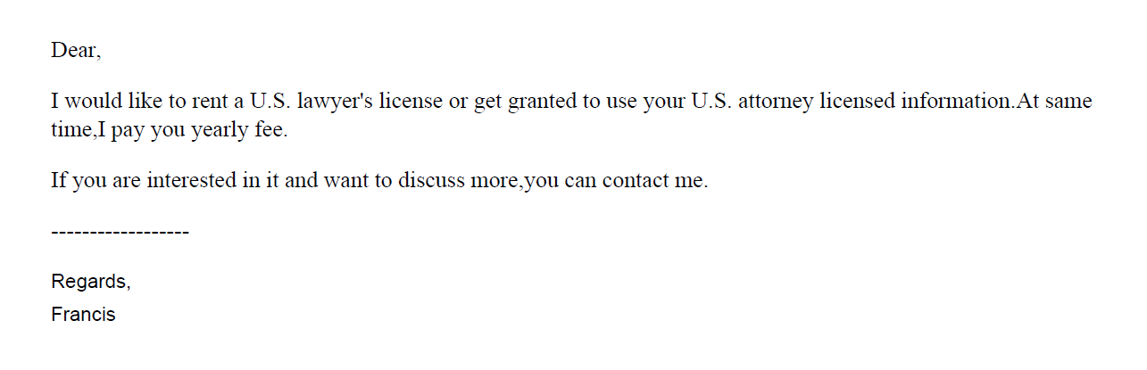
Trademarks: U.S. counsel rule

Slide 9
Improper signatures/communication
In re Lou, Proceeding No. D2021-04 (USPTO May 12, 2021)
  Trademark Attorney had business relationship with foreign company that provided IP services to merchants.
  Over the course of their relationship, attorney reviewed up to 500 applications per month and received over $10,000 in compensation.
  As of Oct. 12, 2020, all of the attorney’s TM cases were received from the foreign company.
  Attorney impermissibly gave a company employee authorization to enter his electronic signature in the applications and attendant declarations.
    Did not subsequently inform applicants that their applications were impermissibly signed.
  Provided the foreign company’s email address as correspondence address in applications.
    Did not monitor the email address; relied on the foreign company to provide him with updates on USPTO correspondence.
  Did not conduct conflicts checks for clients received from the foreign company.
  Settlement: three-month suspension
  Rule highlights:
    37 C.F.R. § 11.101 – Competence
    37 C.F.R. §§ 11.104(a) & (b) – Client communications
    37 C.F.R. §§ 11.303(a)(1), (a)(2), (b) & (d) – Candor toward tribunal
    37 C.F.R. § 11.503(b) – Responsibilities regarding non-practitioner assistance
    37 C.F.R. § 11.505 – Aiding UPL

Slide 10
Improper Signature, Informed Consent, Communication and Scope of Representation
In re Hom, Proceeding No. D2021-10 (USPTO Dec. 17, 2021)
Patent Attorney
-Listed as attorney of record in >13k TM apps
-Before local counsel rule, he was listed in 2k TM apps; afterwards, listed in >11k apps
-Received instructions from foreign intermediaries
-Failed to review specimens which appeared in more than one application for a different applicant; didn’t speak to applicants; and did not personally enter his signature on most apps
-Suspension for two years
Rule Highlights:
37 C.F.R. § 11.101 – Competence
37 C.F.R. § 11.103 – Diligence
37 C.F.R. § 11.104 – Communication
37 C.F.R. § 11.503 – Allowing non-prac assistants to draft TM documents; submit false specs
37 C.F.R. § 11.505 – Assisting UPL
37 C.F.R. § 11.804(d) – Conduct prejudicial to the administration of justice

Slide 11
Improper Signature, Informed Consent, Communication and Scope of Representation
In re Yang, Proceeding No. D2021-11 (USPTO Dec. 17, 2021)
Patent Attorney
-Agreed to allow foreign company to use her name to file TM applications as a domestic representative in exchange for $1500.00 a month for one year
-Failed to review specimens; didn’t speak to TM applicants
-Terminated her business arrangement with company
-Ended company’s access to a joint email address and informed applicants about impermissible signatures and unauthorized filings; informed USPTO about the impermissible signatures
-30-day suspension and probation for 12 mos thereafter
Rule Highlights:
37 C.F.R. § 11.101 – Competence
37 C.F.R. § 11.103 – Diligence
37 C.F.R. § 11.104 – Communication
37 C.F.R. § 11.503 – Allowing non-prac assistants to draft TM documents; submit false specs
37 C.F.R. § 11.505 – Assisting UPL
37 C.F.R. § 11.804(d) – Conduct prejudicial to the administration of justice

Slide 12
Hijacking of U.S. practitioner data
Since the implementation of the local counsel rule, the Office has encountered several instances of co-opting/hijacking of U.S. practitioner’s name, address, and/or bar number.
Referral to state bars and other agencies that address fraud and consumer protection.

Slide 13
OED Diversion Pilot Program
In 2016, the ABA Commission on Lawyer Assistance Programs and the Hazelden Betty Ford Foundation published a study of about 13,000 currently practicing attorneys and found the following:
  About 21% qualify as problem drinkers
  28% struggle with some level of depression
  19% struggle with anxiety
  23% struggle with stress
Other difficulties include social alienation, work addiction, sleep deprivation, job dissatisfaction, and complaints of work-life conflict.
The USPTO launched the Diversion Pilot Program in 2017 and it has been extended until 2022.

Slide 14
OED Diversion Pilot Program – criteria
Practitioner must have willingness and ability to participate in the program.
In some circumstances, prior discipline is not a bar to diversion.
Misconduct at issue must not:
  Involve misappropriation of funds or dishonesty, fraud, deceit, or misrepresentation
  Result in or be likely to result in substantial prejudice to a client or other person
  Constitute a “serious crime” (see 37 C.F.R. § 11.1)
  Be part of a pattern of major similar misconduct or be of the same nature as misconduct for which practitioner has been disciplined within the past five years

Slide 15
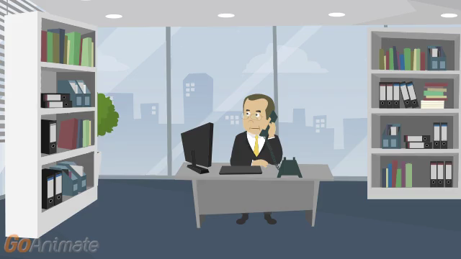

Slide 16
Disreputable or gross misconduct
In re Schroeder, Proceeding No. D2014-08 (USPTO May 18, 2015)
  Patent Attorney:
    Submitted unprofessional remarks in two separate Office action responses.
    Remarks were ultimately stricken from application files pursuant to 37 C.F.R. § 11.18(c)(1).
    Order noted that behavior was outside of the ordinary standard of professional obligation and client’s interests.
    Aggravating factor: has not accepted responsibility or shown remorse for remarks.
  Default: 6-month suspension.
  Rule highlights:
    37 C.F.R. § 10.23(a) – Disreputable or gross misconduct.
    37 C.F.R. § 10.89(c)(5) – Discourteous conduct before the office.
    37 C.F.R. § 10.23(b)(5) – Conduct prejudicial to the administration of justice.
    37 C.F.R. § 11.18 – Certification upon filing of papers.

Slide 17
Disreputable or gross misconduct
In re Tassan, Proceeding No. D2003-10 (USPTO Sept. 8, 2003).
  Registered practitioner who became upset when a case was decided against his client, and left profane voicemails with TTAB judges
    Called and apologized one week later; said he had the flu and was taking strong cough medicine
    Also had a floral arrangement and an apology note sent to each judge
  Mitigating factors:
    Private practice for 20 years with no prior discipline
    Cooperated fully with OED
    Showed remorse and voluntarily sought and received counseling for anger management
  Settlement: public reprimand and ordered to continue attending anger management and have no contact with board judges for 2 years

Slide 18
Decisions imposing public discipline available in “FOIA Reading Room”
foiadocuments.uspto.gov/oed/
Official Gazette for Trademarks:
  www.uspto.gov/learning-and-resources/official-gazette/trademark-official-gazette-tmog

