Slide 2
Professional responsibility and practice before the USPTO
Office of Enrollment and Discipline (OED)

Slide 3
OED: Enrollment
Authorization to practice before the USPTO in patent matters:
Attorneys, agents, limited recognition
3 factors for registration:
Scientific and technical qualifications;
Legal competence: registration exam; and
Moral character.
See 37 C.F.R. § 11.7 and General Requirements Bulletin

Slide 4
OED: Other functions
Pro Bono programs:
Law School Clinic Certification Program; and
Patent Pro Bono Program
Outreach:
Speaking engagements: CLE, roundtables/panels, diversion, pro bono, recent rulemaking, etc.

Slide 5
Practice before the USPTO
Activities that constitute practice before the USPTO are broadly defined in 37 C.F.R. §§ 11.5(b) and 11.14
Includes communicating with and advising a client concerning matters pending or contemplated to be presented before the USPTO (37 C.F.R. § 11.5(b));
Consulting with or giving advice to a client in contemplation of filing a patent application or other document with the USPTO (37 C.F.R. § 11.5(b)(1)); or
Consulting with or giving advice to a client in contemplation of filing a trademark application or other document with the USPTO (37 C.F.R. § 11.5(b)(2)).
Nothing in this section (37 C.F.R. § 11.5(b)) proscribes a practitioner from employing or retaining non-practitioner assistants under the supervision of the practitioner to assist the practitioner in matters pending or contemplated to be presented before the USPTO.
See also 37 C.F.R. § 11.14 for details regarding individuals who may practice before the USPTO in trademark and other non-patent matters.

Slide 6
OED: Discipline
Mission: Protect the public and the integrity of the patent and trademark systems.
Statutory authority:
35 U.S.C. §§ 2(b)(2)(D) and 32.
Disciplinary jurisdiction (37 C.F.R. § 11.19)
All practitioners engaged in practice before the USPTO; and
Non-practitioners who engage in or offer to engage in practice before the USPTO.
Governing regulations:
USPTO Rules of Professional Conduct 37 C.F.R. §§ 11.101-11.901; and
Procedural rules: 37 C.F.R. §§ 11.19-11.60

Slide 7
OED: Disciplinary process
OED investigation begins with receipt of a grievance by the OED Director.
Grievance: a written submission from any source received by the OED Director that presents possible grounds for discipline of a specified practitioner. See 37 C.F.R. § 11.1.
Self-reporting is often considered as a mitigating factor in the disciplinary process.
Time period for filing formal complaint = 1 year from receipt of grievance or 10 years from date of misconduct.
See 35 U.S.C. § 32 and 37 C.F.R. § 11.34(d)
After investigation, OED Director may:
Terminate investigation with no action;
Issue a warning to the practitioner;
Institute formal charges with the approval of the Committee on Discipline; or
Enter into a settlement agreement with the practitioner and submit the same to the USPTO Director for approval.
37 C.F.R. § 11.22(h)

Slide 8
OED: Disciplinary process cont.
Referral to the Committee on Discipline (COD)
OED presents results of investigation to the COD;
COD determines if probable cause of misconduct exists;
If probable cause is found, Solicitor’s Office files formal complaint with hearing officer;
Hearing officer issues an initial decision (37 C.F.R. § 11.54); and
Either party may appeal initial decision to USPTO Director, otherwise it becomes the final decision of the USPTO Director.
37 C.F.R. §§ 11.54 and 11.55

Slide 9
Other types of discipline
Reciprocal discipline (37 C.F.R. § 11.24)
Based on discipline by a state or federal program or agency, and
Often conducted on documentary record only.
Interim suspension based on conviction of a serious crime (37 C.F.R. § 11.25)
Referred to a hearing officer for determination of final disciplinary action

Slide 10
OED Diversion Pilot Program
In 2016, the ABA Commission on Lawyer Assistance Programs and the Hazelden Betty Ford Foundation published a study of about 13,000 currently practicing attorneys and found the following:
About 21% qualify as problem drinkers;
28% struggle with some level of depression;
19% struggle with anxiety; and
23% struggle with stress.
Other difficulties include social alienation, work addiction, sleep deprivation, job dissatisfaction, and complaints of work-life conflict.
The USPTO launched the Diversion Pilot Program in 2017 and it has been extended until 2022.

Slide 11
OED Diversion Pilot Program – criteria
Practitioner must have willingness and ability to participate in the program.
In some circumstances, prior discipline is not a bar to diversion.
Misconduct at issue must not:
Involve misappropriation of funds or dishonesty, fraud, deceit, or misrepresentation;
Result in or be likely to result in substantial prejudice to a client or other person;
Constitute a “serious crime” (see 37 C.F.R. § 11.1); or
Be part of a pattern of major similar misconduct or be of the same nature as misconduct for which practitioner has been disciplined within the past five years.

Slide 12
USPTO disciplinary matters

Slide 13
USPTO disciplinary matters
13

Slide 14
Pro bono programs
USPTO Law School Clinic Certification Program
Allows students in a participating law school’s clinic program to practice before the USPTO under the strict guidance of a law school faculty clinic supervisor; and
Limited recognition for participating students.
www.uspto.gov/lawschoolclinic
USPTO Patent Pro Bono Program
Independent regional programs located across the nation work to match financially under-resourced inventors and small businesses with volunteer practitioners to file and prosecute patent applications.
Inventors and interested attorneys can navigate the USPTO website to find links to their regional program: www.uspto.gov/probonopatents

Slide 15
Ethics scenarios and select case law
OED

Slide 16
OED: Examples of misconduct
Neglect
Failure to communicate
Lying to the client
Lack of candor to the USPTO
Trademark U.S. counsel cases
Invention promotion cases

Slide 17
Neglect/candor
In re Kroll, Proceeding No. D2014-14 (USPTO Mar. 4, 2016)
Patent attorney:
Attorney routinely offered (and charged) to post client inventions for sale on his website;
Did not use modern docket management system;
Failed to file client’s application, but posted the invention for sale on his website; and
Filed application 20 months after posting on the website.
Aggravating factors included prior disciplinary history
Received two-year suspension
Rule highlights:
37 C.F.R. § 10.23(a) – Disreputable or gross misconduct
37 C.F.R. § 11.18(b) – Certification upon submitting of papers
37 C.F.R. § 10.77(c) – Neglect.

Slide 18
Conflicts of interest/improper signatures
In re Starkweather, Proceeding No. D2018-44 (USPTO Oct. 17, 2019)
Practitioner received voluminous referrals from marketing company.
Did not obtain informed consent from clients in light of this arrangement;
Took direction regarding applications from company;
When company operations were shut down and payments stopped, practitioner halted client work, including completed applications; and
Signed clients’ names on USPTO documents.
Settlement: three-year suspension, MPRE, 12 hours of ethics CLE
Rule highlights:
37 C.F.R. § 11.101 – Competence
37 C.F.R. § 11.102 – Abiding by client’s decisions
37 C.F.R. § 11.103 – Diligence
37 C.F.R. § 11.104 – Client communication
37 C.F.R. § 11.107 – Conflicts
37 C.F.R. § 11.303 – False statements to a tribunal
37 C.F.R. § 11.504(c) – Taking direction from 3rd party payer

Slide 19
Signatures on trademark documents
37 C.F.R. § 2.193 Trademark correspondence and signature requirements:
“(a)…Each piece of correspondence that requires a signature must bear:
(1) A handwritten signature personally signed in permanent ink by the person named as the signatory, or a true copy thereof; or
(2) An electronic signature that meets the requirements of paragraph (c) of this section, personally entered by the person named as the signatory….
* * * * *
(c) Requirements for electronic signature. A person signing a document electronically must:
(1) Personally enter any combination of letters, numbers, spaces and/or punctuation marks that the signer has adopted as a signature, placed between two forward slash (“/”) symbols in the signature block on the electronic submission; or
(2) Sign the document using some other form of electronic signature specified by the Director.”

Slide 20
Trademarks: U.S. counsel rule
Increase in foreign parties not authorized to represent trademark applicants and improperly representing foreign applicants in trademark (TM) matters.
Fraudulent or inaccurate claims of use are a burden on the trademark system and the public and jeopardize validity of marks.
Effective August 3, 2019:
Foreign-domiciled trademark applicants, registrants, and parties to Trademark Trial and Appeal Board proceedings must be represented at the USPTO by an attorney who is licensed to practice law in the United States.
Final rule: 84 Fed. Reg. 31498 (July 2, 2019).
Canadian patent agents are no longer able to represent Canadian parties in U.S. TM matters.
Canadian TM attorneys and agents will only be able to serve as additionally appointed practitioners:
Clients must appoint U.S.-licensed attorney to file formal responses; and
The USPTO will only correspond with U.S. licensed attorney.

Slide 21
U.S. counsel rule – solicitation

Slide 22
U.S. counsel rule – solicitation
美标源头律师合作，非华人律师
1 message
US_Trademark_Agent <tony@zcompany.com> Sat, Mar 12, 2022 at 2:23 AM
Reply-To: tony@zcompany.cn
To: @gmail.com
您好，
初步沟通后，可提供美国白皮律师（非华人）商标方案如下：
*符合4月9日新规，USPTO律师实人认证；
*可协助OBJ制作（律师助手子账号操作）；
*使用USPTO Payement Account支付商标官费；

Slide 23
Improper signatures/communication
In re Lou, Proceeding No. D2021-04 (USPTO May 12, 2021):
Trademark (TM) attorney had business relationship with foreign company that provided IP services to merchants.
Attorney reviewed up to 500 TM applications per month and received over $10,000 in total compensation.
As of Oct. 12, 2020, all of the attorney’s TM cases were received from the foreign company.
Attorney gave company authorization to improperly enter his signature directly in the applications.
Provided the company’s email address as correspondence address, did not monitor, and relied on company to provide him updates on USPTO correspondence.
Did not conduct conflicts checks for clients received from the foreign company.
Settlement: three-month suspension
Rule highlights:
37 C.F.R. § 11.101 – Competence
37 C.F.R. § 11.104(a) and (b) – Client communications
37 C.F.R. § 11.303(a)(1), (a)(2), (b) and (d) – Candor toward tribunal
37 C.F.R. § 11.503(b) – Responsibilities regarding non-practitioner assistance
37 C.F.R. § 11.505 – Assisting UPL

Slide 24
Improper signatures/communication
In re Hom, Proceeding No. D2021-10 (USPTO Dec. 12, 2021)
Patent attorney listed as attorney of record in >13k trademark (TM) applications;
Before U.S. counsel rule, he was listed in 2k; afterwards listed in 11k TM applications;
Received instructions from foreign intermediaries; and
Failed to review specimens which appeared in more than one application for a different applicant; didn’t speak to applicants; and did not personally enter his signature on most apps.
Settlement: two-year suspension
Rule highlights:
37 C.F.R. § 11.101 – Competence
37 C.F.R. § 11.103 – Diligence
37 C.F.R. § 11.104 – Client communication
37 C.F.R. § 11.503 – Non-practitioner assistance
37 C.F.R. § 11.505 – Assisting UPL
37 C.F.R. § 11.804(d) – Conduct prejudicial to the administration of justice

Slide 25
Improper signatures/communication
In re Yang, Proceeding No. D2021-11 (USPTO Dec. 17, 2021)
Patent attorney agreed to allow foreign company to use her name to file TM applications as a domestic representative in exchange for $1500.00 a month for one year;
Failed to review specimens; didn’t speak to TM applicants;
Terminated her business arrangement with company; and
Ended company’s access to a joint email address and informed applicants about impermissible signatures and unauthorized filings; informed the USPTO about the impermissible signatures.
30-day suspension and probation for 12 months thereafter
Rule highlights:
37 C.F.R. § 11.101 – Competence
37 C.F.R. § 11.103 – Diligence
37 C.F.R. § 11.104 – Client communication
37 C.F.R. § 11.503 – Non-practitioner assistance
37 C.F.R. § 11.505 – Assisting UPL
37 C.F.R. § 11.804(d) – Conduct prejudicial to the administration of justice

Slide 26
U.S. Counsel Rule Decisions
Yiheng Lou, Proceeding No. D2021-04 (USPTO May 12, 2021)
NY-licensed attorney contracted with Chinese IP firm (5/12/2021)
Devasena Reddy, Proceeding No. D2021-13 (USPTO Sept. 9, 2021)
CA-licensed attorney contracted with Indian TM filing firm (9/9/2021)
Bennett David, Proceeding No. D2021-8 (USPTO Sept. 24, 2021)
Patent attorney and MA-licensed attorney contracted with Chinese IP firm (9/24/2021)
Di Li, Proceeding No. D2021-16 (USPTO Oct. 7, 2021)
CA-licensed attorney contracted with Chinese firm that consults with online retailers (10/7/2021)
Tony Hom, Proceeding No. D2021-10 (USPTO Dec. 17, 2021)
NY-licensed attorney contracted with several different Chinese firms (12/17/2021)

Slide 27
U.S. Counsel Rule Decisions
Jonathan Morton, Proceeding No. D2022-07 (USPTO Apr. 20, 2022)
NY-licensed attorney contracted with foreign entities
Kathy Hao, Proceeding No. D2021-14 (USPTO Apr. 27, 2022)
California licensed attorney contracted with several foreign entities
Weibo Zhang, Proceeding No. D2022-16 (USPTO July 11, 2022)
NY licensed attorney contracted with several foreign entities
Elizabeth Yang, Proceeding No. D2021-11 (USPTO Dec. 17, 2021)
CA-licensed attorney contracted with foreign firm serving online retailers
_ Zhihua Han, Proceeding No. D2022-23 (USPTO Jan. 09, 2023)
WA-licensed attorney contracted with several foreign firms to file both trademark and patent applications

Slide 28
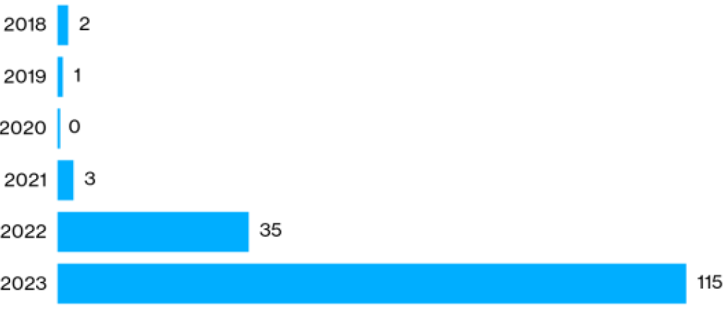
Trademark-Related sanctions issued by USPTO Orders from January 2018 through April 2023
Notes:
Source: Bloomberg Law (Based on USPTO information)

Slide 29
Hijacking of U.S. practitioner data
Since the implementation of the U.S. counsel rule, the Office has encountered several instances of co-opting/hijacking of U.S. practitioner’s name, address, and/or bar number.
Referral to state bars and other agencies that address fraud and consumer protection.

Slide 30
Misrepresentation
In re Anonymous, Proceeding No. D2014-05 (USPTO Apr. 1, 2014)
Trademark attorney:
Submitted sworn statements from himself and his client to the USPTO attesting that the client’s mark had acquired distinctiveness and should be registered due to the client’s “substantially continuous and exclusive use” of the mark in commerce.
Prior to submitting the statements, practitioner was informed that materials provided to him contained evidence contrary to the claim of acquired distinctiveness.
Practitioner failed to look at materials or share them with his client before submitting the statements to the USPTO.
Settlement: Private reprimand
Actions were deemed to constitute violations for the inadequate preparation (37 C.F.R. § 10.77(b)) and presenting a paper in violation of 37 C.F.R. § 11.18 (37 C.F.R. § 10.23(c)(15))

Slide 31
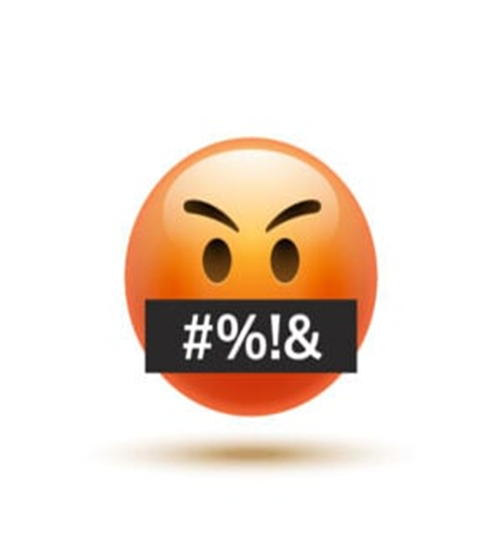
37 C.F.R. § 1.3

Slide 32
Decorum required in trademark (TM) communications
All those who practice TM matters before the USPTO are required to conduct their business with decorum and courtesy. See 37 C.F.R. § 2.192; TMEP 709.07.
If a submitted document contains rude or discourteous remarks, it may be referred to the Deputy Commissioner for Trademark Examination Policy for review.
If it is determined that the document is in violation of 37 C.F.R. § 2.192, the document will not be considered and will be removed from the file.

Slide 33
Notes:
Ethics Scenario: Gross and Disreputable Misconduct – Are you Drunk?
Scene 1: In Patent Attorney’s office. Patent Attorney picks up the phone and Client is on the other line.
Patent Attorney to Client: Hello Client. I have filed a utility patent application for your method of conducting mergers and acquisitions with the USPTO. It will probably be at least one year until we get a response from the USPTO.
Client to Patent Attorney: Okay, great. Thank you! Please let me know when you hear something from the Office.
[Show moving calendar, ticking clock, or sun rising and setting to demonstrate time]
Text Reads: Over 1 year later.
Patent Attorney over phone to Client: Hello Client! I just received a non-final Office action in your application, rejecting the claims as being directed to patent ineligible subject matter under 35 U.S.C. § 101. But don’t worry! I will request an interview with the Examiner to resolve this issue.
Client: Okay. I hope you are able to overcome the rejection. Thank you!
Scene 2: Patent Attorney sitting in front of Examiner in new location.
Patent Attorney: Hello, Examiner. I would like to discuss your subject matter eligibility rejection. I do not agree with your rejection and do not believe the claimed invention is directed to patent ineligible subject matter.
Examiner: I’m sorry, sir, but the claimed invention does not recite eligible subject matter because it is directed to an abstract idea.
Patent Attorney: What do you mean the claimed invention does not recite eligible subject matter? Are you drunk? No, seriously . . . are you drinking scotch and whiskey with a side of crack cocaine while you ‘examine’ patent applications?
Patent Attorney gets up and walks out of interview room. Examiner picks up phone. Phone rings.
Examiner: Hi OED. I’m an Examiner in 3700 and I would like to file a complaint against a practitioner.

Slide 34
Disreputable or gross misconduct
In re Schroeder, Proceeding No. D2014-08 (USPTO May 18, 2015)
Patent attorney:
Submitted unprofessional remarks in two separate Office action responses;
Remarks were ultimately stricken from application files pursuant to 37 C.F.R. § 11.18(c)(1);
Order noted that behavior was outside of the ordinary standard of professional obligation and client’s interests; and
Aggravating factor: Did not accept responsibility or show remorse for remarks.
Default: 6-month suspension
Rule highlights:
37 C.F.R. § 10.23(a) – Disreputable or gross misconduct
37 C.F.R. § 10.89(c)(5) – Discourteous conduct before the Office
37 C.F.R. § 10.23(b)(5) – Conduct prejudicial to the administration of justice
37 C.F.R. § 11.18 – Certification upon filing of papers

Slide 35
Disreputable or gross misconduct
In re Tassan, Proceeding No. D2003-10 (USPTO Sept. 8, 2003)
Registered practitioner who became upset when a case was decided against his client, and left profane voicemails with TTAB judges.
Called and apologized one week later; said he had the flu and was taking strong cough medicine.
Also had a floral arrangement and an apology note sent to each judge.
Mitigating factors: private practice for 20 years with no prior discipline; cooperated fully with OED; showed remorse and voluntary sought and received counseling for anger management.
Settlement: Reprimanded and ordered to continue attending anger management and have no contact with Board judges for 2 years.

Slide 36
Other examples of disreputable or gross misconduct
Practitioner referred to patent examiner as “delusional,” that he “will publish examiner’s statements … along with assessment of their adequacy by a certified psychologist/MD, on Internet/You [T]ube …” and that he will report his “public safety and mental health concerns [about the examiner] to Office of Human Resources of [the] USPTO.”
Practitioner accused examiner of “irrational statements, delusions/hallucinations,” and stated that examiner “could become a t[h]reat for himself if such confusions/hallucinations or delusions happen at driving a car, operating an elevator, …”

Slide 37
Other examples of disreputable or gross misconduct
Practitioner left a voicemail message, asking that the interlocutory call him back “so I don’t have to file another identical motion … that you’ll probably kick back again for fear that maybe you’d have to work,” and “[m]aybe that’s too much to ask of a government official but I don’t think so.”
Practitioner accused the interlocutory of “posturing and drama,” and closed his voicemail message with “when an examiner sits in an ivory tower and seems to have a greater perception of a case in which she [has] (sic) simply refused to look at the facts or circumstances and rather would like to sling mud, then that gets under my ire,” and stated that “when you’re able to calm down, [then] (sic) you can call me and act respectfully and appropriately instead of mudslinging or otherwise threatening counsel who’s simply trying to do his job ….”

Slide 38
Other examples of disreputable or gross misconduct
When he spoke to another interlocutory, practitioner was “in a rage and screamed at him” and to another, he yelled and told the interlocutory “how awful [you] all are” and “how terrible all government workers are.”
While yelling at an interlocutory over the phone, Practitioner also claimed to be a friend of Judge Rogers and that he should receive special treatment, and again attacked the character of PTO employees, and demanded that the interlocutory on his case be replaced. Another instance, after yelling at the interlocutory, he hung up on her.

Slide 39
Decisions imposing public discipline available in “FOIA Reading Room”
foiadocuments.uspto.gov/oed/
Official Gazette for Trademarks:
www.uspto.gov/learning-and-resources/official-gazette/trademark-official-gazette-tmog

Slide 40
OED
571-272-4097

