Slide 2
Professional responsibility and practice before the USPTO
Office of Enrollment and Discipline (OED)

Slide 3
OED: enrollment
Authorization to practice before the USPTO in patent matters:
  Attorneys, agents, limited recognition.
3 factors for registration:
  Scientific and technical qualifications;
  Legal competence: registration exam; and
  Moral character.
  See 37 C.F.R. § 11.7 and General Requirements Bulletin.

Slide 4
Practice before the USPTO
Activities that constitute practice before the USPTO are broadly defined in 37 C.F.R. §§ 11.5(b) and 11.14:
  Includes communicating with and advising a client concerning matters pending or contemplated to be presented before the USPTO (37 C.F.R. § 11.5(b));
  Consulting with or giving advice to a client in contemplation of filing a patent application or other document with the USPTO (37 C.F.R. § 11.5(b)(1)); or
  Consulting with or giving advice to a client in contemplation of filing a trademark application or other document with the USPTO (37 C.F.R. § 11.5(b)(2)).
  Nothing in this section (37 C.F.R. § 11.5(b)) proscribes a practitioner from employing or retaining non-practitioner assistants under the supervision of the practitioner to assist the practitioner in matters pending or contemplated to be presented before the USPTO.
  See also 37 C.F.R. § 11.14 for details regarding individuals who may practice before the USPTO in trademark and other non-patent matters.

Slide 5
OED: discipline
Mission: protect the public and the integrity of the patent and trademark systems.
Statutory authority:
  35 U.S.C. §§ 2(b)(2)(D) and 32.
Disciplinary jurisdiction (37 C.F.R. § 11.19):
  All practitioners engaged in practice before the USPTO; and
  Non-practitioners who engage in or offer to engage in practice before the USPTO.
Governing regulations:
  USPTO Rules of Professional Conduct 37 C.F.R. §§ 11.101-11.901; and
  Procedural rules: 37 C.F.R. §§ 11.19-11.60.

Slide 6
Life cycle of a complaint or grievance
OED investigation begins with receipt of a grievance by the OED Director.
  Grievance: a written submission from any source received by the OED Director that presents possible grounds for discipline of a specified practitioner. See 37 C.F.R. § 11.1.
  Self-reporting is often considered as a mitigating factor in the disciplinary process.
Time period for filing formal complaint = 1 year from receipt of grievance or 10 years from date of misconduct.
  See 35 U.S.C. § 32 and 37 C.F.R. § 11.34(d).
After investigation, OED Director may:
  Terminate investigation with no action;
  Issue a warning to the practitioner;
  Institute formal charges with the approval of the Committee on Discipline; or
  Enter into a settlement agreement with the practitioner and submit the same to the USPTO Director for approval.
  37 C.F.R. § 11.22(h).

Slide 7
OED: disciplinary process
Referral to the Committee on Discipline (COD)
  OED presents results of investigation to the COD;
  COD determines if probable cause of misconduct exists;
  If probable cause is found, Solicitor’s Office files formal complaint with hearing officer;
  Hearing officer issues an initial decision (37 C.F.R. § 11.54); and
  Either party may appeal initial decision to USPTO Director, otherwise it becomes the final decision of the USPTO Director.
  37 C.F.R. §§ 11.54 and 11.55.

Slide 8
Other types of discipline
Reciprocal discipline (37 C.F.R. § 11.24):
  Based on discipline by a state or federal program or agency, and
  Often conducted on documentary record only.
Interim suspension based on conviction of a serious crime (37 C.F.R. § 11.25):
  Referred to a hearing officer for determination of final disciplinary action.

Slide 9
OED: other functions
Pro Bono programs:
  Law School Clinic Certification Program; and
  Patent Pro Bono Program.
Outreach:
  Speaking engagements: continuing legal education, roundtables/panels, diversion, pro bono, recent rulemaking, etc.

Slide 10
OED Diversion Program
37 C.F.R §11.30
In 2016, the ABA Commission on Lawyer Assistance Programs and the Hazelden Betty Ford Foundation published a study of about 13,000 currently practicing attorneys and found the following:
  About 21% qualify as problem drinkers;
  28% struggle with some level of depression;
  19% struggle with anxiety; and
  23% struggle with stress.
Other difficulties include social alienation, work addiction, sleep deprivation, job dissatisfaction, and complaints of work-life conflict.
The USPTO launched the Diversion Pilot Program in 2017 and it became formalized as a rule in August 2023.

Slide 11
OED Diversion Program – criteria
Practitioner must have willingness and ability to participate in the program.
In some circumstances, prior discipline is not a bar to diversion.
Misconduct at issue must not:
  Involve misappropriation of funds or dishonesty, fraud, deceit, or misrepresentation;
  Result in or be likely to result in substantial prejudice to a client or other person;
  Constitute a “serious crime” (see 37 C.F.R. § 11.1); or
  Be part of a pattern of major similar misconduct or be of the same nature as misconduct for which practitioner has been disciplined within the past five years.

Slide 12
USPTO disciplinary matters

Slide 13
USPTO disciplinary matters
13

Slide 14
USPTO disciplinary matters

Slide 15
Ethics scenarios and select case law
OED

Slide 16
OED: Examples of misconduct
Neglect;
Failure to communicate;
Lying to the client;
Lack of candor to the USPTO;
Trademark U.S. counsel cases; and
Invention promotion cases.

Slide 17
Neglect/candor
In re Kroll, Proceeding No. D2014-14 (USPTO Mar. 4, 2016):
Patent attorney:
  Attorney routinely offered (and charged) to post client inventions for sale on his website;
  Did not use modern docket management system;
  Failed to file client’s application, but posted the invention for sale on his website; and
  Filed application 20 months after posting on the website.
Aggravating factors included prior disciplinary history.
Received two-year suspension.
Rule highlights:
  37 C.F.R. § 10.23(a) – Disreputable or gross misconduct;
  37 C.F.R. § 11.18(b) – Certification upon submitting of papers; and
  37 C.F.R. § 10.77(c) – Neglect.

Slide 18

Conflicts between clients

Slide 19


Slide 20
Conflict of interest
In re Radanovic, Proceeding No. D2014-29 (USPTO December 16, 2014)
  Patent attorney:
    Represented two joint inventors of patent application.
    No written agreement regarding representation.
    Attorney became aware of a dispute where one inventor alleged that the other did not contribute to the allowed claims.
    Continued to represent both inventors.
    Expressly abandoned application naming both inventors in favor of continuation naming one.
  Mitigating factors included clean 50-year disciplinary history.
  Received public reprimand.

Slide 21

Patent agent privilege

Slide 22
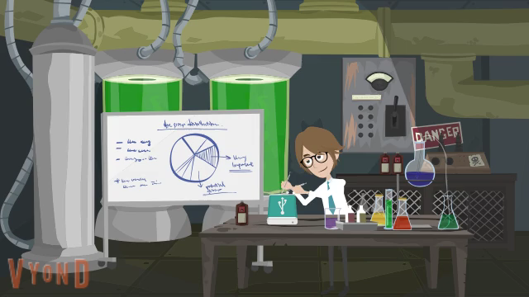

Slide 23
Patent agent privilege
In re Queen’s University at Kingston, 820 F.3d 1287 (Fed. Cir. 2016)
  U.S. District Court granted Samsung’s motion to compel documents, including communications between Queen’s University employees and registered (non-lawyer) patent agents discussing prosecution of patents at issue in suit.
  Federal Circuit recognized privilege only as to those activities that patent agents are authorized to perform (see 37 C.F.R. § 11.5(b)(1)).
In re Silver, 540 S.W.3d 530 (Tex. 2018)
  Lower court ruled that communications between client and patent agent were not protected from discovery because Texas law did not recognize patent agent privilege.
  Supreme Court of Texas overturned, citing patent agents’ authorization to practice law.
Rule on Attorney-Client Privilege for Trials Before the Patent Trial and Appeal Board, 82 Fed. Reg. 51570 (Nov. 7, 2017)

Slide 24
Patent agent privilege
Onyx Therapeutics, Inc. v. Cipla Ltd. et. al., C.A. No. 16-988-LPS (consolidated), 2019 WL 668846, (D. Del. Feb. 15, 2019)
  U.S. District Court found that a group of documents it inspected in camera would “almost certainly be within the scope of attorney client privilege,” but would not be “protected by the narrower patent agent privilege,” because they were not “reasonably necessary and incident to” the ultimate patent prosecution.
  Documents were communications between scientists referencing prior art found by an individual who performed a patent assessment at the direction of a patent agent.
  Email discussion among the scientists was found not to be protected by the patent-agent privilege “because the assessment was done as part of a plan to develop new chemical formulations, not to seek patent protection for already-developed formulations.”

Slide 25
Unauthorized practice of law (UPL)
In re Campbell, Proceeding No. D2014-11 (USPTO Apr. 29, 2014):
  Patent agent represented a person in Colorado on matters involving DUI charges.
    Attempted to claim he was “attorney in fact” for driver.
      Identified himself as "an attorney in fact duly appointed, and licensed to practice Federal Law in the United States of America.”
      Arrest warrant was issued for driver for failure to appear.
    Sued City of Colorado Springs in civil court on behalf of driver.
      Identified himself before magistrate in civil suit as a “federal attorney” and provided his USPTO registration number as his “federal attorney registration number.”
    Appeared on behalf of driver in license revocation hearing.
  Excluded from practice before the USPTO.
  Rule highlights:
    Dishonesty, fraud, deceit, or misrepresentation – 37 C.F.R. §§ 10.23(b)(4)
    Conduct prejudicial to the administration of justice – 37 C.F.R. § 10.23(b)(5)
    Holding oneself out to be an attorney or lawyer – 37 C.F.R. § 10.31(d)(1)
    Intentionally or habitually violating disciplinary rules – 37 C.F.R. § 10.89(c)(6)

Slide 26
Conflict of interest
In re Walpert, Proceeding No. D2018-07 (USPTO Apr. 29, 2021):
Disciplinary complaint alleged:
  Respondent entered into business relationship with his client and was given partial ownership interest in client company as compensation for providing legal services;
  Did not obtain informed consent from company or disclose any potential risks associated with transacting business with a client;
  Several patent applications Respondent had worked on for the company became abandoned;
  Fabricated emails purportedly showing that he notified the company of application filing irregularities; and
  Failed to notify company of the problems with their applications.
Exclusion from practice before the office.
Rule highlights:
  37 C.F.R. § 10.62 (2012) – Refusing employment where the interest of practitioner may impair practitioner’s independent judgment;
  37 C.F.R. § 10.65 (2012) – Limiting business relations with a client;
  37 C.F.R. § 11.108 – Conflict of interest;
  37 C.F.R. § 11.303(a) – Candor towards the tribunal; and
  37 C.F.R. § 11.804(c) – Conduct that involves dishonesty, fraud, deceit, or misrepresentation.

Slide 27
Conflict of interest/UPL
In re Chow, Proceeding No. D2018-27 (USPTO April 30, 2019):
  Patent agent was sole registered practitioner for company that provided patent services to clients.
    Patent agent’s son operated a second company that provided client referrals.
    Between August 2012 and December 2017, agent’s customer number was associated with 6,760 patent applications (~105/month, ~5/work day).
    Non-practitioner employees of son’s company drafted patentability opinions and patent applications and routinely communicated with clients, all with little to no supervision from patent agent.
    Clients paid son’s company, who would allegedly pass funds along to patent agent. No disclosure to client of payment arrangement.
    No disclosure to client regarding large referral relationship between companies.
  Settlement: three-year suspension
  Rule highlights:
    Conduct prejudicial to the administration of justice: 37 C.F.R. §§ 10.23(b)(5) & 11.804(d)
    Aiding UPL: 37 C.F.R. §§ 10.47(a),(c) & 11.505
    Conflicts: 37 C.F.R. §§ 10.62(a), 10.68(a)(1), 11.107(a)(2), & 11.108(f)

Slide 28

Pop Quiz!
Rule 1.56

Slide 29
Pop Quiz – Rule 1.56
Which of the following persons is least likely to have a duty to disclose material information to the USPTO in connection with an application or proceeding pursuant to 37 CFR § 1.56?
A. A registered practitioner representing an applicant in a reexamination proceeding;
B. An inventor working with her employer’s counsel on prosecution of the patent application for her invention;
C. An unregistered R&D Director who coordinates related patent litigation and reexamination proceedings for a company; or
D. A typist working for a law firm prosecuting a patent application.

Slide 30
Pop Quiz – Rule 1.56
Answer: D - Typist
“Individuals having a duty of disclosure are limited to those who are ‘substantively involved in the preparation or prosecution of the application.’ This is intended to make clear that the duty does not extend to typists, clerks, and similar personnel who assist with an application.”
  - MPEP 2001.01

Slide 31
Inequitable conduct:
In re Tendler, Proceeding No. D2013-17 (USPTO Jan. 8, 2014)
Patent attorney filed Rule 131 declaration re: reduction to practice with USPTO.
Soon after, attorney learned that the inventor did not review the declaration and that declaration contained inaccurate information.
Respondent did not advise the office in writing of the inaccurate information and did not fully correct the record in writing.
District court held resultant patent unenforceable due to inequitable conduct, in part, because of false declaration. Intellect Wireless v. HTC Corp., 910 F. Supp. 1056 (N.D. Ill. 2012). Federal Circuit upheld.
  First requirement is to expressly advise the USPTO of existence of misrepresentation, stating specifically where it resides.
  Second requirement is that the USPTO be advised of misrepresented facts, making it clear that further examination may be required if USPTO action may be based on the misrepresentation.
  It does not suffice to merely supply the office with accurate facts without calling attention to the misrepresentation.
Settlement: Four-year suspension (eligible for reinstatement after two years).

Slide 32
Candor toward tribunal
In re Hicks, Proceeding No. D2013-11 (USPTO Sept. 10, 2013)
Attorney sanctioned by EDNY for non-compliance with discovery orders.
Federal Circuit affirmed sanction and found appellate brief to contain “misleading or improper” statements.
  Brief reads, “Both the Magistrate and the District Court Found that RTI's and its Litigation Counsel Hicks' Pre–Filing Investigation Was Sufficient.” However, neither the magistrate judge nor the district court ultimately found that RTI's or Mr. Hicks's pre-filing investigation was “sufficient.”
  Mr. Hicks also failed to inform the court that a case citation was non-precedential and therefore unavailable to support his legal contentions aside from “claim preclusion, issue preclusion, judicial estoppel, law of the case, and the like.”
  Rates Technology, Inc. v Mediatrix Telecom, Inc., 688 F.3d 742 (Fed. Cir. 2012).
Settlement: public reprimand and one-year probation.

Slide 33
Pop Quiz!
Signatures

Slide 34
Pop Quiz - signature
After consulting with Patent Agent, Client decided to have Patent Agent represent him in prosecuting his patent application before the USPTO. Client wants to grant Power of Attorney to Patent Agent with respect to the patent application.
Which of the following statements is accurate?
A. Patent Agent may sign the Power of Attorney since he is the Client’s representative;
B. Patent Agent may sign the Power of Attorney on behalf of Client as long as Client agrees;
C. Client, as the applicant, is the only authorized individual to sign the Power of Attorney; or
D. Patent Agent or anyone acting under the authority of Patent Agent may sign the Power of Attorney as long as Client gives prior consent.

Slide 35
Pop Quiz – signature
Answer: C – Client only
37 CFR § 1.32 Power of attorney.
*****
(b) A power of attorney must:
*****
(4) Be signed by the applicant for patent (§ 1.42) or the patent owner. A patent owner who was not the applicant under § 1.46 must appoint any power of attorney in compliance with §§ 3.71 and 3.73 of this chapter.

Slide 36
Pop Quiz – signature
Patent Agent represents Inventor and files Inventor’s patent application with the USPTO along with a properly executed Power of Attorney.
Which of the following statements is accurate with respect to the oath or declaration in the application?
A. Patent Practitioner Agent may sign the oath/declaration since he is the Inventor’s attorney/representative;
B. Patent Practitioner may sign the oath/declaration on behalf of Inventor as long as Inventor gives prior consent;
C. Inventor is the only individual authorized to sign the oath/declaration; or
D. Patent Practitioner or anyone acting under the authority of Patent Practitioner may sign the oath/declaration as long as Inventor gives prior consent.

Slide 37
Pop Quiz – signature
Answer: C – Inventor only
35 U.S.C. § 115(a)
“…Except as otherwise provided in this section, each individual who is the inventor or a joint inventor of a claimed invention in an application for patent shall execute an oath or declaration in connection with the application.”
See however, substitute statements pursuant to 35 U.S.C. § 115(d).

Slide 38
Signatures on patent documents
37 C.F.R. § 1.4(d)(1) Handwritten signature.
  “Each piece of correspondence, except as provided in paragraphs (d)(2), (d)(3), (d)(4), (e), and (f) of this section, filed in an application, patent file, or other proceeding in the Office which requires a person's signature, must:
    (i) Be an original, that is, have an original handwritten signature personally signed, in permanent dark ink or its equivalent, by that person; or
    (ii) Be a direct or indirect copy, such as a photocopy or facsimile transmission (§1.6(d)), of an original. In the event that a copy of the original is filed, the original should be retained as evidence of authenticity. If a question of authenticity arises, the Office may require submission of the original.

Slide 39
Signatures on patent documents (contd)
37 C.F.R. § 1.4(d)(2) S-signature.
  “(i)…the person signing the correspondence must insert his or her own S-signature…”
37 C.F.R. § 1.4(d)(4)(ii) Certification as to the signature.
  “The person inserting a signature under paragraph (d)(2) or (d)(3) of this section in a document submitted to the Office certifies that the inserted signature appearing in the document is his or her own signature.”
Note: recent removal of 37 C.F.R. § 1.4(e) (original handwritten signatures in permanent dark ink for OED correspondence and non EFS credit card payments).
  See 86 FR 35226 (July 2, 2021).

Slide 40
Signatures on trademark documents
37 C.F.R. § 2.193 Trademark correspondence and signature requirements:
  “(a)…Each piece of correspondence that requires a signature must bear:
    (1) A handwritten signature personally signed in permanent ink by the person named as the signatory, or a true copy thereof; or
    (2) An electronic signature that meets the requirements of paragraph (c) of this section, personally entered by the person named as the signatory….
    * * * * *
  (c) Requirements for electronic signature. A person signing a document electronically must:
    (1) Personally enter any combination of letters, numbers, spaces and/or punctuation marks that the signer has adopted as a signature, placed between two forward slash (“/”) symbols in the signature block on the electronic submission; or
    (2) Sign the document using some other form of electronic signature specified by the Director.”

Slide 41

U.S. Counsel Rule

Slide 42
Trademarks: U.S. Counsel Rule
Increase in foreign parties not authorized to represent trademark applicants and improperly representing foreign applicants in trademark (TM) matters.
Fraudulent or inaccurate claims of use are a burden on the trademark system and the public and jeopardize validity of marks.
Effective August 3, 2019:
  Foreign-domiciled trademark applicants, registrants, and parties to Trademark Trial and Appeal Board proceedings must be represented at the USPTO by an attorney who is licensed to practice law in the United States.
Final rule: 84 Fed. Reg. 31498 (July 2, 2019).
Canadian patent agents are no longer able to represent Canadian parties in U.S. TM matters.
Canadian TM attorneys and agents will only be able to serve as additionally appointed practitioners:
  Clients must appoint U.S.-licensed attorney to file formal responses; and
  The USPTO will only correspond with U.S. licensed attorney.

Slide 43
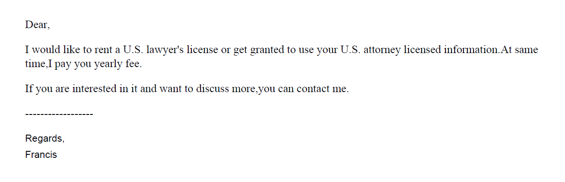
U.S. Counsel Rule – solicitation

Slide 44
U.S. Counsel Rule – solicitation
美标源头律师合作，非华人律师
1 message
US_Trademark_Agent <tony@zcompany.com> Sat, Mar 12, 2022 at 2:23 AM
Reply-To: tony@zcompany.cn
To: @gmail.com
您好，
初步沟通后，可提供美国白皮律师（非华人）商标方案如下：
*符合4月9日新规，USPTO律师实人认证；
*可协助OBJ制作（律师助手子账号操作）；
*使用USPTO Payement Account支付商标官费；

Slide 45
U.S. Counsel Rule Decisions
  Yiheng Lou, Proceeding No. D2021-04 (USPTO May 12, 2021)
    NY-licensed attorney contracted with Chinese IP firm (5/12/2021)
  Devasena Reddy, Proceeding No. D2021-13 (USPTO Sept. 9, 2021)
    CA-licensed attorney contracted with Indian TM filing firm (9/9/2021)
  Bennett David, Proceeding No. D2021-8 (USPTO Sept. 24, 2021)
    Patent attorney and MA-licensed attorney contracted with Chinese IP firm (9/24/2021)
  Di Li, Proceeding No. D2021-16 (USPTO Oct. 7, 2021)
    CA-licensed attorney contracted with Chinese firm that consults with online retailers (10/7/2021)
  Tony Hom, Proceeding No. D2021-10 (USPTO Dec. 17, 2021)
    NY-licensed attorney contracted with several different Chinese firms (12/17/2021)

Slide 46
U.S. Counsel Rule Decisions
  Jonathan Morton, Proceeding No. D2022-07 (USPTO Apr. 20, 2022)
    NY-licensed attorney contracted with foreign entities
  Kathy Hao, Proceeding No. D2021-14 (USPTO Apr. 27, 2022)
    California licensed attorney contracted with several foreign entities
  Weibo Zhang, Proceeding No. D2022-16 (USPTO July 11, 2022)
    NY licensed attorney contracted with several foreign entities
  Elizabeth Yang, Proceeding No. D2021-11 (USPTO Dec. 17, 2021)
    CA-licensed attorney contracted with foreign firm serving online retailers
_ Zhihua Han, Proceeding No. D2022-23 (USPTO Jan. 09, 2023)
    WA-licensed attorney contracted with several foreign firms to file both trademark and patent applications

Slide 47
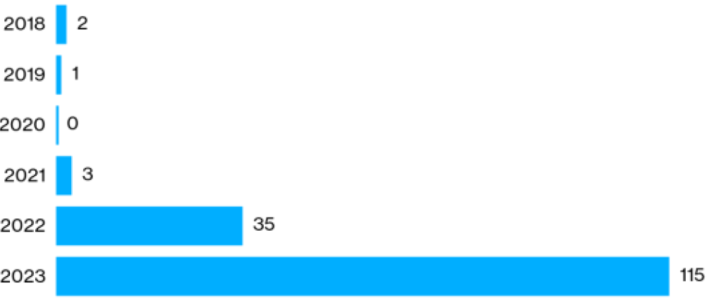
Trademark-Related sanctions issued by USPTO Orders from January 2018 through April 2023
Source: Bloomberg Law

Slide 48
Hijacking of U.S. practitioner data
Since the implementation of the U.S. counsel rule, the Office has encountered several instances of co-opting/hijacking of U.S. practitioner’s name, address, and/or bar number.
Referral to state bars and other agencies that address fraud and consumer protection.

Slide 49
U.S. counsel rule - sponsorship
Per the USPTO.gov User Agreement, U.S. trademark (TM) practitioners may only sponsor USPTO.gov accounts for their own employees whom they supervise.
Lately, there have been instances where U.S. TM practitioners have been solicited to sponsor USPTO.gov accounts for foreign trademark filing entities. Also, there have been instances where U.S. TM practitioners have sponsored users from foreign trademark filing entities.
Such conduct violates the terms of the USPTO.gov User Agreement. Accordingly, the Commissioner of Trademarks has suspended accounts of practitioners who engage in this conduct.
This conduct is also subject to investigation by the Office of Enrollment and Discipline for ethical violation(s) of the USPTO Rules of Professional Conduct.
In the future, all users (attorneys along with paralegals and other sponsored account users) will be required to verify their identity before filing TM documents with the USPTO.

Slide 50

37 C.F.R. § 1.3

Slide 51
Decorum required in trademark (TM) communications
All those who practice TM matters before the USPTO are required to conduct their business with decorum and courtesy. See 37 C.F.R. § 2.192; TMEP 709.07.
If a submitted document contains rude or discourteous remarks, it may be referred to the Deputy Commissioner for Trademark Examination Policy for review.
If it is determined that the document is in violation of 37 C.F.R. § 2.192, the document will not be considered and will be removed from the file.

Slide 52
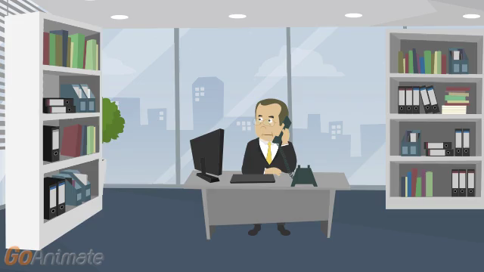
Notes:
Ethics Scenario: Gross and Disreputable Misconduct – Are you Drunk?
Scene 1: In Patent Attorney’s office. Patent Attorney picks up the phone and Client is on the other line.
Patent Attorney to Client: Hello Client. I have filed a utility patent application for your method of conducting mergers and acquisitions with the USPTO. It will probably be at least one year until we get a response from the USPTO.
Client to Patent Attorney: Okay, great. Thank you! Please let me know when you hear something from the Office.
[Show moving calendar, ticking clock, or sun rising and setting to demonstrate time]
Text Reads: Over 1 year later.
Patent Attorney over phone to Client: Hello Client! I just received a non-final Office action in your application, rejecting the claims as being directed to patent ineligible subject matter under 35 U.S.C. § 101. But don’t worry! I will request an interview with the Examiner to resolve this issue.
Client: Okay. I hope you are able to overcome the rejection. Thank you!
Scene 2: Patent Attorney sitting in front of Examiner in new location.
Patent Attorney: Hello, Examiner. I would like to discuss your subject matter eligibility rejection. I do not agree with your rejection and do not believe the claimed invention is directed to patent ineligible subject matter.
Examiner: I’m sorry, sir, but the claimed invention does not recite eligible subject matter because it is directed to an abstract idea.
Patent Attorney: What do you mean the claimed invention does not recite eligible subject matter? Are you drunk? No, seriously . . . are you drinking scotch and whiskey with a side of crack cocaine while you ‘examine’ patent applications?
Patent Attorney gets up and walks out of interview room. Examiner picks up phone. Phone rings.
Examiner: Hi OED. I’m an Examiner in 3700 and I would like to file a complaint against a practitioner.

Slide 53
Disreputable or gross misconduct
In re Schroeder, Proceeding No. D2014-08 (USPTO May 18, 2015):
Patent attorney:
  Submitted unprofessional remarks in two separate Office action responses;
  Remarks were ultimately stricken from application files pursuant to 37 C.F.R. § 11.18(c)(1);
  Order noted that behavior was outside of the ordinary standard of professional obligation and client’s interests; and
  Aggravating factor: has not accepted responsibility or shown remorse for remarks.
Default: 6-month suspension.
Rule highlights:
  37 C.F.R. § 10.23(a) – Disreputable or gross misconduct;
  37 C.F.R. § 10.89(c)(5) – Discourteous conduct before the Office;
  37 C.F.R. § 10.23(b)(5) – Conduct prejudicial to the administration of justice; and
  37 C.F.R. § 11.18 – Certification upon filing of papers.

Slide 54
Disreputable or gross misconduct
In re Tassan, Proceeding No. D2003-10 (USPTO Sept. 8, 2003):
Registered practitioner who became upset when a case was decided against his client, and left profane voicemails with TTAB judges.
Called and apologized one week later; said he had the flu and was taking strong cough medicine.
Also had a floral arrangement and an apology note sent to each judge.
Mitigating factors: private practice for 20 years with no prior discipline; cooperated fully with OED; showed remorse and voluntary sought and received counseling for anger management.
Settlement: Reprimanded and ordered to continue attending anger management and have no contact with Board judges for 2 years.

Slide 55
Other examples of disreputable or gross misconduct
Practitioner referred to patent examiner as “delusional,” that he “will publish examiner’s statements … along with assessment of their adequacy by a certified psychologist/MD, on Internet/You [T]ube …” and that he will report his “public safety and mental health concerns [about the examiner] to Office of Human Resources of [the] USPTO.”
Practitioner accused examiner of “irrational statements, delusions/hallucinations,” and stated that examiner “could become a t[h]reat for himself if such confusions/hallucinations or delusions happen at driving a car, operating an elevator, …”

Slide 56
Other examples of disreputable or gross misconduct
Practitioner left a voicemail message, asking that the interlocutory call him back “so I don’t have to file another identical motion … that you’ll probably kick back again for fear that maybe you’d have to work,” and “[m]aybe that’s too much to ask of a government official but I don’t think so.”
Practitioner accused the interlocutory of “posturing and drama,” and closed his voicemail message with “when an examiner sits in an ivory tower and seems to have a greater perception of a case in which she [has] (sic) simply refused to look at the facts or circumstances and rather would like to sling mud, then that gets under my ire,” and stated that “when you’re able to calm down, [then] (sic) you can call me and act respectfully and appropriately instead of mudslinging or otherwise threatening counsel who’s simply trying to do his job ….”

Slide 57
Other examples of disreputable or gross misconduct
When he spoke to another interlocutory, practitioner was “in a rage and screamed at him” and to another, he yelled and told the interlocutory “how awful [you] all are” and “how terrible all government workers are.”
While yelling at an interlocutory over the phone, Practitioner also claimed to be a friend of Judge Rogers and that he should receive special treatment, and again attacked the character of PTO employees, and demanded that the interlocutory on his case be replaced. Another instance, after yelling at the interlocutory, he hung up on her.

Slide 58
Decisions imposing public discipline available in “FOIA Reading Room”
foiadocuments.uspto.gov/oed/
Official Gazette for Trademarks:
  www.uspto.gov/learning-and-resources/official-gazette/trademark-official-gazette-tmog

Slide 59
OED
571-272-4097

