Slide 2
Modernizing industrial design protection for new technologies
David Gerk - Acting Senior Patent Counsel,
Office of Policy and International Affairs
February 9, 2021

Slide 3
Overview
New technologies and environments
International discussions
Notable practice/law changes
Current discussions

Slide 4
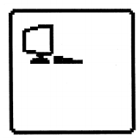
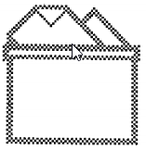
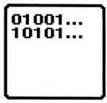
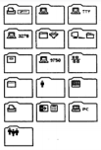
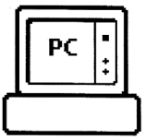
New technologies and environments
State of new electronics technology in the 1980s and early 1990s.
www.wipo.int/edocs/mdocs/sct/en/sct_35/sct_35_6_rev_2.pdf

Slide 5
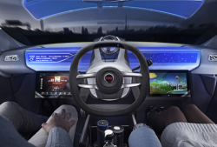
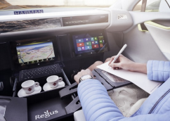
New technologies and environments
Virtually any product now may utilize a GUI in interaction with users.
Designs appear on glass, in air, on walls, etc.
www.wipo.int/edocs/mdocs/sct/en/sct_35/sct_35_6_rev_2.pdf

Slide 6

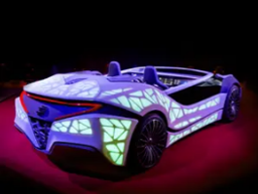
New technologies and environments
Projected in air or on a surface.
May react to user actions large or small.
www.wipo.int/edocs/mdocs/sct/en/sct_35/sct_35_6_rev_2.pdf

Slide 7


New technologies and environments
Virtual reality and augmented reality environments.
Environments not considered when global industrial design laws drafted.

Slide 8
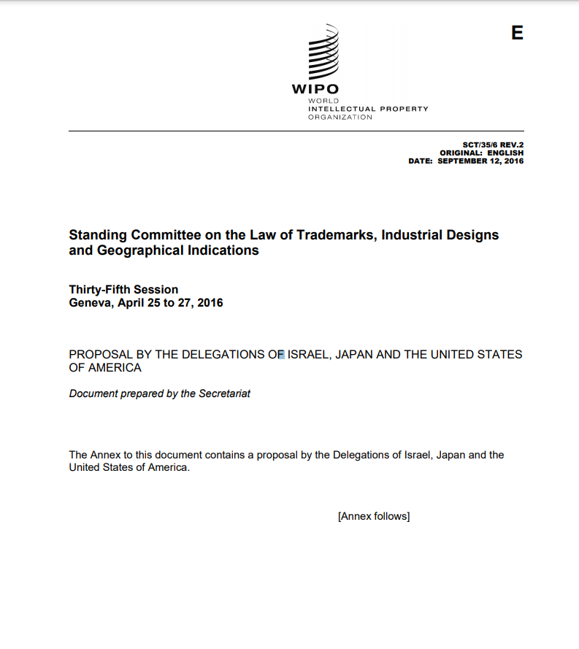
International discussions
SCT/35/6 Rev. 2
  September 12, 2016
  US-JP-IL Proposal
Similarities and differences in the protection of new technological designs.
www.wipo.int/edocs/mdocs/sct/en/sct_35/sct_35_6_rev_2.pdf

Slide 9
International discussions
SCT/36/2 Rev. 2 – August 4, 2016
  Responses to comparative questionnaire covering system of protection, applications, examination, scope and duration of protections for designs in new technology designs
  (66 member states, 2 IGOs and 6 NGOs).
www.wipo.int/edocs/mdocs/geoind/en/sct_36/sct_36_2_rev_2.pdf

Slide 10
International discussions
SCT/37/2 – January 31, 2017: WIPO Secretariat’s analysis of response
  GUIs/icons and typeface/type font designs are widely protected.
  In almost all jurisdictions GUI/icons and typeface/type font designs can be protected with a variety of representations: b&w, color photographs, line drawings, etc.
  Eligibility criteria for GUIs, icons or typefaces/type fonts do not differ from those for other designs.
  In a majority of jurisdictions, the scope of protection is not limited by the classification of the design.
  In more than half of jurisdictions, if a GUI/icon is protected in relation to one product, it is also protected against its use in relation to another product.
www.wipo.int/edocs/mdocs/sct/en/sct_37/sct_37_2.pdf

Slide 11
International discussions
SCT/41/2 Rev. – January 23, 2020
  Compilation of returns to the second questionnaire on GUI, icon and typeface/type font designs
  Two main focuses:
    Link between design and article or product
    Protection of animated designs
  40 member states; 2 IGOs
https://www.wipo.int/edocs/mdocs/sct/en/sct_41/sct_41_2_rev.pdf

Slide 12
International discussions
SCT/43/2 – February 5, 2020
  Analysis of returns to the second questionnaire
    Article / design link
      In 67 percent of responding jurisdictions, a link between the GUI/icon design and an article is not required (GUI/icon per se).
      In 60 percent of responding jurisdictions, a single design registration can cover use of the design in a physical environment and in a virtual computer environment; in 19 percent it cannot.
      In 76 percent of the responding jurisdictions, there is no distinction in the infringement criteria; the other 24 percent did not reply.
www.wipo.int/edocs/mdocs/sct/fr/sct_43/sct_43_2.pdf

Slide 13
International discussions
SCT/43/2– February 5, 2020
  Analysis of Returns to the Second Questionnaire
    Publication
      67 percent of responding jurisdictions designs published animated designs electronically; 22 percent on paper.
      50 percent of responding jurisdictions publish only electronically;
      5 percent publish only in paper; 17 percent publish in both forms.
    Non-permanent designs
      protected in 69% percent of responding jurisdictions; not protected in 29% of responding jurisdictions.
www.wipo.int/edocs/mdocs/sct/fr/sct_43/sct_43_2.pdf

Slide 14
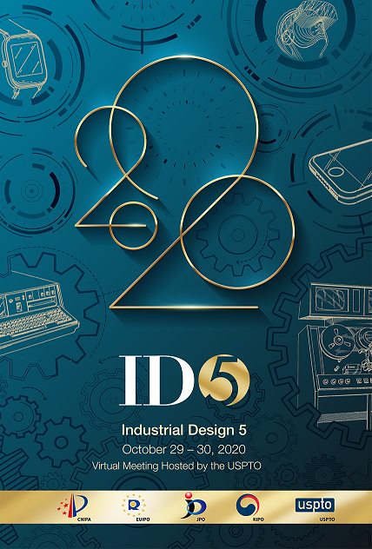
ID5 developments
ID5 comparative studies:
  3D Printing in the Protection of Industrial Designs
  Practices on the Protection of
  New Technological Designs
www.id-five.org

Slide 15
Developments in Singapore
“Non-physical” products are now eligible for design protection as of 2018
  A non-physical product is defined as anything that does not have a physical form, is produced by the projection of a design on a surface or into a medium (including air), and has an intrinsic utilitarian function (other than merely to portray the appearance of the thing or to convey information).
  Example of eligible subject matter: A virtual keyboard that is projected onto a surface that can be used to type characters in the same manner as a physical computer keyboard
    Intrinsic utilitarian function: can be used to type characters in the same manner as a physical computer keyboard.
  Example of ineligible subject matter: The appearance of a cup that is projected onto a surface or into the air, and that cannot actually hold liquid.
    It merely portrays the appearance of a thing.
See Intellectual Property Office of Singapore, Practice Direction No. 4 of 2018 (June 20, 2018)

Slide 16
Developments in Japan
Expanded the scope of protected designs to cover graphic images that are not recorded or shown on articles. (March 1, 2019)
  Digital images that are not displayed on an article, such as graphic designs viewed or provided through a computer network and projected images, including images on screens (GUI/icon per se).
  Images appearing through virtual and augmented reality.
See Ministry of Economy, Trade and Industry (METI), Cabinet Decision on the Bill for the Act of Partial Revision of the Patent Act (Mar. 1, 2019), www.meti.go.jp/​english/​press/​2019/​0301_​003.html

Slide 17
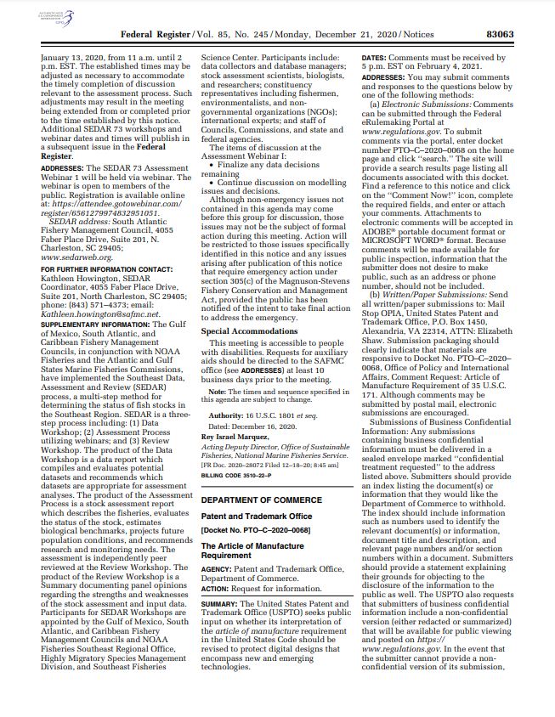
Current discussions
USPTO - Request for information
  The Article of Manufacture Requirement (35 USC 171).
  Docket No. PTO-C-2020-0068.
  Federal Register, Vol. 85, No. 245, Monday, December 21, 2020.
www.govinfo.gov/content/pkg/FR-2020-12-21/pdf/2020-28110.pdf

Slide 18
Current discussions
Summary:
Request for public input on whether the USPTO’s interpretation of the article of manufacture requirement in the United States Code should be revised to protect digital designs that encompass new and emerging technologies.
www.govinfo.gov/content/pkg/FR-2020-12-21/pdf/2020-28110.pdf

Slide 19
Current discussions
Link between design and article
  Effect of new technology
Scope
  Are virtual and tangible product environments covered by a single industrial registration? Can they be? Should they be?
Artificial intelligence
  Tool for examination? Creation of designs?

