Slide 2
An overview of the
USPTO Patent Pro Bono Program
Office of Enrollment and Discipline
United States Patent and Trademark Office

Slide 3
USPTO Patent Pro Bono Program (PPBP)
Assists financially under-resourced independent inventors and small businesses
  Section 32 of AIA – The USPTO Director shall work with and support intellectual property law associations across the country in the establishment of pro bono programs designed to assist financially under-resourced independent inventors and small businesses.
  The USPTO 2019 – 2022 Strategic Plan calls for the USPTO to enhance “the assistance we provide to independent inventors and small businesses.”
Regional programs work to match financially under-resourced inventors and small businesses with volunteer practitioners to prepare, file, and prosecute patent applications.

Slide 4
Regional patent pro bono programs
Regional programs may cover individual or multiple states.
Regional programs are operated by
  Nonprofit organizations focusing on copyright and trademark (e.g., lawyers for the arts).
  Universities.
  Bar associations.
Regional programs follow general guidelines but are independent of the USPTO and set their own policies and procedures.
Regional programs are responsible for screening and matching patent pro bono applicants:
  Ensure applicants meet requirements for pro bono assistance
  Screen for
    Income.
    Knowledge of the patent system.
    An actual invention (more than an idea).

Slide 5
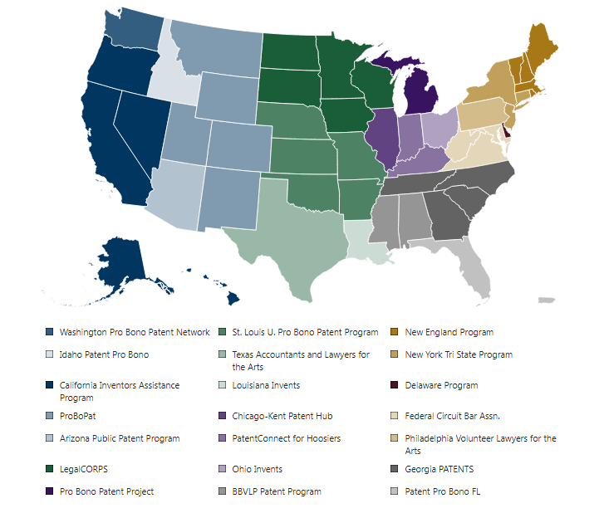
Current nationwide coverage

Slide 6
PPBP by calendar year
* Data collection began in Q2 of CY 2015

Slide 7
PPBP and under-represented communities
Applicant Gender Demographics
Applicant Race Demographics
Male | Female | Did not Specify
785 | 549 | 386
Black | American Native | White | Asian | 2 or More | Did not specify
351 | 18 | 661 | 66 | 74 | 506
Note: Persons claiming Hispanic origin are estimated to be 14.2% of survey respondents

Slide 8
  Patent practitioners are the linchpin
  More than 1,600 practitioners have signed on to volunteer
  Need outpaces supply.
  Unlike other forms of pro bono representation, only registered practitioners can represent financially under-resourced inventors to prepare, file, and prosecute patent applications before the USPTO.
  Improved patent quality
  A pro se inventor is now represented.
  The inventor is educated about the patent system.
  Professional advice may help the inventor make better decisions.
    “No” may be what the inventor needs to hear.
  Practitioner benefits
  Patent practitioners can volunteer in their area of expertise.
  State bars increasingly are offering continuing legal education credit for pro bono service.
  Creates a path for inventors to become job creator.
  Inventors may become paying clients.

Slide 9
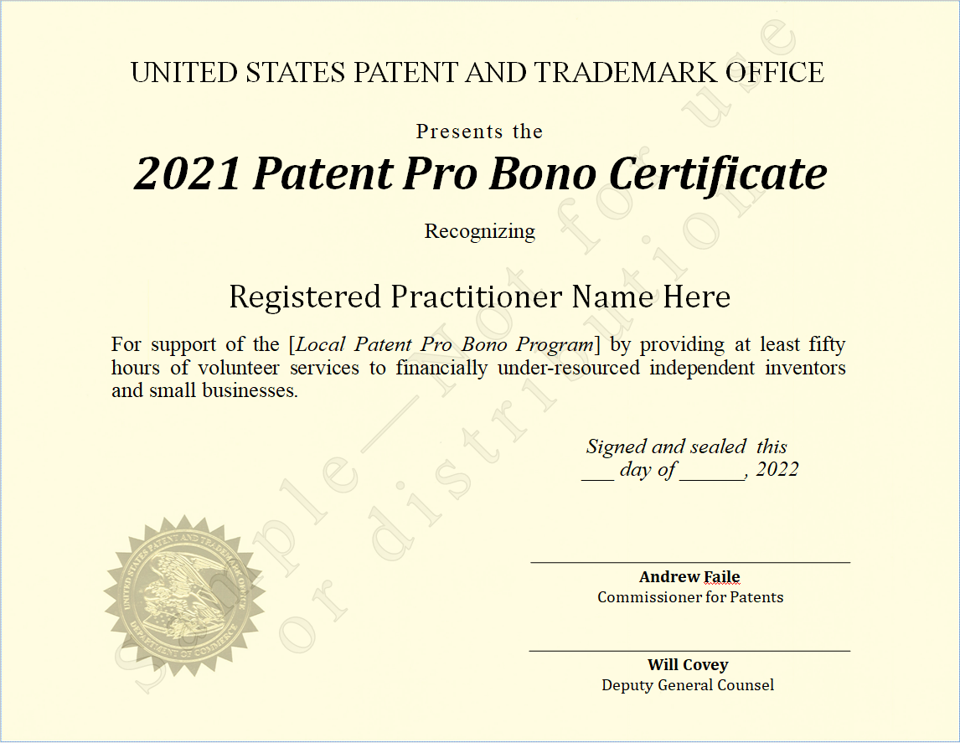
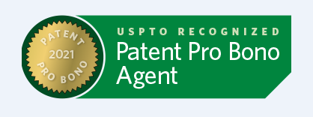
Practitioner recognition
  The USPTO issues certificates to registered patent practitioners who provide 50+ hours of patent pro bono service in a calendar year.
  Patent practitioner name, firm, and regional program are posted on the USPTO website.
  Signed by the Commissioner for Patents and the Director for the Office of Enrollment and Discipline.
  The USPTO has issued over 450 certificates to patent practitioners since 2017.
  The USPTO expanded recognition to include consecutive recipients.
  Certificate recipients receive signature graphic.

Slide 10
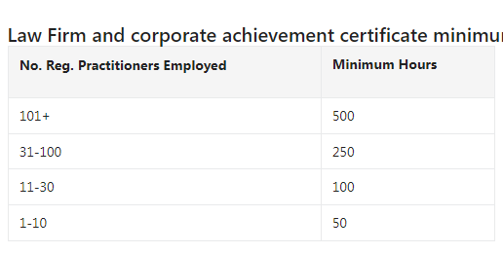
Law firm/corporation recognition
  The USPTO recognizes law firms and corporations that support the PPBP.
Certificates awarded annually based on cumulative hours/firm and firm size.
Recipient names are posted on the USPTO website.
The USPTO recognized more than 20 firms/corporations in 2021.
Law firm hours expanded to include non-practitioner assistance.

Slide 11
More information
Visit https://www.uspto.gov/probonopatents.
Email probono@uspto.gov.
OED Phone 571-272-4097.
  TTAB
    https://www.uspto.gov/learning-and-resources/inventors-and-entrepreneurs/ttab-pro-bono-clearinghouse-program.
  PTAB
    https://www.uspto.gov/patents/patent-trial-and-appeal-board/patent-trial-and-appeal-board-pro-bono-program-independent.

Slide 12
Professional responsibility and practice before the USPTO
OED

Slide 13
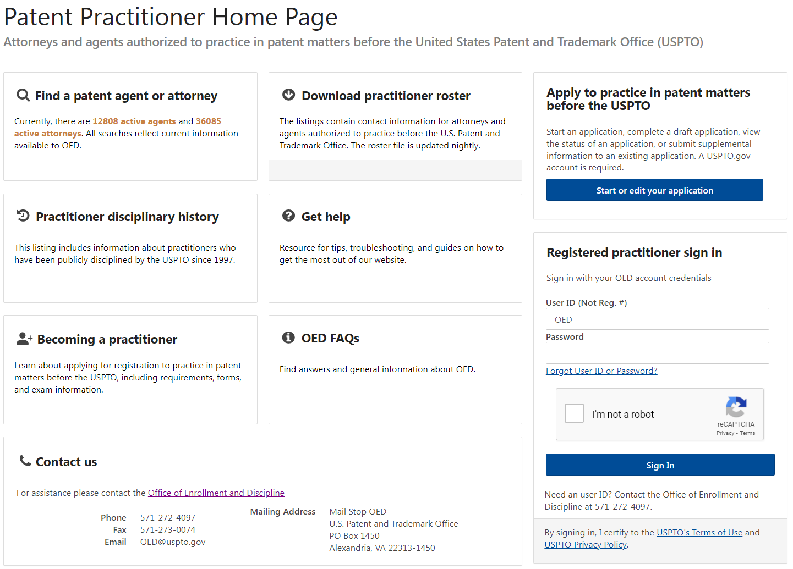
Register of patent practitioners
https://oedci.uspto.gov/OEDCI/

Slide 14
OED Diversion Pilot Program
In 2016, the ABA Commission on Lawyer Assistance Programs and the Hazelden Betty Ford Foundation published a study of about 13,000 currently practicing attorneys and found the following:
  About 21% qualify as problem drinkers.
  28% struggle with some level of depression.
  19% struggle with anxiety.
  23% struggle with stress.
Other difficulties include social alienation, work addiction, sleep deprivation, job dissatisfaction, and complaints of work-life conflict.
The USPTO launched the Diversion Pilot Program in 2017 and it has been extended until 2022.

Slide 15
OED Diversion Pilot Program – criteria
Willingness and ability to participate in the program.
No public discipline by the USPTO or another jurisdiction in the past three years, unless the discipline is based on the same conduct as the conduct that is the basis for the investigation.
Misconduct at issue must not:
  Involve misappropriation of funds or dishonesty, fraud, deceit, or misrepresentation
  Result in or be likely to result in substantial prejudice to a client or other person
  Constitute a “serious crime” (see 37 C.F.R. § 11.1)
  Be part of a pattern of similar misconduct or be of the same nature as misconduct for which practitioner has been disciplined within the past five years, unless the misconduct is minor and related to a chronic health condition or disease.

Slide 16
Law School Clinic Certification Program
Allows students in a participating law school’s clinic program to practice before the USPTO under the strict guidance of a Law School Faculty Clinic Supervisor.
The OED Director grants participating law students limited recognition to practice before the USPTO.
Signed into law on December 16, 2014.
60 law schools actively participate:
  24 trademark only.
  6 patent only.
  30 both.
www.uspto.gov/lawschoolclinic.

Slide 17
Office of Enrollment and Discipline (OED)
Select OED regulations

Slide 18
Practice before the office
Activities that constitute practice before the USPTO are broadly defined in 37 C.F.R. §§ 11.5(b) & 11.14:
  Includes communicating with and advising a client concerning matters pending or contemplated to be presented before the office (37 C.F.R. § 11.5(b)).
  Consulting with or giving advice to a client in contemplation of filing a patent application or other document with the office (37 C.F.R. § 11.5(b)(1)).
  Consulting with or giving advice to a client in contemplation of filing a trademark application or other document with the office (37 C.F.R. § 11.5(b)(2)).
  Nothing in this section (37 C.F.R. § 11.5(b)) proscribes a practitioner from employing or retaining non-practitioner assistants under the supervision of the practitioner to assist the practitioner in matters pending or contemplated to be presented before the office.
  See also 37 C.F.R. § 11.14 for details regarding individuals who may practice before the office in trademark and other non-patent matters.

Slide 19
OED discipline: grievances and complaints
An investigation into possible grounds for discipline may be initiated by the receipt of a grievance (see 37 C.F.R. § 11.22(a)).
Grievance: “a written submission from any source received by the OED Director that presents possible grounds for discipline of a specified practitioner” (37 C.F.R. § 11.1).
In the course of the investigation, the OED Director may request information and evidence regarding possible grounds for discipline of a practitioner from:
  The grievant,
  The practitioner, or
  Any person who may reasonably be expected to provide information and evidence needed in connection with the grievance or investigation.
  (37 C.F.R. § 11.22(f)(1)).

Slide 20
OED discipline: grievances and complaints
Upon the conclusion of an investigation, the OED Director may:
  Close the investigation without issuing a warning or taking disciplinary action.
  Issue a warning to the practitioner.
  Institute formal charges upon the approval of the Committee on Discipline, or
  Enter into a settlement agreement with the practitioner and submit the same for approval of the USPTO Director.
  (37 C.F.R. § 11.22(h)).
Self-reporting is often considered as a mitigating factor in the disciplinary process.

Slide 21
Other types of discipline
Reciprocal discipline (37 C.F.R. § 11.24)
  Based on discipline by a state or federal program or agency.
  Often conducted on documentary record only.
Interim suspension based on conviction of a serious crime (37 C.F.R. § 11.25).
  Referred to a hearing officer for determination of final disciplinary action.

Slide 22
USPTO disciplinary matters
*Through Q3

Slide 23
USPTO disciplinary matters
*Through Q3
23

Slide 24
Ethics scenarios and select case law
Office of Enrollment and Discipline

Slide 25
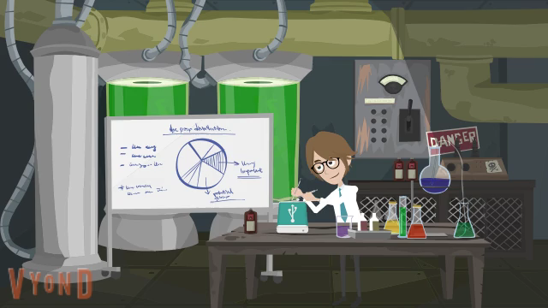

Slide 26
Patent agent privilege
In re Queen’s University at Kingston, 820 F.3d 1287 (Fed. Cir. 2016)
  U.S. District Court granted Samsung’s Motion to Compel documents, including communications between Queen’s University employees and registered (non-lawyer) patent agents discussing prosecution of patents at issue in suit.
  Federal Circuit recognized privilege only as to those activities that patent agents are authorized to perform (see 37 C.F.R. § 11.5(b)(1)).
In re Silver, 540 S.W.3d 530 (Tex. 2018)
  Lower court ruled that communications between client and patent agent were not protected from discovery because Texas law did not recognize patent agent privilege.
  Supreme Court of Texas overturned, citing patent agents’ authorization to practice law.
Rule on Attorney-Client Privilege for Trials Before the Patent Trial and Appeal Board, 82 Fed. Reg. 51570 (Nov. 7, 2017).

Slide 27
Patent agent privilege
Onyx Therapeutics, Inc. v. Cipla Ltd. et. al., C.A. No. 16-988-LPS (consolidated), 2019 WL 668846, (D. Del. Feb. 15, 2019)
  U.S. District Court found that a group of documents it inspected in camera would “almost certainly be within the scope of attorney client privilege,” but not be “protected by the narrower patent agent privilege,” because they were not “reasonably necessary and incident to” the ultimate patent prosecution.
  Documents were communications between scientists referencing prior art found by an individual who performed a patent assessment at the direction of a patent agent.
  Email discussion among the scientists was found not to be protected by the patent-agent privilege “because the assessment was done as part of a plan to develop new chemical formulations, not to seek patent protection for already-developed formulations.”

Slide 28
Unauthorized practice of law (UPL)
In re Campbell, Proceeding No. D2014-11 (USPTO Apr. 29, 2014):
  Patent agent represented a person in Colorado on matters involving DUI charges.
    Attempted to claim he was “attorney in fact” for driver.
      Identified himself as "an attorney in fact duly appointed, and licensed to practice Federal Law in the United States of America.”
      Arrest warrant was issued for driver for failure to appear.
    Sued City of Colorado Springs in civil court on behalf of driver.
      Identified himself before magistrate in civil suit as a “federal attorney” and provided his USPTO registration no. as his “federal attorney registration number.”
    Appeared on behalf of driver in license revocation hearing.
  Excluded from practice before the USPTO.
  Rule highlights:
    Dishonesty, fraud, deceit, or misrepresentation – 37 C.F.R. §§ 10.23(b)(4).
    Conduct prejudicial to the administration of justice – 37 C.F.R. § 10.23(b)(5).
    Holding oneself out to be an attorney or lawyer – 37 C.F.R. § 10.31(d)(1).
    Intentionally or habitually violating disciplinary rules – 37 C.F.R. § 10.89(c)(6).

Slide 29
Misrepresentation/UPL
In re Chow, Proceeding No. D2018-27 (USPTO April 30, 2019):
  Patent agent was sole registered practitioner for company that provided patent services to clients.
    Patent agent’s son operated a second company that provided client referrals.
    Between August 2012 and December 2017, agent’s customer number was associated with 6,760 patent applications (~105/month, ~5/work day).
    Non-practitioner employees of son’s company drafted patentability opinions and patent applications and routinely communicated with clients, all with little to no supervision from patent agent.
    Clients paid son’s company, who would allegedly pass funds along to patent agent. No disclosure to client of payment arrangement.
    No disclosure to client regarding large referral relationship between companies.
  Settlement: three-year suspension.
  Rule highlights:
    Conduct prejudicial to the administration of justice: 37 C.F.R. §§ 10.23(b)(5) & 11.804(d).
    Aiding UPL: 37 C.F.R. §§ 10.47(a),(c) & 11.505.
    Conflicts: 37 C.F.R. §§ 10.62(a), 10.68(a)(1), 11.107(a)(2), & 11.108(f).

Slide 30
Conflicts of interest/client communication
In re Starkweather, Proceeding No. D2018-44 (USPTO Oct. 17, 2019)
  Practitioner received voluminous referrals from marketing company.
    Did not obtain informed consent from clients in light of this arrangement.
    Took direction regarding applications from company.
    When company operations were shut down and payments stopped, practitioner halted client work, including completed applications.
    Signed clients’ names on USPTO documents.
  Settlement: three-year suspension, MPRE, 12 hours of ethics CLE.
  Rule highlights:
    Competence: 37 C.F.R. § 11.101.
    Abiding by client’s decisions: 37 C.F.R. § 11.102.
    Diligence: 37 C.F.R. § 11.103.
    Client communication: 37 C.F.R. § 11.104.
    Conflicts: 37 C.F.R. § 11.107.
    False statements to a tribunal: 37 C.F.R. § 11.303.
    Taking direction from 3rd party payer: 37 C.F.R. § 11.504(c).

Slide 31
Conflict of Interest
37 C.F.R. § 11.107
(a) Except as provided in paragraph (b) of this section, a practitioner shall not represent a client if the representation involves a concurrent conflict of interest. A concurrent conflict of interest exists if:
(1) The representation of one client will be directly adverse to another client; or
(2) There is a significant risk that the representation of one or more clients will be materially limited by the practitioner's responsibilities to another client, a former client or a third person or by a personal interest of the practitioner.
(b) Notwithstanding the existence of a concurrent conflict of interest under paragraph (a) of this section, a practitioner may represent a client if:
(1) The practitioner reasonably believes that the practitioner will be able to provide competent and diligent representation to each affected client;
(2) The representation is not prohibited by law;
(3) The representation does not involve the assertion of a claim by one client against another client represented by the practitioner in the same litigation or other proceeding before a tribunal; and
(4) Each affected client gives informed consent, confirmed in writing.

Slide 32
Conflict of Interest
37 C.F.R. § 11.108(f)
A practitioner shall not accept compensation for representing a client from one other than the client unless:
The client gives informed consent;
(2) There is no interference with the practitioner's independence of professional judgment or with the client-practitioner relationship; and
(3) Information relating to representation of a client is protected as required by §11.106.
37 C.F.R. § 11.504(c)
A practitioner shall not permit a person who recommends, employs, or pays the practitioner to render legal services for another to direct or regulate the practitioner's professional judgment in rendering such legal services.

Slide 33
Signatures on patent documents
37 C.F.R. § 1.4((d)(1) Handwritten signature.
  “Each piece of correspondence, except as provided in paragraphs (d)(2), (d)(3), (d)(4), (e), and (f) of this section, filed in an application, patent file, or other proceeding in the Office which requires a person's signature, must:
    (i) Be an original, that is, have an original handwritten signature personally signed, in permanent dark ink or its equivalent, by that person; or
    (ii) Be a direct or indirect copy, such as a photocopy or facsimile transmission (§1.6(d)), of an original. In the event that a copy of the original is filed, the original should be retained as evidence of authenticity. If a question of authenticity arises, the Office may require submission of the original.
37 C.F.R. § 1.4((d)(2) S-signature.
  “(i)…the person signing the correspondence must insert his or her own S-signature…”
37 C.F.R. § 1.4(d)(4)(ii) Certification as to the signature.
  “The person inserting a signature under paragraph (d)(2) or (d)(3) of this section in a document submitted to the Office certifies that the inserted signature appearing in the document is his or her own signature.”

Slide 34
Signatures on patent documents
MPEP § 502.02
  (I) Handwritten signature: “The word original, as used herein, is defined as correspondence which is personally signed in permanent dark ink or its equivalent by the person whose signature appears thereon.”
  (II) S-Signature:
    “The person signing the correspondence must insert his or her own S-signature…”
    “The ‘must insert his or her own signature’ requirement is met by the signer directly typing his or her own signature using a keyboard. The requirement does not permit one person (e.g., a secretary) to type in the signature of a second person (e.g., a practitioner) even if the second person directs the first person to do so.”

Slide 35
Signatures on trademark documents
37 C.F.R. § 2.193 Trademark correspondence and signature requirements
  “(a)…Each piece of correspondence that requires a signature must bear:
    (1) A handwritten signature personally signed in permanent ink by the person named as the signatory, or a true copy thereof; or
    (2) An electronic signature that meets the requirements of paragraph (c) of this section, personally entered by the person named as the signatory….
    * * * * *
  (c) Requirements for electronic signature. A person signing a document electronically must:
    (1) Personally enter any combination of letters, numbers, spaces and/or punctuation marks that the signer has adopted as a signature, placed between two forward slash (“/”) symbols in the signature block on the electronic submission; or
    (2) Sign the document using some other form of electronic signature specified by the Director.
    * * * * *
  (f) Signature as certification. The presentation to the Office (whether by signing, filing, submitting, or later advocating) of any document by any person, whether a practitioner or non-practitioner, constitutes a certification under §11.18(b) of this chapter. Violations of §11.18(b) of this chapter may jeopardize the validity of the application or registration, and may result in the imposition of sanctions under §11.18(c) of this chapter. Any practitioner violating §11.18(b) of this chapter may also be subject to disciplinary action. See §11.18(d) and §11.804 of this chapter.”

Slide 36
Signatures on trademark documents
TMEP § 611.01(c) Requirements for signature
  “All documents must be personally signed.
  37 C.F.R. §§2.193(a)(1), (c)(1), 11.18(a). The person(s) identified as the signatory must manually enter the elements of the electronic signature. Another person (e.g., paralegal, legal assistant, or secretary) may not sign the name of a qualified practitioner or other authorized signatory. See In re Dermahose Inc., 82 USPQ2d 1793 (TTAB 2007) ; In re Cowan, 18 USPQ2d 1407 (Comm’r Pats. 1990). Just as signing the name of another person on paper does not serve as the signature of the person whose name is written, typing the electronic signature of another person is not a valid signature by that person.”

Slide 37
Trademarks: U.S. counsel rule
Increase in foreign parties not authorized to represent trademark applicants and improperly representing foreign applicants in trademark (TM) matters.
Fraudulent or inaccurate claims of use are a burden on the trademark system and the public and jeopardize validity of marks.
Effective August 3, 2019:
  Foreign-domiciled trademark applicants, registrants, and parties to Trademark Trial and Appeal Board proceedings must be represented at the USPTO by an attorney who is licensed to practice law in the United States.
Final rule: 84 Fed. Reg. 31498 (July 2, 2019)
Canadian patent agents are no longer able to represent Canadian parties in U.S. TM matters.
Canadian TM attorneys and agents will only be able to serve as additionally appointed practitioners.
  Clients must appoint U.S.-licensed attorney to file formal responses.
  The USPTO will only correspond with U.S. licensed attorney.

Slide 38
Hijacking of U.S. practitioner data
Since the implementation of the U.S. counsel rule, the Office has encountered several instances of co-opting/hijacking of U.S. practitioner’s name, address, and/or bar number.
Referral to state bars and other agencies that address fraud and consumer protection.

Slide 39
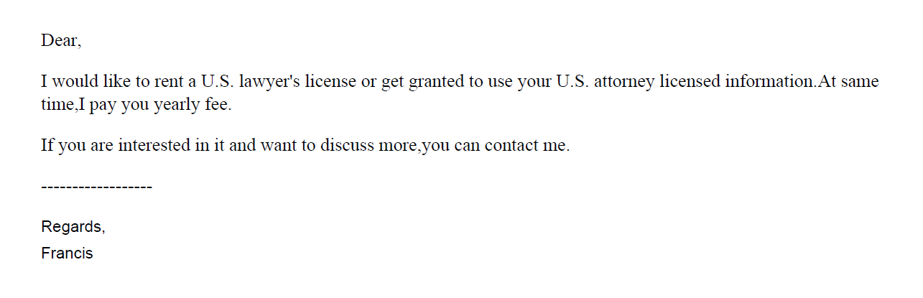
Example solicitation for U.S. counsel

Slide 40
ID.me
美标源头律师合作，非华人律师
1 message
US_Trademark_Agent <tony@zcompany.com> Sat, Mar 12, 2022 at 2:23 AM
Reply-To: tony@zcompany.cn
To: @gmail.com
您好，
初步沟通后，可提供美国白皮律师（非华人）商标方案如下：
*符合4月9日新规，USPTO律师实人认证；
*可协助OBJ制作（律师助手子账号操作）；
*使用USPTO Payement Account支付商标官费；

Slide 41
Improper signatures/communication
In re Lou, Proceeding No. D2021-04 (USPTO May 12, 2021)
  Trademark Attorney had business relationship with foreign company that provided IP services to merchants.
  Over the course of their relationship, attorney reviewed up to 500 applications per month and received over $10,000 in compensation.
  As of Oct. 12, 2020, all of the attorney’s TM cases were received from the foreign company.
  Attorney impermissibly gave a company employee authorization to enter his electronic signature in the applications and attendant declarations.
    Did not subsequently inform applicants that their applications were impermissibly signed.
  Provided the foreign company’s email address as correspondence address in applications.
    Did not monitor the email address; relied on the foreign company to provide him with updates on USPTO correspondence.
  Did not conduct conflicts checks for clients received from the foreign company.
  Settlement: three-month suspension
  Rule highlights:
    37 C.F.R. § 11.101 – Competence.
    37 C.F.R. §§ 11.104(a) & (b) – Client communications.
    37 C.F.R. §§ 11.303(a)(1), (a)(2), (b) & (d) – Candor toward tribunal.
    37 C.F.R. § 11.503(b) – Responsibilities regarding non-practitioner assistance.
    37 C.F.R. § 11.505 – Aiding UPL.

Slide 42
Improper Signature, Informed Consent, Communication and Scope of Representation
In re Yang, Proceeding No. D2021-11 (USPTO Dec. 17, 2021)
  Patent Attorney – agreed to allow foreign company to use her name to file TM applications as a domestic representative in exchange for $1500.00 a month for one year.
  Failed to review specimens; didn’t speak to TM applicants.
  Terminated her business arrangement with company.
  Ended company’s access to a joint email address and informed applicants about impermissible signatures and unauthorized filings; informed the USPTO about the impermissible signatures.
  30-day suspension and probation for 12 months thereafter.
  Rule highlights:
    37 C.F.R. § 11.101 – Competence.
    37 C.F.R. 11.103 – Diligence.
    37 C.F.R. §§ 11.104 – Client communication.
    37 C.F.R. § 11.503 – Allowing non-practitioner assistants to draft TM documents; submit false specimens.
    37 C.F.R. § 11.505 – Assisting UPL.
    37 C.F.R. 11.804(d) – Conduct prejudicial to the administration of justice.

Slide 43
Hijacking of U.S. practitioner data
Since the implementation of the U.S. counsel rule, the Office has encountered several instances of co-opting/hijacking of U.S. practitioner’s name, address, and/or bar number.
Referral to state bars and other agencies that address fraud and consumer protection.

Slide 44
Decorum Required in TM Communications
All those who practice TM matters before the USPTO are required to conduct their business with decorum and courtesy. 37 C.F.R. § 2.192; TMEP 709.07.
If a submitted document contains rude or discourteous remarks, it may be referred to the Deputy Commissioner for Trademark Examination Policy for review.
If it is determined that the document is in violation of 37 C.F.R. § 2.192, the document will not be considered and remove the document from the file.

Slide 45
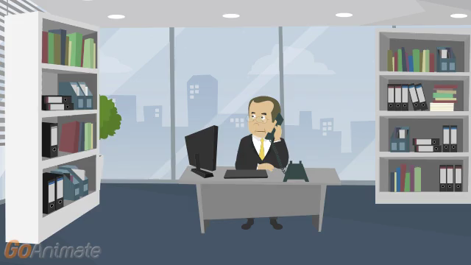

Slide 46
Disreputable or Gross Misconduct
In re Schroeder, Proceeding No. D2014-08 (USPTO May 18, 2015).
  Patent Attorney:
    Submitted unprofessional remarks in two separate Office action responses.
    Remarks were ultimately stricken from application files pursuant to 37 C.F.R. § 11.18(c)(1).
    Order noted that behavior was outside of the ordinary standard of professional obligation and client’s interests.
    Aggravating factor: has not accepted responsibility or shown remorse for remarks.
  Default: 6-month suspension.
  Rule highlights:
    37 C.F.R. § 10.23(a) – Disreputable or gross misconduct.
    37 C.F.R. § 10.89(c)(5) – Discourteous conduct before the Office.
    37 C.F.R. § 10.23(b)(5) – Conduct prejudicial to the administration of justice.
    37 C.F.R. § 11.18 – Certification upon filing of papers.

Slide 47
Disreputable or Gross Misconduct
In re Tassan, Proceeding No. D2003-10 (USPTO Sept. 8, 2003)
  Registered practitioner who became upset when a case was decided against his client, and left profane voicemails with TTAB judges.
  Called and apologized one week later; said he had the flu and was taking strong cough medicine.
  Also had a floral arrangement and an apology note sent to each judge.
  Mitigating factors: private practice for 20 years with no prior discipline; cooperated fully with OED; showed remorse and voluntary sought and received counseling for anger management.
  Settlement: Reprimanded and ordered to continue attending anger management and have no contact with board judges for 2 years.

Slide 48
Decisions imposing public discipline available in “FOIA Reading Room”
foiadocuments.uspto.gov/oed/
Official Gazette for Patents
    www.uspto.gov/news/og/patent_og/index.jsp
      Select a published issue from the list, and click on the “Notices” link in the menu on the left side of the webpage.

Slide 49
OED
571-272-4097

