Slide 1

August, 2018
Patent Fee Proposal
Detailed Appendix
Presented to:
Patent Public Advisory Committee

Slide 2
Introduction
This document includes appendices that provide background
information and explain details supporting the Executive Summary of the Patent Fee Proposal, presented separately. The following additional documents are an integral part of the proposal:
Letter from the Director to PPAC
Executive Summary
Table of Patent Fee Adjustments
Table of Patent Fees – Current, Proposed, and Unit Cost

Slide 3
Table of Contents
Appendices:
Appendix A – Background on USPTO Funding Model …………………………………..……...… 4
Appendix B – Background on Fee Setting Methodology and Analyses ……………....….11
Appendix C – Background on Activity Based Information (ABI) Costing Methodology (Unit Cost Calculation)……………….…………………….….…..24
Appendix D – Background on Patent Fees …………………………………………………..……...….31
Appendix E – Aggregate Cost Information ……………………………………………………...……..40
Appendix F – Aggregate Revenue Information ……………………………………………...…….…48
Appendix G – Rationale for Fee Changes ……………………………………………………..….……..57
Appendix H – Small and Micro Entity Fees ……………….……………………….………..….…..…..71
Appendix I – Elasticity Assumptions …………………….…..………………………………..……….....74
Appendix J – Operating Reserve (Carryover of Fees) …………………………………....……....76

Slide 4
Appendix A
Background on USPTO
Funding Model
Appendix A
Background on USPTO
Funding Model
The information included in this appendix provides more details on the manner in which the USPTO’s fees fund operations and the relationship between fees, costs, application filings, and workload.

Slide 5
USPTO Funding Model
The USPTO operates like a business in certain respects:
  Stakeholders request products and services and expect them to be delivered in either the current or future years, in accordance with established performance metrics.
  The aggregate cost [see Appendix E for details] of providing patent products and services (budgetary requirements) are funded from the aggregate revenue [see Appendix F for details] derived from patent fees and funding from the operating reserve.
Every year more than half a million patent applications are filed, bringing with them both fees (albeit at less than one half the cost to prosecute the application) and the associated workload in patent examination.

Slide 6
USPTO Funding Model (cont.)
Issue and maintenance fees from granted patents subsidize the cost of patent examination, including applications that ultimately are not allowed.
This fee model, while beneficial for innovation and the U.S. Intellectual Property (IP) system, adds additional complexities when analyzing, forecasting, and monitoring patent fee collections in relation to patent costs.
The Leahy-Smith America Invents Act (AIA) mandates that patent fees be set to recover the prospective aggregate cost of patent operations – leaving a zero net cost to general taxpayers.

Slide 7
USPTO Funding Model (cont.)
The chart on the following page depicts the relationship between:
  The patent application backlog;
  New incoming requests for products and services (applications);
  The budgetary requirements (prospective aggregate costs) necessary to address the existing and incoming workload;
  Fees and other funding used to offset the cost of operations; and
  The cost drivers in the form of performance targets and commitments.
USPTO has a backlog of unexamined patent applications in inventory and over a half million more applications arrive each year.
The USPTO has committed to examine these applications within a certain timeframe.
  Achieving these targets facilitates issued patents in the marketplace to increase commercialization, thereby, helping the economy and creating jobs.

Slide 8
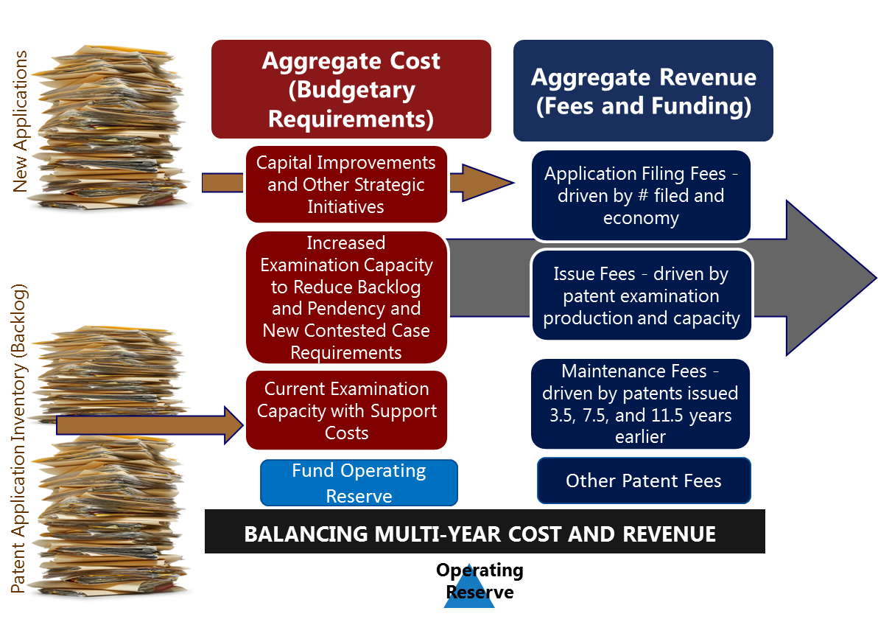

USPTO Funding Model
Strategic Goals, Objectives,
and Performance Targets
Innovation, Commercialization of New Technologies, and Job Creation

Slide 9
USPTO Funding Model (description of previous slide)
Given USPTO production and forecasting models, including the numerous data points monitored regularly, we estimate the level of resources required to meet these dates/targets. The costs of those requirements are estimated – the “red” budgetary requirements box (our aggregate cost).
The requirements are funded with (1) application fees collected in the current year, (2) issue fees, (3) maintenance fees from patents issued in the past renewed at various rates for each stage, (4) other patent fees (extensions of time, petition fees, PTAB services, etc.), and (4) operating reserve funds carried over from prior years to meet operating requirements.
If we receive more fees than planned, it’s usually due to (a) receiving more applications than planned or (b) our production was greater than planned. In both instances, the aggregate costs within the USPTO increase due to increased workload requirements.
The ability to calibrate our fee structure, coupled with the operating reserve, gives the USPTO the right balance to manage this iterative model.

Slide 10
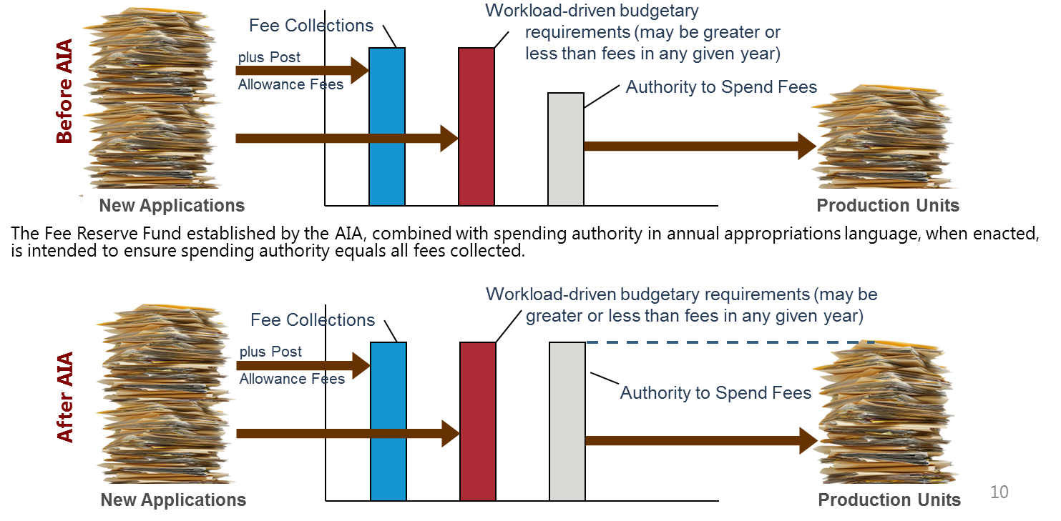
USPTO Funding Model
35 U.S.C. 42 provides for spending of USPTO fees to the extent and in amounts authorized by Congress in appropriations acts. If this spending authority does not keep pace with fee collections, the backlog may grow (indicated by fewer production units below). This issue was intended to be addressed by the AIA.

Slide 11
Appendix B
Background on Fee Setting Methodology and Analysis
Appendix B
Background on Fee Setting Methodology and Analysis
The information included in this appendix describes the framework and philosophy of USPTO fee setting, the biennial fee review process, the methodology used to recalibrate the fee structure, and an overview of the various analyses completed to arrive at the proposed fee structure.

Slide 12
Authority and Requirements for Fee Setting
Section 10 of AIA authorizes the Director of the USPTO to set or adjust by rule all patent and trademark fees established, authorized, or charged under Title 35 of the U.S. Code and the Trademark Act of 1946 (15 U.S.C. § 1051 et seq.), respectively.
  Authority effective on date of enactment (9/16/2011); Sec. 10 (i)(1)
  Authority terminates 7 years after enactment (9/15/2018); Sec. 10(i)(2)
  Patent fees may be set to only recover the aggregate estimated cost of the patent operations, including administrative costs to the USPTO; Sec. 10(a)(2)
  Trademark fees may be set to only recover the aggregate estimated cost of the trademark operations, including administrative costs to the USPTO; Sec. 10(a)(2)

Slide 13
Authority and Requirements for Fee Setting (cont.)
  When patent fees for filing, searching, examining, issuing, appealing, and maintaining patent applications and patents are set using this authority, those fees shall be reduced as follows; Sec. 10(b):
  By 50% for small entities that qualify for reduced fees under 35 U.S.C. 41(h)(1)
  By 75% for micro entities as defined in 35 U.S.C. 123, as added by Sec. 10(g) of AIA

Slide 14
Authority and Requirements for Fee Setting (cont.)
Fee Setting Authority Process
  Annually, the USPTO shall consult with the Patent Public Advisory Committee (PPAC) on the advisability of reducing fees; Sec. 10(c)
  USPTO shall provide PPAC proposed fees not less than 45 days prior to publishing the proposed fee(s) in the Federal Register; Sec. 10 (d)(1)
  PPAC shall hold a public hearing related to the proposed fee(s) during the first 30 days of the 45 day period; Sec. 10(d)(2)(B)
  PPAC shall make a written report with comments, advice, and recommendations related to the proposed fees available to the public; Sec. 10(d)(3)
    USPTO shall consider and analyze the report before setting or adjusting the proposed fee(s); Sec. 10(d)(4)

Slide 15
Authority and Requirements for Fee Setting (cont.)
Fee Setting Authority Process (continued)
  USPTO shall publish any proposed fee change in the Federal Register; Sec. 10(e)(1)(A)
    The proposal shall include the rationale and purpose for the proposal, including possible expectations or benefits; Sec. 10(e)(1)(B)
    No later than the date published, the USPTO shall notify Congress of the proposed change; Sec. 10(e)(1)(C)
  The public comment period will be not less than 45 days; Sec. 10(e)(2)
  The final rule will be published in the Federal Register and Official Gazette; Sec. 10(e)(3)
    The new or adjusted fee(s) may not become effective before 45 days after publishing the final rule; Sec. 10(e)(4)(A)
    Congress may pass a law to disapprove the new or adjusted fee(s); Sec. 10(e)(4)(B)

Slide 16
Biennial Fee Review
Proposals were developed to align with the Office’s fee structure philosophy and the goal to provide sufficient financial resources to facilitate the effective administration of the United States IP system. The following objectives support this goal:
Promote Administration innovation strategies
Align fees with the full cost of products and services
Set fees to facilitate the effective administration of the patent and trademark system
Offer application processing options
As part of biennial fee reviews, the USPTO follows the defined fee structure philosophy, including the goal, objectives, and guiding principles. The most recent biennial fee review has resulted in the patent fee proposal addressed in this briefing.

Slide 17
Fee Structure Philosophy
Guiding Principles
Self-Sustaining Transparent
Streamlined Balanced
Dynamic Agile
Guiding Principles
Goal
Provide sufficient financial resources to facilitate the effective administration of the United States intellectual property system.
Objectives
Explanation of Objectives
Promote Administration Innovation Strategies
Promoting competitive markets that spur productive entrepreneurship;
Fostering innovation that will lead to technologies of the future; and
Encouraging high-growth and innovation-based small business entrepreneurship.
* Small entrepreneur subsidy * Easy entry * Certain amount of back-end subsidy *
Align fees with the full cost of products and services.
Analyzing the full cost of USPTO processes compared to the fee amount.
Aggregate fees should recover the full prospective cost of aggregate costs of the patent or trademark business.
Total fees should be sufficient to address workload input on a steady-state basis, plus the necessary costs to achieve strategic objectives such as reducing the backlog, process improvements, multi-year initiatives, capital improvements, and maintain an operating reserve.
Set fees to facilitate the effective administration of the patent and trademark systems.
Submitting applications or taking actions which help to facilitate efficient processing;
Encouraging the prompt conclusion of application prosecution; or
Recovering costs for actions that are strenuous on the patent and trademark systems (i.e., increased fees for certain rework, large applications, missing parts).
Offer application processing options.
Setting fees for certain processes that provide special (unique) value or advantages for the applicant.
Includes processing choices such as prioritized examination (Track 1) and streamlined reexamination.
“Innovation IP Protection Jobs Economic Growth”

Slide 18
Fee Setting Components
The examination production capacity is the foundation for workload estimates related to the number of times a fee is expected to be collected in a given year. The relative cost for the examination capacity should be captured in the multi-year budget plans. The fees must be set at a rate to unite the appropriate balance.
Production Workloads
Economic data and data related to the elasticity of certain fees will provide a frame of reference for the balance between setting fees at certain amounts to achieve a desired impact on volumes.
In addition, calculate the more global economic impact of fee changes.
The data output from ABI cost analyses of fees will be used for the baseline historical cost.
Historical ABI Cost
Economic Analysis
USPTO Fee Structure
Fee Setting
Budget Formulation
Legal & Policy Analysis
Information from the established process will
provide the planned (prospective)
cost of sustaining and improving the USPTO.
Fees should be set at a rate
to recover the cost of the
multi-year budget plan.
While analyzing the
relationships between fees and operational processes, legal and/or policy expertise may be required.
In addition to each of these components, proposed fee rates will consider the relationships among fees or groups of fees and the cost of the related operational processes.
Strategic Planning
Understanding USPTO
priorities and plans for the
future permits prospective fee amounts to be set at the appropriate level to pay for achieving strategic objectives and improvements.

Slide 19
Fee Setting Methodology
Activity based historical cost and aggregate cost from budget plans
Initial forecast of fees
Apply economic elasticity analysis
Review and readjust fee rates
Forecast total aggregate revenue and refine
+/- for changes to Strategic Priorities, Plans, and Processes
+/- for changes to USPTO production input/output
Escalate for prospective aggregate cost
Calculate operating reserve needs
Review economic impact of intellectual property fee changes
Forecast total aggregate revenue and refine
Review and readjust fee rates
The fee setting process uses a complex and iterative methodology until the optimal balance between aggregate revenue and aggregate cost is achieved
USPTO
Fee Setting Methodology

Slide 20
Basic Patent Process and Relative Fee Payments
Fees collected for patent activities occur at different intervals over the life of patent application prosecution
The dark blue boxes display a high-level overview of the basic patent lifecycle
The light grey boxes identify the fees associated with each element of the patent lifecycle
Filing
Publication
Search and Exam
Issue
Maintenance
Application Filings (Filing, Search, Examination, Excess Claims, Size Fees)
Responses During Prosecution (Extension of Time, Appeal Fees)
Fees After Examination
(Issue Fees)
Maintaining Exclusive Rights (Maintenance Fees)

Slide 21
Reformulating the Fee Structure
Complete calculations and analyses of:
  Historical cost using an activity-based information cost accounting analysis [see Appendix C for details];
    Identify the full historical cost associated with the activities supporting fees and use as a reference point to set fees based on both cost and policy factors.
    The full cost includes compiling all costs that directly support an individual activity, such as patent examination or issuing a patent, and allocating an appropriate share of indirect costs (e.g., general, financial, administrative, and legal expenses).
  Aggregate prospective costs that will be required beginning in the year fees will be effective [see Appendix E for details];
  Establish and maintain a sufficient operating reserve [see Appendix J for details];

Slide 22
Reformulating the Fee Structure
  Relationships among individual fees and the cost of operational processes;
    Increases to fees to close the gap between cost and current fee rate
    Economic impact of patent fees and fee changes, and the relationship of fees to each other and to beneficial outcomes
    Fee changes that could administratively improve application processing

Slide 23
Reformulating the Fee Structure
Complete calculations and analyses of:
  Economic and statistical information;
  Where appropriate, setting fees during patent prosecution so that an applicant pays the fee at a point in time where there is more information to make a decision about proceeding
  Amount of aggregate revenue [see Appendix F for details] required to fund the aggregate cost of operations [see Appendix E for details] over multiple years.
  Elasticity of demand related to paying fees [see Appendix I for details] as it impacts the amount of aggregate revenue required to fund the aggregate cost of operations over multiple years [see Appendix F and Table of Patent Fee Adjustments for details]

Slide 24
Appendix C
Background on Activity-Based Information (ABI) Costing Methodology (Unit Cost Calculation)
Appendix C
Background on Activity-Based Information (ABI) Costing Methodology (Unit Cost Calculation)
The information included in this appendix provides an overview of the methodology used by USPTO to determine the unit cost of the patent fees at Appendix G – Rationale for Specific Fee Changes and Table of Patent Fee Adjustments.

Slide 25
USPTO ABI Costing Program
  A major component of analyzing patent user fees is to identify the full cost of activities associated with the fee rates. This information is used as a reference point when reviewing the alignment of costs with collection points in the patent process.
  The Office uses an activity-based costing methodology, which is referred to as activity-based information (ABI) at the USPTO, to determine its historical costs for patent-related activities and outputs (fee services) as well as allocating an appropriate share of administrative costs to determine aggregate cost.
  The USPTO’s ABI program has been in place for over 20 years and is responsible for developing, maintaining and updating cost information for all USPTO organizations. The ABI methodology follows the full cost guidance outlined in Federal managerial cost accounting and fee setting standards.
  USPTO’s ABI program is widely recognized to be one of the best in the Federal government and also compares well with commercial implementations of ABC. The USPTO ABI program has been the subject of a special Inspector General study, and is examined each year as part of the financial statement audit. There has never been a material weakness in internal controls reported concerning the ABI methodology or data.

Slide 26
USPTO ABI Costing Program (cont.)
  An independent verification and validation study was conducted on the ABI program in 2009, which identified the USPTO ABI program as a best practice in the Federal government.
Since the inception of the program, ABI methodologies have continuously improved and are consistently used in fee setting, budgeting, performance reporting, financial statement (Statement of Net Costs) preparation, and ad-hoc cost analyses and studies.
To facilitate agency-wide collaboration in the ABI program, the ABI Steering Committee was established and is the official rulemaking body for all issues related to ABI at the USPTO. This committee is comprised of representatives from all organizations at the USPTO and all changes to ABI methodology or ABI models are approved by the Steering Committee.

Slide 27
USPTO ABI Costing Program (cont.)
  ABI uses a two-step methodology to assign costs to its work activities and then to its related outputs.
  Expenses (also referred to as costs) are those things on which an organization spends its budget, such as salaries and benefits for employees, contractor costs, rent, equipment, etc.
  Activities represent the work that people in the organization undertake (e.g., examining a patent application, printing a patent, fee processing).
  Outputs are the goods or services that the organization produces through its activities (e.g., completed patent applications).
  The cost analysis and all historical expenses referenced in this proposal are based upon FY 2017 data as FY 2017 is the most recent fiscal year for which complete cost and production measure information was available during analysis.

Slide 28
USPTO ABI Costing Program (cont.)
  The ABI analysis starts with extracting expense information from the USPTO’s core financial system. This information is “tagged” with identifiers such as the organization that spent the money, the activities the money was spent for, and the type of expense (e.g., salaries, benefits, printing, rent).
  When compiling patent costs, any spending by, or directly on behalf of, the patent organization is considered direct expenses. These expenses do not require any type of allocation methodology to aggregate them with patent costs.
  Indirect expenses are those expenses that originate in one organization, but are allocated to the patent operation because they indirectly facilitate patent services or products (e.g. IT help desk support, human resources hiring support, invoice processing).
  Indirect expenses require a “driver” of costs (e.g., help desk calls by organization, number of hires, or invoices processed) to allocate the indirect expenses to the patent operation.
Direct expenses are compiled into “categories” of spending called processes and activities – “examination” is an example of a process and “perform initial search” is an example of an activity.

Slide 29
USPTO ABI Costing Program (cont.)
  All direct and indirect costs are aggregated into the activities.
  The direct cost for an activity plus the indirect costs is known as the “fully burdened” cost for that activity.
  The “fully burdened” cost for an activity is then divided by workload measures (number of outputs for that particular activity completed) to arrive at the fully burdened unit cost for that activity.
  In some cases, the cost for a particular process is then determined by ascertaining which activities occur for the process, and how often each activity occurs. This is known as the “frequency factor” and is based on a statistical analysis of a one year set of completed applications.
  During the last five years (FY 2013 thru FY 2017), on average, direct expenses accounted for 82% of the Patents organization’s costs while the remaining 18% were classified as indirect.
  Examples of the unit cost calculations for filing fees can be found on the following page.

Slide 30
USPTO ABI Costing Program Example: Patent Filings
Fee Code | Fee Code Description | Activity | FY17 Activity Expense | Driver Volume | FY17 Activity Unit Rate
1011/2011/3011 | Basic filing fee - Utility | 1.01 - Process Incoming Paper | $714,725 | 684,993 | $1.04
 |  | 1.02 - Process Application Fees | $18,925,075 | 684,993 | $27.63
 |  | 1.03 - Application Indexing/Scanning | $41,148,669 | 685,251 | $60.05
 |  | 1.04 - Routing Classification/Security Screening | $4,803,780 | 683,883 | $7.02
 |  | 1.05 - Second-level Security Screening and L&R Processing | $880,751 | 591,846 | $1.49
 |  | 1.06 - Conduct Formalities Review | $15,887,449 | 537,538 | $29.56
 |  | 1.07 - Customer Service (Pre- and Post-Examination) | $4,763,345 | 629,098 | $7.57
 |  | 2.01 - Tech Support Application Process | $47,023,423 | 462,731 | $101.62
 |  | 2.19 - Paralegal PCT Review (Patent Legal Research Center) | $523,956 | 453,459 | $1.16
 |  | 2.02 - Classification and Assignment by Art Unit | $6,545,473 | 462,731 | $14.15
1011/2011/3111 Total |  |  |  |  | $251.28

Slide 31
Appendix D
Background on Patent Fees
Appendix D
Background on Patent Fees
The information included in this appendix provides an overview of the current Patent fee structure, including historical trends of fees and fee collections.

Slide 32
Patent Filings by Type

Slide 33
FY 2017 Patent Fee Collections by Type
Total FY 2017 Patent Fee Collections $2,772 Million

Slide 34
Patent Application Filing Fees
Fees are collected for the initial request to process, search and examine a patent application filing. In addition to assumptions on the economy, demand, legislative/regulatory and judicial environment, fee assessments are made based on:
    Number of claims
    Size (number of pages)
    Type of application filing
    Manner of submission
    Entity size
These fees reflect the following design characteristics: beneficiary pays principle, marginal (discretionary) costs, equity (ability to pay), and efficiency of administrative burden

Slide 35
Fees During Patent Prosecution
Fees are collected for optional extensions of timeframes and examination procedures to respond to USPTO actions and optional examination procedures. In addition to assumptions on applicant behavior and resources available to complete the examination process, fee assessments are made on:
    Entity size
    Type of application filing
  These fees reflect the following design characteristics: beneficiary pays principle, marginal (discretionary) costs, equity (ability to pay), and efficiency of administrative burden

Slide 36
Fees After Patent Application Examination
Fees in this category include the issue fee and the publication fee, which are collected upon the successful allowance of a patent. In addition to assumptions on the quality of the examination process and the resources available to complete the process, fee assessments are made on:
    Type of patent
    Entity size
    Payment timing
  These fees reflect the following design characteristics: beneficiary pays principle, equity (ability to pay), and efficiency of administrative burden

Slide 37
Maintaining Exclusive Patent Rights Fees
Fees are collected by patent holders at certain intervals to maintain their exclusivity rights. In addition to assumptions of economic and market conditions, fee assessments are made on:
    Type of patent
    Entity size
    Payment timing
  These fees reflect the following design characteristics: beneficiary pays principle, equity (ability to pay), and efficiency of administrative burden
Patent Maintenance Fees
$1,210 M 44%

Slide 38
Patent Fee Collections

Slide 39
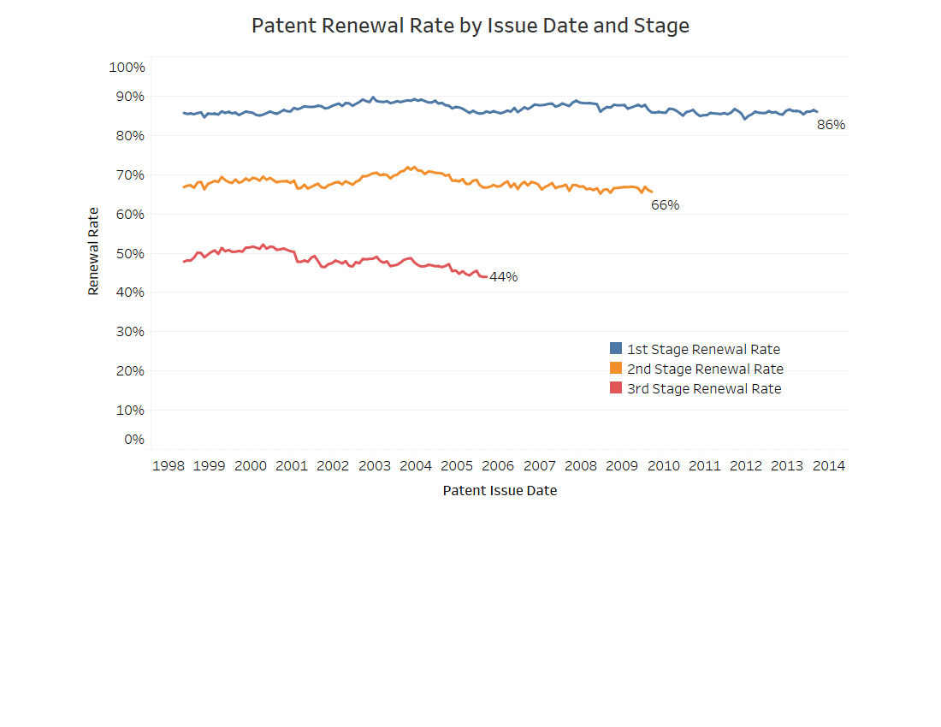
Maintenance of Patents

Slide 40
Appendix E
Aggregate Cost Information
Appendix E
Aggregate Cost Information
The information included in this appendix provides additional details related to the prospective aggregate cost that will be paid for with the aggregate revenue derived from the proposed fee structure.
This appendix also outlines the assumptions for patent filing, workload, production, and performance, which provide the underlying foundation for calculating aggregate cost.

Slide 41
Strategic Plan
Investing in the goals and objectives of the 2014 – 2018 Strategic Plan has put the USPTO on the right path to success.
An updated (2018-2022) Strategic Plan is under development. The Strategic Plan is expected to be published in late Fall 2018, following a period of public review and comment.
Following the publication of the updated Strategic Plan, USPTO will ensure that fee proposals and budget plans reflect efficient implementation of strategic priorities.

Slide 42
Aggregate Costs – Revenue Balance
To ensure the USPTO’s core operations are shielded from financial shock, the USPTO has identified an optimal operating reserve balance that it wishes to maintain, and a minimum, or lower bound, operating reserve size in which the USPTO will operate while building the operating reserve to the optimal level [see Appendix J for details].

Slide 43
Aggregate Cost Distribution
A majority of the fees used to support the patent operation are spent on activities that directly support patent examination and patent information resources and IT infrastructure
A percentage of patent fees are used to support underlying mission support services
* Miscellaneous General Expense (MGE) includes cross-cutting expenses such as rent, utilities, telecommunications, and lease management.

Slide 44
Aggregate Cost Calculation Methodology
The Strategic Plan is the foundation for defining priorities and activities upon which the USPTO calculates its aggregate costs to support the goals and objectives of the multi-year plan.
When calculating aggregate costs, the USPTO reviews its key strategic initiatives, goals, and performance targets to ensure they continue to be aligned with annual plans – reassessments are made as necessary.
The calculations supporting the most significant patent operating cost – patent examining activities– begin with analyzing and forecasting the estimated application filings coming into the USPTO and the necessary examination capacity, with the associated production and workload statistics. These statistics are monetized by estimating the salaries and benefits that will be required for the personnel carrying out the examination activities, other non salary and benefits costs, such as production workload contracts, and the cost of publishing patents.

Slide 45
Aggregate Cost Calculation Methodology (cont.)
Aside from analyzing the examination capacity, this same process is repeated for each of the activities supporting the patent operation (e.g., ex parte appeals, IT resources, and operational support).
All of these estimated prospective costs, including the minimal operating reserve balance, are summarized to obtain the total aggregate prospective cost for the patent operation.
This process takes several months to complete. Requests and suggestions for increases and decreases to specific activities, or new initiatives, are reviewed and approved at the executive level.
The USPTO continuously reviews its activities to identify opportunities for cost savings and/or activities that can be redirected to higher priority items.
The graphic on the following page outlines the cost environment of the USPTO. A majority of the USPTO’s spending is on items for which the USPTO has limited discretion in choosing to pay for, such as patent examination and publishing, maintaining and operating supporting IT systems, rent, and utilities.

Slide 46
Breakdown of Aggregate Costs
The vast majority of USPTO’s spending is for items that the Office has limited discretion in choosing to pay. There is flexibility in only a small portion of the USPTO’s aggregate cost.
Higher discretion items, 9%
Low Discretion Items
Compensation and Benefits | 67%
Contracts | 16%
Rent and Utilities | 4%
Publishing | 4%
Supplies and Materials | 1%
Higher Discretion Items
Equipment | 7%
Other | 2%

Slide 47
Appendix F
Aggregate Revenue Information
Appendix F
Aggregate Revenue Information
The information included in this appendix provides an overview of the methodology used to forecast aggregate revenue.

Slide 48
Fee Collections Forecasting Components
When forecasting fees to calculate aggregate revenue, the USPTO considers many factors, such as:
  The global and national economic outlook, by analyzing forecasts of Gross Domestic Product (GDP), research and development (R&D), consumer price index (CPI), and venture capital investments as indicators of future applicant demand;
  The future of the IP environment, by examining legislative, regulatory and judicial actions/changes and procedural/process improvements that may affect demand for IP rights. This includes strategic initiatives, management of resources, and fee rate adjustments;
  The Office’s historical experience by analyzing events and trends to help predict future demand for IP and applicant behavior; and
  Stakeholder input.

Slide 49
Arriving at Fee Collection Projections
The USPTO uses information compiled from reviewing the factors defined on the previous slide, coupled with internal data to:
  Estimate application filing and major patent process workloads;
  Apply the historical trends (relationships among workloads and demand for products and services) to future events, when applicable;
  Classify information by applicant type, where applicable (entity, manner, origin, discipline);
  Incorporate timing of fee payments and the applicant behavior associated with anticipated fee rate or legislative/regulatory/procedural adjustments;
  Estimate a specific workload or forecasting assumption for each fee code; and
  Multiply the forecasting assumption by the fee rate to calculate the estimated aggregate revenue for the particular fee.
Each of the aggregate revenues for the individual fees are summed to calculate the total aggregate revenue.

Slide 50
Proposed Fee Structure Changes
The following pages summarize the composition of the projected aggregate patent revenue as it transitions from the current fee structure to the proposed fee structure.
Each page presents the percentage of revenue (fee collections) in each of the major patent fee categories for FY 2017 (actual data), FY 2019 (projected, before the fee proposals go into effect), and FY 2021 (projected, after the fee proposals go into effect).

Slide 51
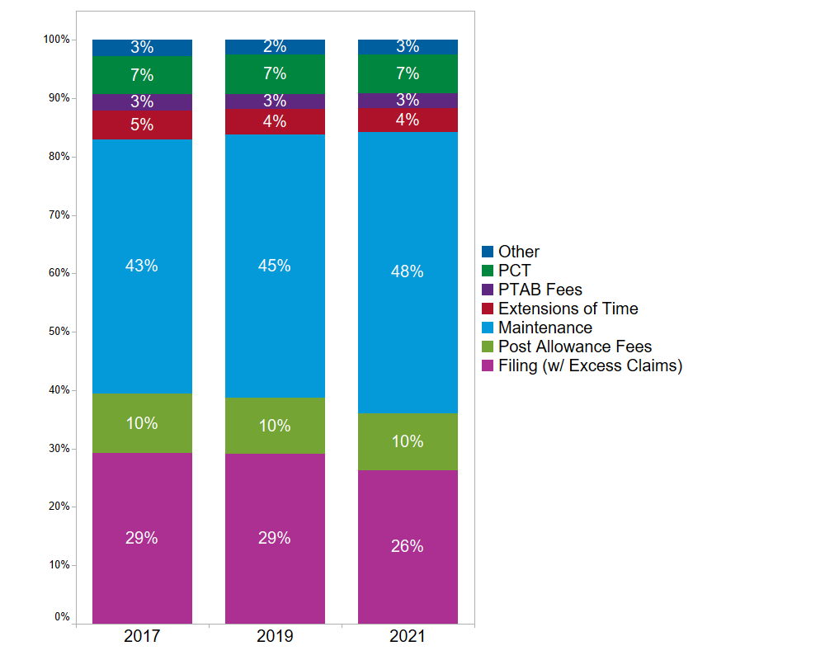
Proposed Fee Structure – Projected Trends of Aggregate Patent Fee Revenue
Patent application fees (which include filing/search/exam, excess claims, and RCEs) will decrease from 29% of aggregate revenue in FY 2019 to 26% in FY 2021.
Patent Post Allowance Fees (which include issue and publication fees) will vary slightly from year to year, but remain around 10% of aggregate collections.
The percentage of aggregate revenue from maintenance fees will increase from 45% in FY 2019 to 48% in FY 2021. This is primarily due to changes in the number of patents eligible for renewal.
The relative proportion of aggregate revenue from most other fee categories will remain relatively stable over the 4-year period.

Slide 52
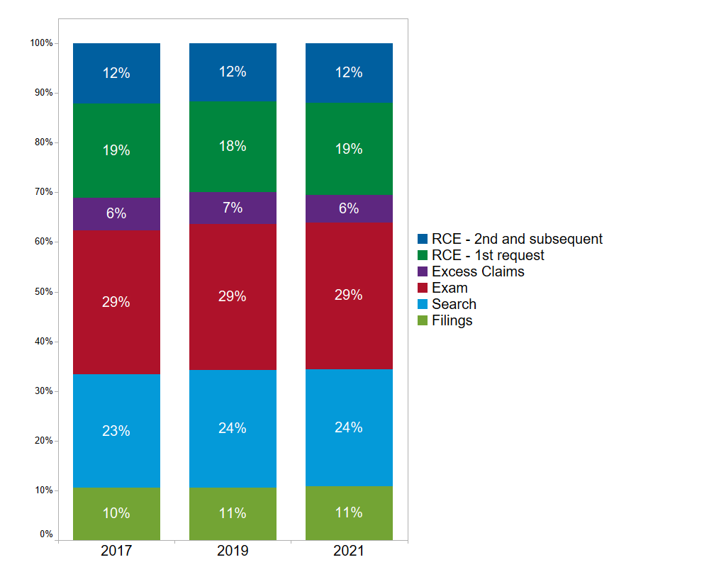
Proposed Fee Structure – Projected Trends of Aggregate Patent Application Fee Revenue
No targeted changes are being made to patent application fees, other than introducing a surcharge for non-DOCX filing of utility patents.
The distribution of fees within the Patent Application Fees category is only projected to see slight shifts.
The entire category will decrease as a percentage of total patent revenue. This is mostly attributable to changes in the number of patents eligible for renewal driving the maintenance fee percentage of total patent revenue up, which pushes the filing share down.

Slide 53
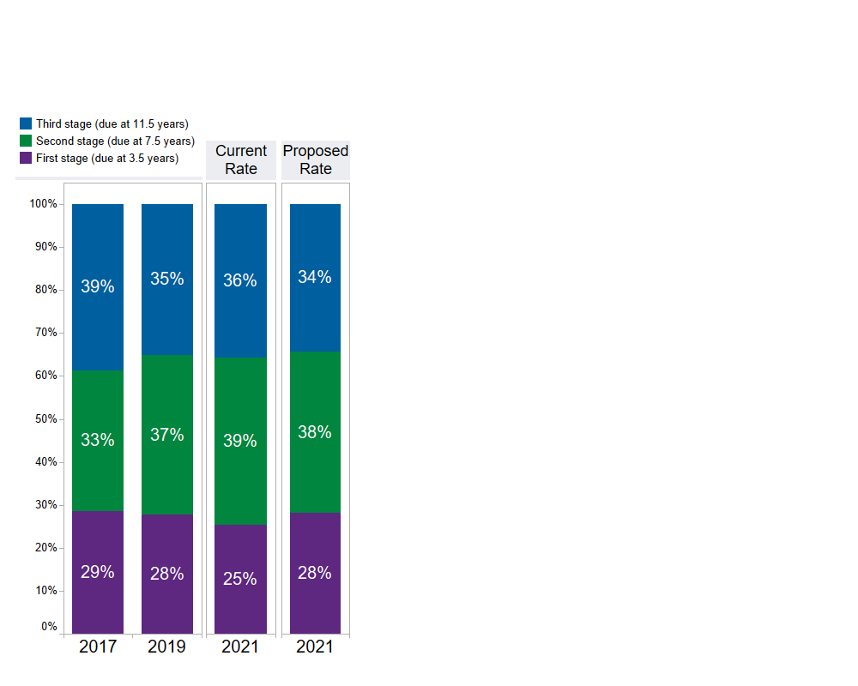
Proposed Fee Structure – Projected Trends of Aggregate Patent Maintenance Fee Revenue
Despite the proposed increase in first stage maintenance fee rates being a larger percentage than proposed for second and third stage fees, the revenue breakdown will remain similar.
First stage maintenance fees will remain steady at 28% of maintenance fee revenue in FY 2019 and FY 2021. However, without the proposed fee rates, the share would decrease to 25% in FY 2021.
The year-to-year variance is primarily due to historical patterns in patents issued that lead to variance in the number of patents eligible for each stage of renewal.

Slide 54
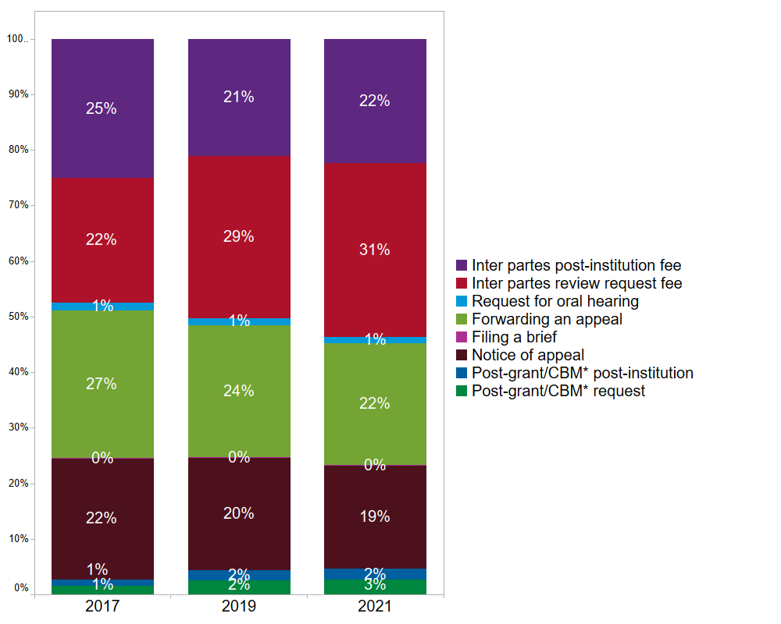
Proposed Fee Structure – Projected Trends of Aggregate Patent Trial and Appeal Revenue
Inter Partes Review Request and Post Institution fees will have the largest growth in percentage of total PTAB fee revenue, going from 29% and 21% in FY 2019 to 31% and 22% in FY 2021, respectively. This is primarily due to the proposed increases in the fee amounts.
Notice of Appeal and Forwarding an Appeal fees decrease as a total percentage of PTAB fee revenue because of the increase in fee rates for AIA trials.
*CBM – Covered Business Methods

Slide 55
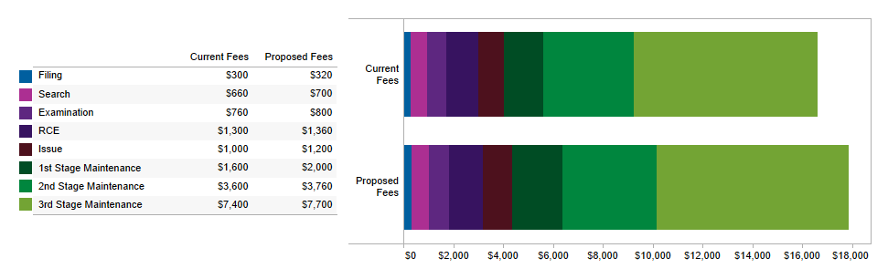
Front End and Back End Fees
The proposed fee changes have little impact on balance between front end and back end fees. For a large entity utility filing with one RCE and lifetime maintenance, front end fees will continue to be about 18% of the total fees paid.
Within the back end fees, fee rates are restructured to allow the Office to recover initial search and examination costs earlier in the patent lifecycle (see slide 64). The issue fee and 1st stage maintenance fee will increase from a combined 16% to a combined 19% of total fees paid.

Slide 56
Appendix G
Rationale for Specific Fee Changes
Appendix G
Rationale for Fee Changes
The information included in this appendix outlines the rationale for the patent fee change.

Slide 57
  Investing in the Future
Adjusting the patent fee schedule allows the Agency to continue to serve its critical stakeholder community. Some of our key programs and initiatives that will benefit:
  Patent Pendency – The IP system must be efficient and it should not take excessive time to issue patents. Of critical importance is that we examine patent applications within the statutory patent term adjustment timeframes.
  Patent Quality - Reliable patent rights are key to economic growth. Providing high quality, efficient examination of patent applications will serve the American economy well. We will continue to look for ways to improve our prior art search and consistency of examination.

Slide 58
  Investing in the Future (cont.)
  PTAB’s AIA Trial Provisions – Focus time and engage stakeholders to ensure the USPTO’s review in these proceedings is consistent with the intent of the AIA, and the overall goals of predictable, high quality patent rights. We will also continue to assess potential improvements to the AIA trial standards and processes.
  IT Modernization - The USPTO continues to invest in the modernization of its information technology (IT) and retiring its legacy systems. The new tools are built on a modern, flexible, and more stable web-based infrastructure leveraging cloud-based hosting. Improving our IT systems to better support patent examination, PTAB and other parts of the office include Big Data capabilities, data analytics and artificial intelligence to improve overall performance as well as fuel data-driven decision and policy making.

Slide 59
  Investing in the Future (cont.)
  Domestic and International IP Policy – The Agency plays a leading role in promoting strong and balanced protection and effective enforcement of IP at home and abroad. We assess what steps, if any, towards greater harmonization of substantive patent law are advisable.
  Education and Outreach – The USPTO is committed to serving local innovation economies through our regional offices; and encouraging and supporting future generations of inventors and entrepreneurs to play an active role in America’s innovation economy.

Slide 60
  Benefits For Stakeholders
Implementation of the USPTO fee proposal would benefit the IP community by enabling the USPTO to:
  Continue to look for ways to improve prior art search and consistency of examination
  Reach optimal examination times that will facilitate bringing valuable patent assets to market faster, and reducing congestion for all other applicants
  Provide more patent prosecution options to enhance applicant choice and agency efficiency
  Align PTAB fees with cost while maintaining high quality and efficient proceedings
  Modernize patent IT systems to increase efficiencies by providing a uniform platform for conducting business with the Office, including registering, entering, and updating information, and paying fees
  Stabilize USPTO operations to deliver quality patent examinations and minimize future patent application backlogs, even in times of financial fluctuations

Slide 61
Non-DOCX Filing Surcharge Fee
Fee Code | Description | Historical Cost (2017) | Current Large Entity Fee | Proposed Large Entity Fee | Dollar Change | Percent Change
New | Non-DOCX Filing Surcharge | n/a | -- | $400 | + $400 | --
This fee will be charged for utility non-provisional filings submitted in a format other than DOCX (Microsoft Word).
Encouraging applicants to use DOCX will improve examination quality and lower processing costs.
Applications filed using DOCX will be more accessible in future searches of publication materials.

Slide 62
Maintenance Fee Surcharge – Late Payment within Six Months
Fee Code | Description | Historical Cost (2017) | Current Large Entity Fee | Proposed Large Entity Fee | Dollar Change | Percent Change
1554 | Surcharge - 3.5 year - Late payment within 6 months | n/a | $160 | $1,000 | + $840 | +525%
1555 | Surcharge - 7.5 year - Late payment within 6 months | n/a | $160 | $1,000 | + $840 | +525%
1556 | Surcharge - 11.5 year - Late payment within 6 months | n/a | $160 | $1,000 | + $840 | +525%
Increasing this fee encourages timely maintenance fee payments and brings the fee more in line with similar fees in other IP offices.

Slide 63
Request for Expedited Examination of a Design Application Fee
Fee Code | Description | Historical Cost (2017) | Current Large Entity Fee | Proposed Large Entity Fee | Dollar Change | Percent Change
1802 | Request for expedited examination of a design application | $107 | $900 | $2,000 | + $1,100 | +122%
This fee change will allow the Office to better manage demand for this service, better align the fee with the benefit received from an expedited examination, and will bring the fee more in line with the request for prioritized examination of a utility patent examination (currently $4,000).

Slide 64
Restructure Utility Patent Issue and Maintenance Fees
Fee Code | Description | Historical Cost (2017) | Current Large Entity Fee | Proposed Large Entity Fee | Dollar Change | Percent Change
1501 | Utility Issue Fee | $309 | $1,000 | $1,200 | + $200 | +20%
1511 | Reissue Issue Fee | $309 | $1,000 | $1,200 | + $200 | +20%
1551 | For Maintaining an Original or Any Reissue Patent, Due at 3.5 years | n/a | $1,600 | $2,000 | + $400 | +25%
1552 | For Maintaining an Original or Any Reissue Patent, Due at 7.5 years | n/a | $3,600 | $3,760 | + $160 | +4%
1553 | For Maintaining an Original or Any Reissue Patent, Due at 11.5 years | n/a | $7,400 | $7,700 | + $300 | +4%
These changes will allow the Office to recover initial search and examination costs earlier in the patent lifecycle.
As technology lifecycles grow shorter, it is important that USPTO not rely too heavily on fees paid late in the life of a patent.
Maintenance fee rates have not changed since 2013.

Slide 65
Office of Enrollment and Discipline (OED) Annual Active Patent Practitioner Fee
Fee Code | Description | Historical Cost (2017) | Current Fee | Proposed Fee | Dollar Change | Percent Change
New | Annual Active Patent Practitioner Fee filed on paper without certifying continuing legal education (CLE) completion | n/a | -- | $410 | +$410 | --
New | Annual Active Patent Practitioner Fee filed electronically without certifying continuing legal education (CLE) completion | n/a | -- | $340 | +$340 | --
New | Annual Active Patent Practitioner Fee filed on paper with certifying continuing legal education (CLE) completion | n/a | -- | $310 | +$310 | --
New | Annual Active Patent Practitioner Fee filed electronically with certifying continuing legal education (CLE) completion | n/a | -- | $240 | +$240 | --
These fee rates are proposed to allow the costs associated with the services OED provides practitioners in administering the disciplinary system and roster maintenance to be recovered directly from those practitioners.
These fees promote the integrity of the patent practitioner roster and eliminate the need for a survey.
This fee is similar to the annual fee charged by the vast majority of state and territorial bars.
Encouraging CLE, by offering a discount, will improve the quality of the bar and therefore of the resulting patents.

Slide 66
Petition Fee for Pro Hac Vice Admission
Fee Code | Description | Historical Cost (2017) | Current Fee | Proposed Fee | Dollar Change | Percent Change
New | Fee for non-registered practitioners to appear before the Patent Trial and Appeals Board | n/a | -- | $250 | +$250 | --
This fee is for counsel who are not registered practitioners to be granted admission in limited circumstances, e.g., where a practitioner is an experienced litigator who is familiar with the subject matter involved in the proceeding.
Once the petition is granted, the counsel is admitted for the entire duration of the proceeding, which may extend for several years, e.g., when an inter partes review proceeds to final written decision, and, after appeal to the Federal Circuit, is remanded back to PTAB for further proceedings.
These fees shift the cost of the services PTAB provides in processing petitions by counsel, who are not registered practitioners, from the overall trial fees to the petitioning counsel.

Slide 67
AIA Trial Fees
Fee Code | Description | Historical Cost (2017) | Current Fee | Proposed Fee | Dollar Change | Percent Change
1406 | Inter Partes Review Request Fee-Up to 20 Claims | $15,922 | $15,500 | $19,500 | $4,000 | +26%
1414 | Inter Partes Review Post-Institution Fee—Up to 20 Claims* | $16,206 | $15,000 | $18,750 | $3,750 | +25%
1407 | Inter Partes Review Request of Each Claim in Excess of 20 | n/a | $300 | $375 | $75 | +25%
1415 | Inter Partes Post-Institution Request of Each Claim in Excess of 20* | n/a | $600 | $750 | $150 | +25%
1408 | Post-Grant or Covered Business Method Review Request Fee - Up to 20 Claims | $18,824 | $16,000 | $20,000 | $4,000 | +25%
1416 | Post-Grant or Covered Business Method Review Post-Institution Fee—Up to 20 Claims* | $30,163 | $22,000 | $27,500 | $5,500 | +25%
1409 | Post-Grant or Covered Business Method Review Request of Each Claim in Excess of 20 | n/a | $375 | $475 | $100 | +27%
1417 | Post-Grant or Covered Business Method Review Post-Institution Request of Each Claim in Excess of 20* | n/a | $825 | $1,050 | $225 | +27%
* Threshold for post-institution excess claims fees is currently 15 claims.
These fee increases will allow PTAB to continue high quality, timely, and efficient proceedings with the expected increase in work following the Supreme Court decision in SAS Institute Inc. v. Iancu.
The post-institutional threshold for paying claims fees will increase from 15 to 20 claims, bringing it in sync with PTAB’s request threshold, reflecting the fact that PTAB is required to institute all claims or none.

Slide 68
Patent Service Fees
Fee Code | Description | Historical Cost (2017) | Current Fee | Proposed Fee | Dollar Change | Percent Change
8057 | Copy of Patent Technology Monitoring Team (PTMT) patent bibliographic extract and other DVD (optical disc) | n/a | $50 | Discontinue | n/a | n/a
8058 | Copy of U.S. patent custom data extracts | n/a | $100 | Discontinue | n/a | n/a
8059 | Copy of selected technology reports, miscellaneous technology areas | n/a | $30 | Discontinue | n/a | n/a
In January 2018 the other computer service fees were discontinued and these services were made free. These proposed changes follow that trend.
  8055 - Copy of Patent Grant Single-Page TIFF Images (52 week subscription)
  8056 - Copy of Patent Grant Full-Text W/Embedded Images, Patent Application Publication Single-Page TIFF Images, or Patent Application Publication Full-Text W/Embedded Images (52 week subscription)
These service fees will be eliminated and the Office will instead provide these services, in a slightly modified form (i.e. electronic), for free.

Slide 69
Other Fees
The Patent and PTAB fees not listed above will be increased by approximately five percent.
  The proposed amounts are subject to USPTO fee rounding conventions, meaning that some fees will not change while others will be increasing slightly more or slightly less than five percent.
Additional revenue generated from the proposed increases will allow USPTO to identify and advance policies that enhance the country’s innovation ecosystem and provide strong, reliable, and predictable IP rights.
Given the nearly three-year gap between the implementation of the last fee adjustments and the anticipated effective date of this fee setting effort, a five percent increase to fees is similar to fees rising by 1.6 percent annually, in order to help USPTO keep up with inflationary costs increases.
For the detailed list of these increases as well as the targeted increases please see Table of Patent Fee Adjustments which can be found at https://www.uspto.gov/about-us/performance-and-planning/fee-setting-and-adjusting

Slide 70
Appendix H
Small and Micro Entity Fee
Appendix H
Small and Micro Entity Fee
The information included in this appendix provides an overview of the fees eligible for small and micro entity discounts.
A complete listing of small and micro entity fees can be found in Table of Patent Fee Adjustments.

Slide 71
Small and Micro Entity Fees
The small entity fee discount of 50% is applied to all statutory fees outlined in 35 U.S.C. § 41(a) and (b) for those who qualify as a “small business concern” as defined under section 3 of the Small Business Act.
For a micro entity, the definition is specific to an “applicant;” therefore, the micro entity fee discount of 75% is only eligible for fees paid by the applicant/owner. Fees paid by a third party are not eligible for the micro entity discount.
A small entity fee discount can apply whether the party paying the fee is the applicant/owner or a third party.
Both entities, when meeting their respective definitions, will receive a 50% discount for small entities and a 75% discount for micro entities on all fees set or adjusted in the proposed fee schedule for “filing, searching, examining, issuing, appealing, and maintaining patent applications and patents.”
For purposes of forecasting aggregate revenue, each fee has a different small and micro entity estimate dependent on historical actuals and current trends.

Slide 72
Small and Micro Entity Fees (cont.)
For filing, search, and examination of a patent application in FY 2017, 67.6% of applicants paid the large entity fees, 26.8% paid the small entity fees, and 5.6% paid the micro entity fees.
For patent applications issued in FY 2017, 75.9% paid the large entity issue fee, 21.2% paid the small entity fee, and 2.8% paid the small entity fee.
Of fees paid to the PTAB for filing a notice of appeal in FY 2017, 75.3% paid the large entity fee, 22.8% paid the small entity fee, and 1.9% paid the micro entity fee. For Forwarding an Appeal to the Board in FY 2017, 80.1% paid the large entity fee, 18.1% paid the small entity fee, and 1.8% paid the micro entity fee.
Patent maintenance fees by stage and fee paid:
 | Large | Small | Micro
First Stage | 81.0% | 17.7% | 1.4%
Second Stage | 84.8% | 14.4% | 0.8%
Third Stage | 85.7% | 13.5% | 0.8%

Slide 73
Appendix I
Elasticity Assumptions
Appendix I
Elasticity Assumptions
The information included in this appendix describes elasticity and the information used to estimate the impact on demand associated with the proposed fee changes.

Slide 74
Elasticity
Elasticity is a measurement of how sensitive fee payers are to fee changes.
  If elasticity is low enough (meaning demand is inelastic), then when fees increase, the decrease in fee payments (demand for product/service) is minor enough that overall revenue increases.
  If elasticity is high enough (meaning demand is elastic), then increasing fees will result in a more significant decrease in fee payments (demand for product/service) and revenue will decrease overall.
A previous review of elasticity showed the demand for USPTO services is relatively inelastic.
The Office will update the previous study based on the most recent information available.
For the initial estimates presented here, the Office used a rough assumption about the elasticity of demand for USPTO services.
More detailed estimates based on the updated study will be used, and discussed in more detail, to accompany a patent fee notice of proposed rulemaking.

Slide 75
Appendix J
Operating Reserve Assumptions
(Carryover of Fees)
Appendix J
Operating Reserve Assumptions
(Carryover of Fees)
The information included in this appendix provides more details on rationale, purpose, and size determination of the USPTO operating reserve used to carry over unspent fees into future years.

Slide 76
Operating Reserve – Definition and Purpose
The patent operating reserve is funded from patent fee collections that have been appropriated but unobligated and carried over from the prior year.
The operating reserve is intended to sustain operations in the event of short term lapses in appropriation authority, unanticipated lower fee collections and/or increases in operating expenses or for long term investments.
Overall, the operating reserve is intended to:
  Improve long-term financial stability and response to immediate and temporary changes.
  Protect against unexpected increases in requirements or unexpected declines in fee collections.
  Mitigate the risk of a cash flow shortage.
  Provide a contingency to minimize the impact of normal fluctuations in fee collections.

Slide 77
Operating Reserve – Size
The USPTO will manage the patent operating reserve within a range of acceptable balances.
  The USPTO has defined an optimal balance and a minimal acceptable balance for the patent operating reserve.
  The optimal balance sets the upper goal for the operating reserve. It is currently stated in terms of the amount of budgetary requirements sufficient to fund three months of patent operations.
  The minimum acceptable balance establishes a lower bound of operating reserve the USPTO will use in planning budgetary requirements. It is currently set at $300 million for patent operations.

Slide 78
Operating Reserve – Assessment
The USPTO assess, at least every two years, risks to determine the patent operating reserve sizes.
  The routine evaluation is necessary because a risk that was appropriate last year may not be appropriate in the future due to changing circumstances, to ensure that it continues to represent the USPTO risk appetite.
  A change in circumstance may cause the USPTO to reevaluate the operating reserve sizes more frequently. The results of the most recent evaluation should be used to inform the USPTO comprehensive fee review, fee setting, and the requirements-based budget formulation processes.

Slide 79
Operating Reserve – Assessment (cont.)
The USPTO recognizes that it may take a significant amount of time to achieve the optimal operating reserve balance and, once achieved, the occurrence of any number of risk factors could cause the balance to fall below the optimal level.
The minimum acceptable balance is defined to address immediate unplanned changes in the economic and operating environment or circumstances. The considerations for the minimum acceptable balance is more operational in nature than the optimal operating reserve balance.

Slide 80
Operating Reserve - Review
A comprehensive review of the five-year projected patent operating reserve balances are completed as a part of the requirements-based budget formulation process.
  This is accomplished by estimating patent fee collections for each of the five years, subtracting the respective patent budgetary requirements for each of the five years, and accumulating the excess of fees or costs into the beginning operating reserve balance to calculate an estimated ending balance in each of the five years (projected annual operating reserve balance).
  The projected annual operating reserve balance is evaluated against the current minimum and optimal operating reserve amounts. Variances between the projected annual operating reserve balances and the minimum acceptable and optimal operating reserve sizes are reviewed and assessed.

