Slide 2

Patent Quality
Community Symposium

Slide 3
WELCOME
Valencia Martin Wallace
Deputy Commissioner for Patent Quality,
United States Patent and Trademark Office

Slide 4
MORNING AGENDA
Time (ET) | Topic | Speakers
9:00-9:10 | Welcome | Valencia Martin Wallace, Deputy Commissioner for Patent Quality
9:10-9:20 | Opening Remarks Before and After: How Is Enhanced Patent Quality Making a Difference | Michelle K. Lee, Under Secretary of Commerce for Intellectual Property and Director of the USPTO
9:20-10:00 | (I) Search & Training Enhancements Highlights include: Global Dossier and Clarity of the Record Training | Maria Holtmann, Director of International Programs Don Hajec, Assistant Deputy Commissioner for Patent Operations
10:00-10:30 | (II) Prosecution Enhancements Highlights include: Clarity of the Record Pilot | Robin Evans, Director, Technology Center 2800
10:30-10:45 | MORNING BREAK
10:45-11:05 | (III) Post-Examination Enhancements Highlights include: Post Grant Outcomes | Jack Harvey, Acting Assistant Deputy Commissioner for Patent Operations
11:05-11:45 | (IV) Improving Evaluation of Examination Highlights include: Topic Submission for Case Studies and Big Data | Brian Hanlon, Director of the Office of Patent Legal Administration
Notes:
Q&A will be conducted after each agenda segment to collect participant feedback
After opening remarks, we have 4 segments on our quality enhancing programs directed at various points in patent prosecution…
Morning Agenda
Welcome
Opening Remarks
(1) Search and Training Enhancements
(II) Prosecution Enhancements
(III) Post Examination Enhancements
(IV) Improving Evaluation of Examination

Slide 5
AFTERNOON AGENDA
Time (ET) | Topic | Speakers
11:45-12:45 | LUNCH BREAK (on your own)
12:45-1:00 | Quality Metrics Improving Patent Quality Measurement | Marty Rater, Chief Statistician, Office of Patent Quality Assurance
1:00-2:30 | Master Review Form (MRF) Hands-On Workshop Reviewing for Correctness, Clarity, and Consistency | Sandie Spyrou, Supervisory Review Quality Assurance Specialist Kathleen Bragdon, Senior Advisor to the Deputy Commissioner for Patent Quality
2:30-3:00 | MRF Report Out From the workshop
3:00-3:15 | AFTERNOON BREAK
3:15-4:15 | Panel Discussion How Applicants Can File and Prosecute a Quality Application | Russ Slifer, Deputy Under Secretary of Commerce for Intellectual Property and Deputy Director of the USPTO Bill Bunker, Knobbe Martens Rick Nydegger, Workman Nydegger Kevin Noonan, MBHB Laura Sheridan, Google Tim Wilson, SAS
4:15-4:50 | Q&A with Panel | Moderated by Russ Slifer, Deputy Under Secretary and Deputy Director
4:50-5:00 | Closing Remarks USPTO's Commitment to Quality | Drew Hirshfeld, Commissioner for Patents
Notes:
Afternoon Agenda
Quality Metrics
Master Review Form (MRF) Hands-on Workshop
Panel Discussion
Q&A with Panel
Closing Remarks

Slide 6
OPENING REMARKS
Michelle K. Lee
Under Secretary of Commerce for Intellectual Property and
Director of the United States Patent and Trademark Office

Slide 7
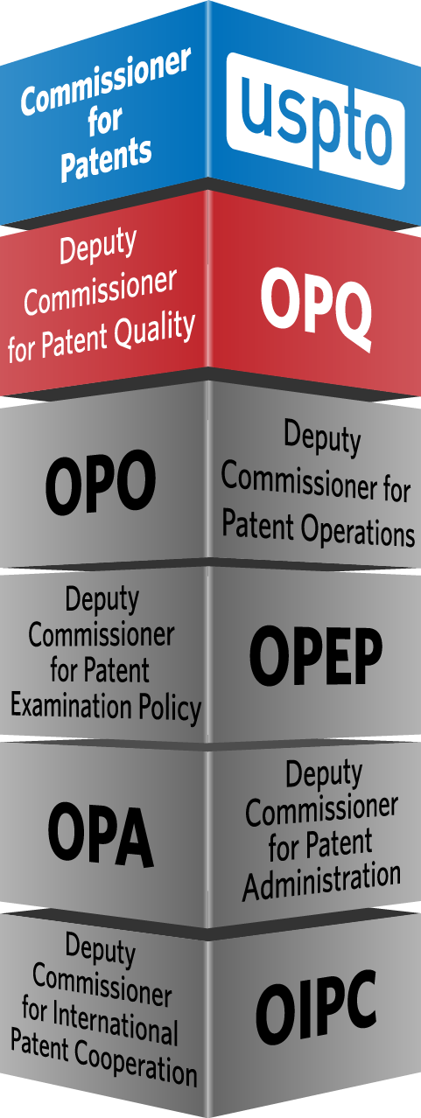
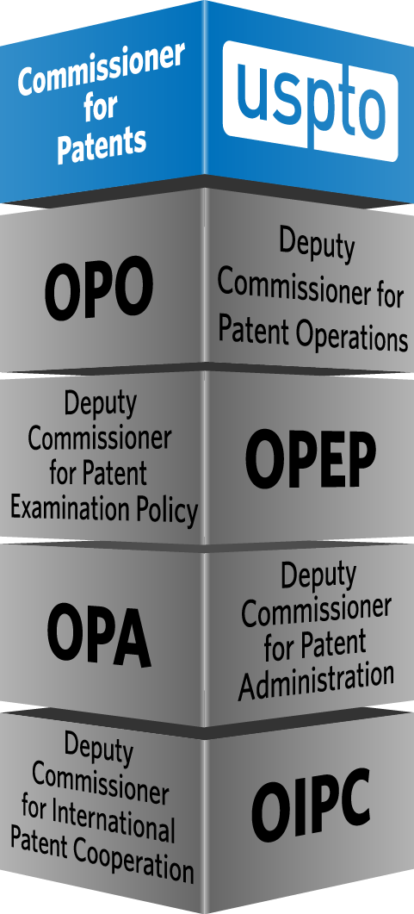
Organizational Structure
for Patents at the USPTO
BEFORE AFTER
Focusing on Patent Quality with a
NEW DEPUTY COMMISSIONER’S OFFICE
Notes:
A before and after diagram of the Patents Organization structure is shown.
The before Patents organization diagram shows:
Commissioner for patents
Deputy Commissioner for Patent Examination Policy (OPEP)
Deputy Commissioner for Patent Examination Policy (OPEP)
Deputy Commissioner for Patent Administration (OPA)
Deputy Commissioner for International Patent Cooperation (OPIPC)
The after diagram shows:
Commissioner for Patents
Deputy Commissioner for Patent Quality (OPQ)
Deputy Commissioner for Patent Operations( OPO)
Deputy Commissioner for Patent Examination Policy (OPEP)
Deputy Commissioner for Patent Administration (OPA)
Deputy Commissioner for International Patent Cooperation (OIPC)

Slide 8
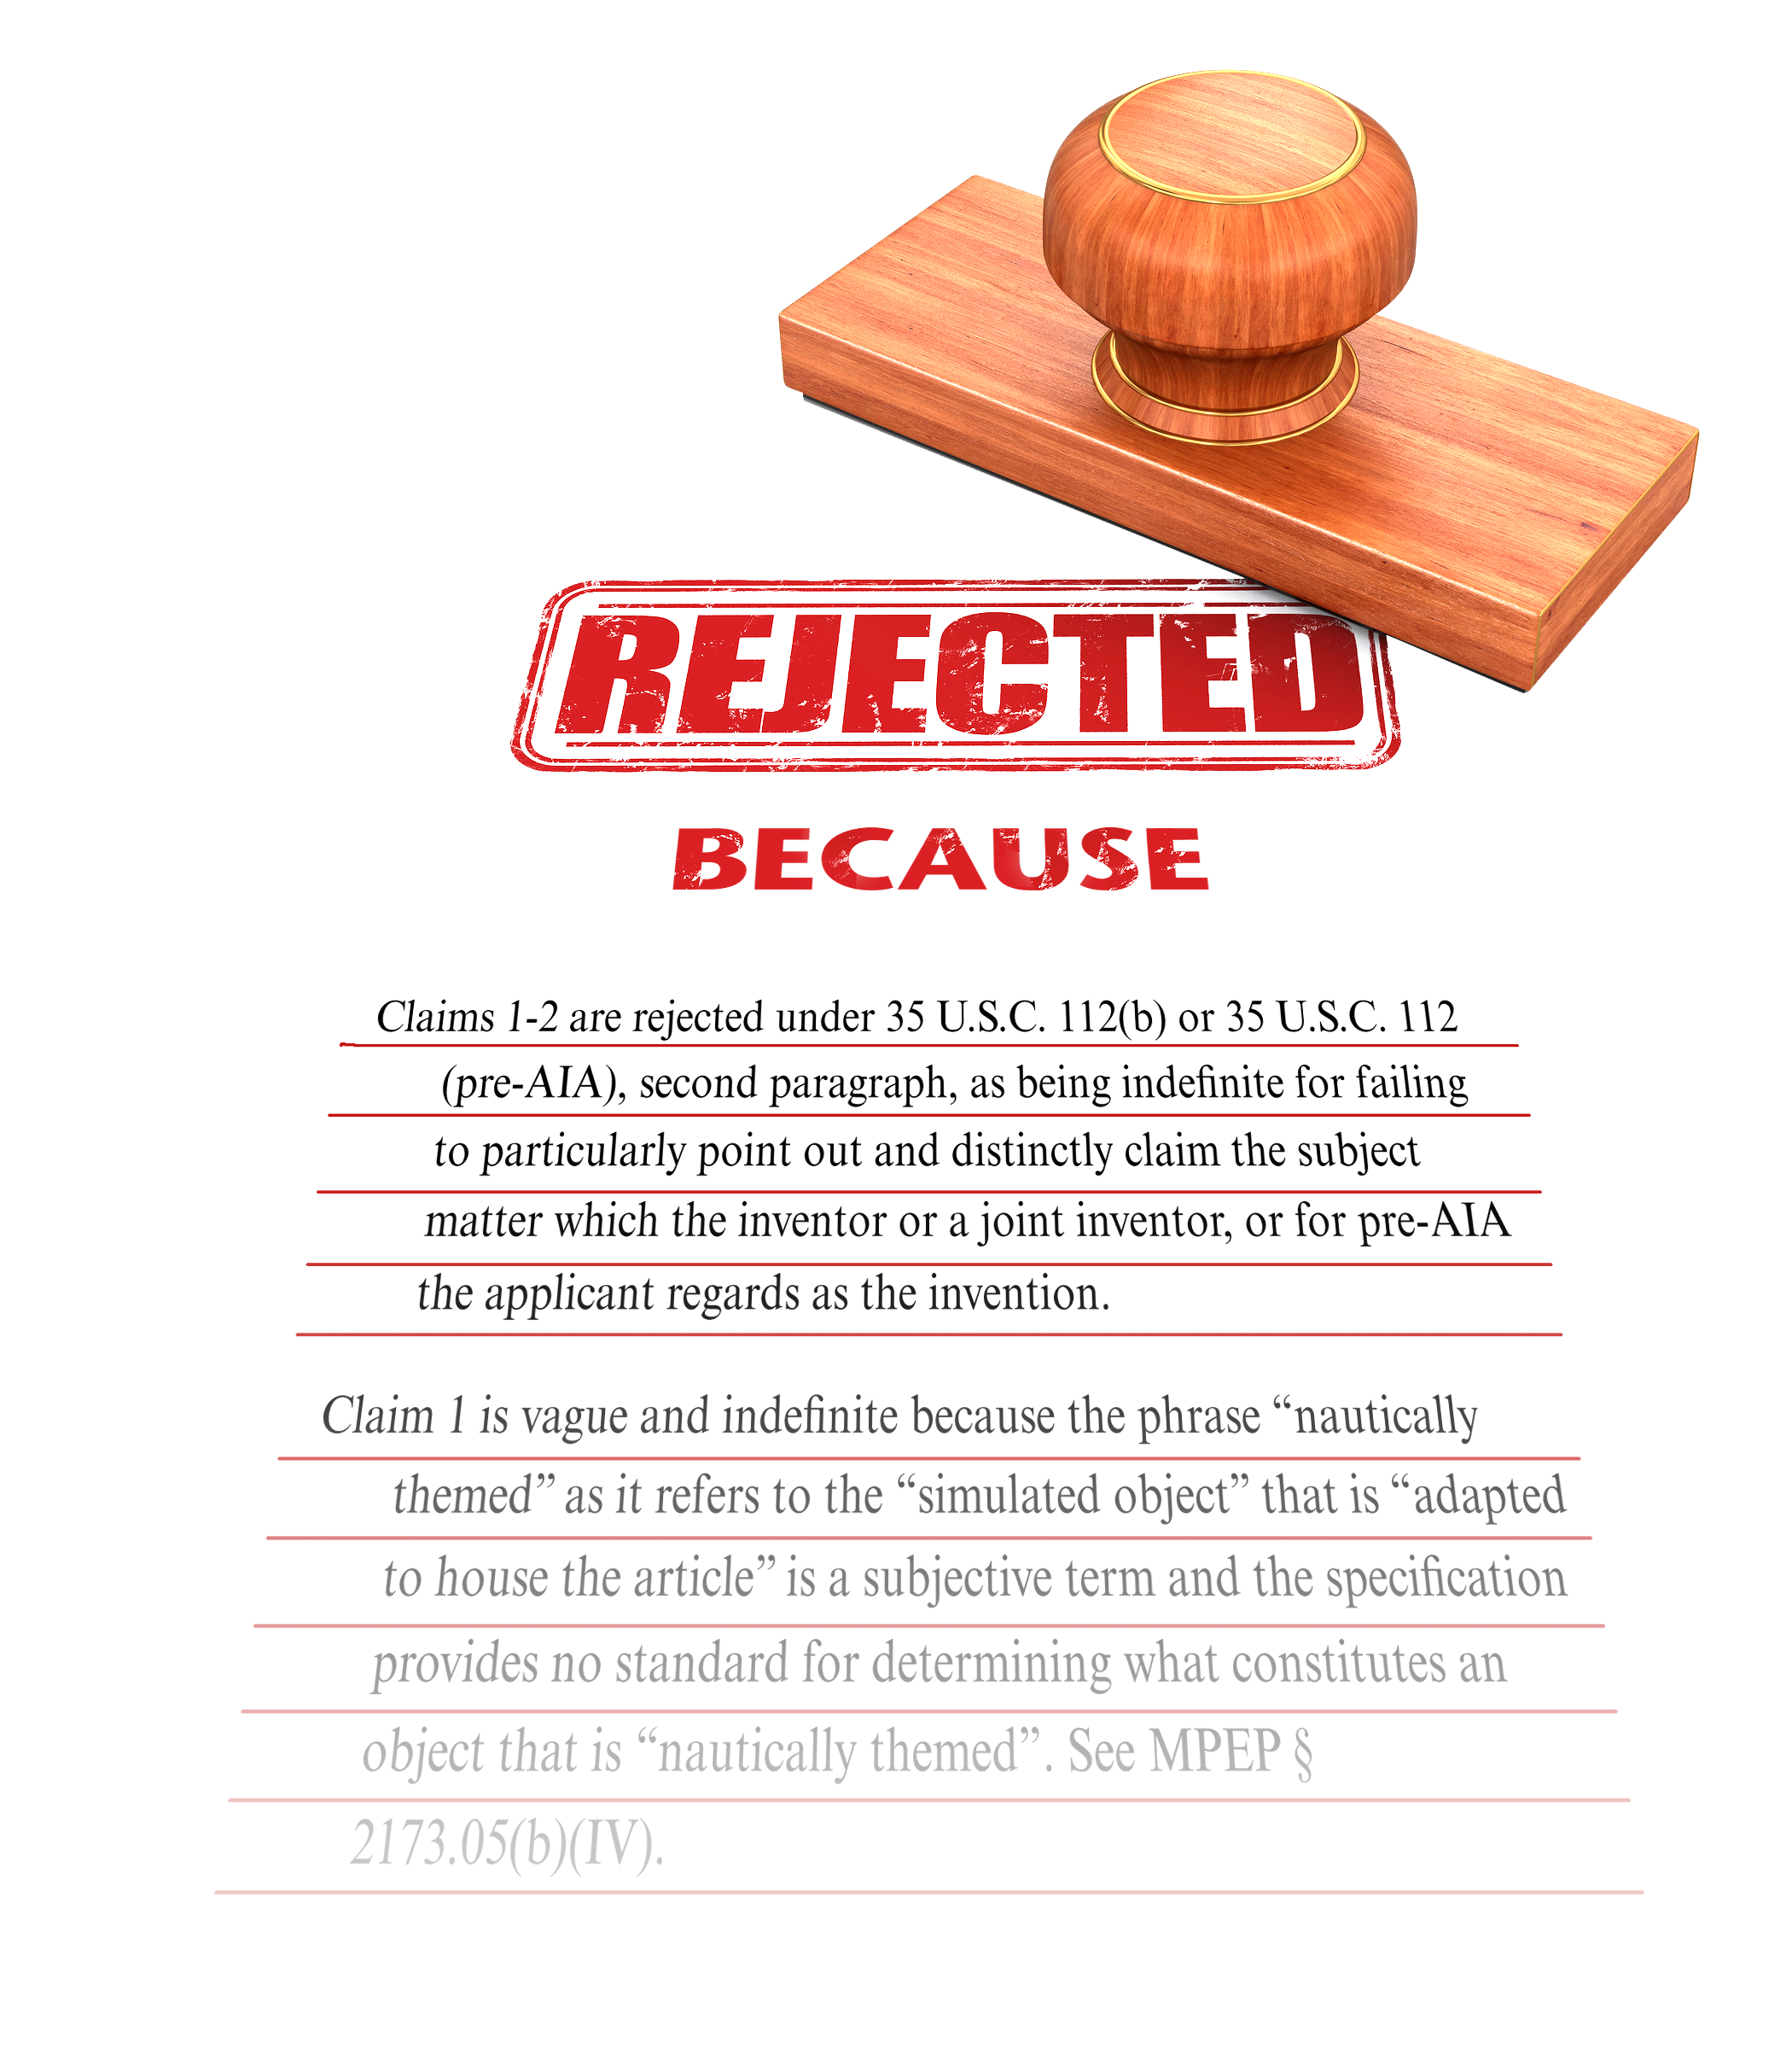

Prosecution
Enhancements
CLARIFYING
the scope of the claims and
the entire prosecution record
BEFORE AFTER
Notes:
A before and after diagram of Prosecution Enhancements is shown.
In the before portion of the diagram is a picture of a rubber stamp with the word “Rejected” shown which is blurry.
In the after portion of the diagram is a picture of a rubber stamp with the word “Rejected” shown clearly with other text showing a clarified prosecution record.
As part of the Enhanced Patent Quality Initiative we have looked at:
Prosecution Enhancements which clarifying the scope of the claims and the entire prosecution record
We established a pilot program to address clarity of the record, where examiners assess best practices to achieve record clarity—whether by putting interpretations of key claim terms on the record, by more completely recording an interview summary, or by documenting reasons for allowance.

Slide 9
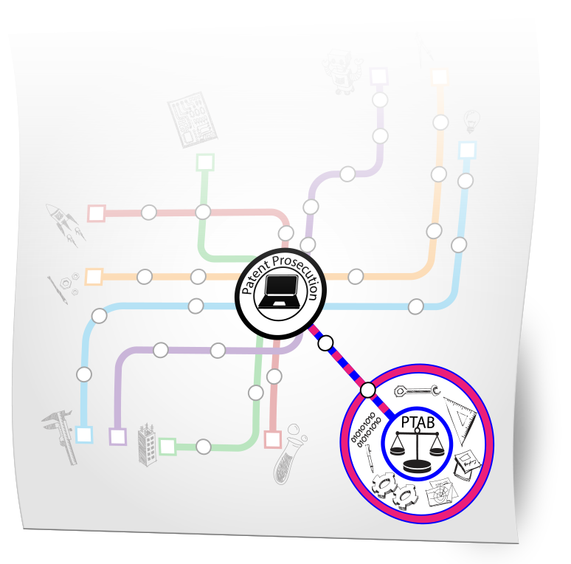
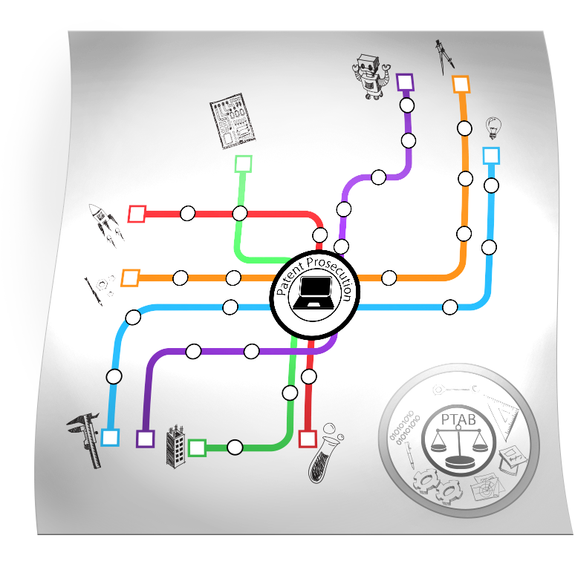
Post-Examination
Enhancements
Enriching pending
patent prosecution with
INFORMATION FROM
POST GRANT PROCEEDINGS
BEFORE AFTER
Notes:
A before and after diagram of Post-Examination Enhancements is shown.
In the before portion of the diagram is a picture of a patent prosecution process map with a diagram of the PTAB not connected to the patent prosecution map.
In the after portion of the diagram is a picture of a patent prosecution process map with a diagram of the PTAB connected to the patent prosecution map showing enriched patent prosecution with information from post grant proceedings provided to the prosecution process.

Slide 10


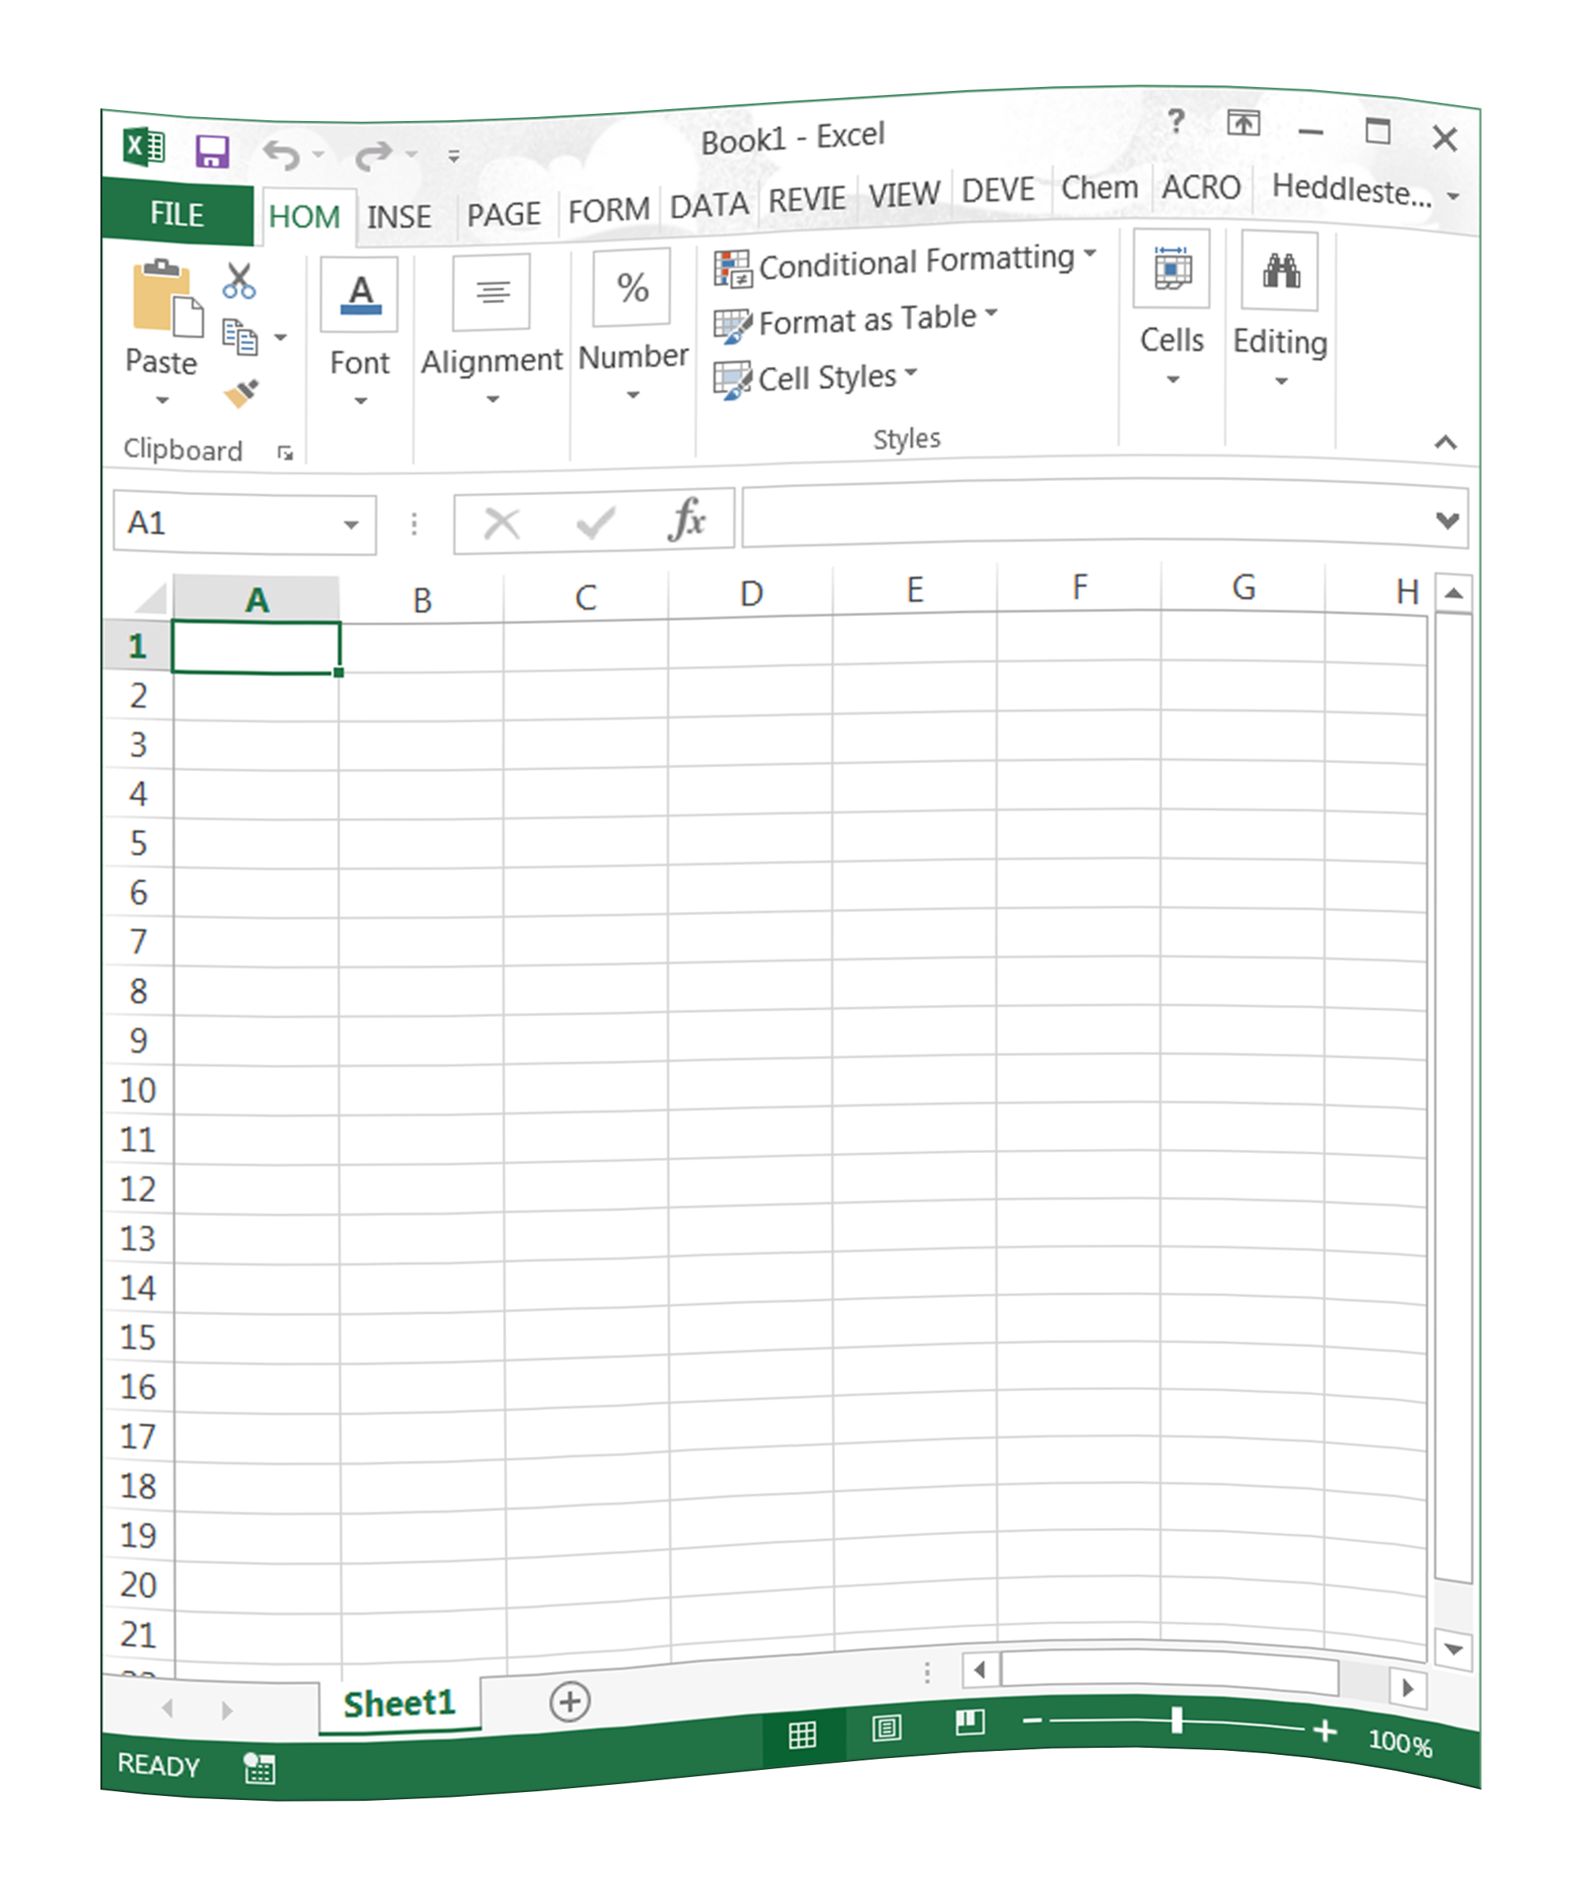
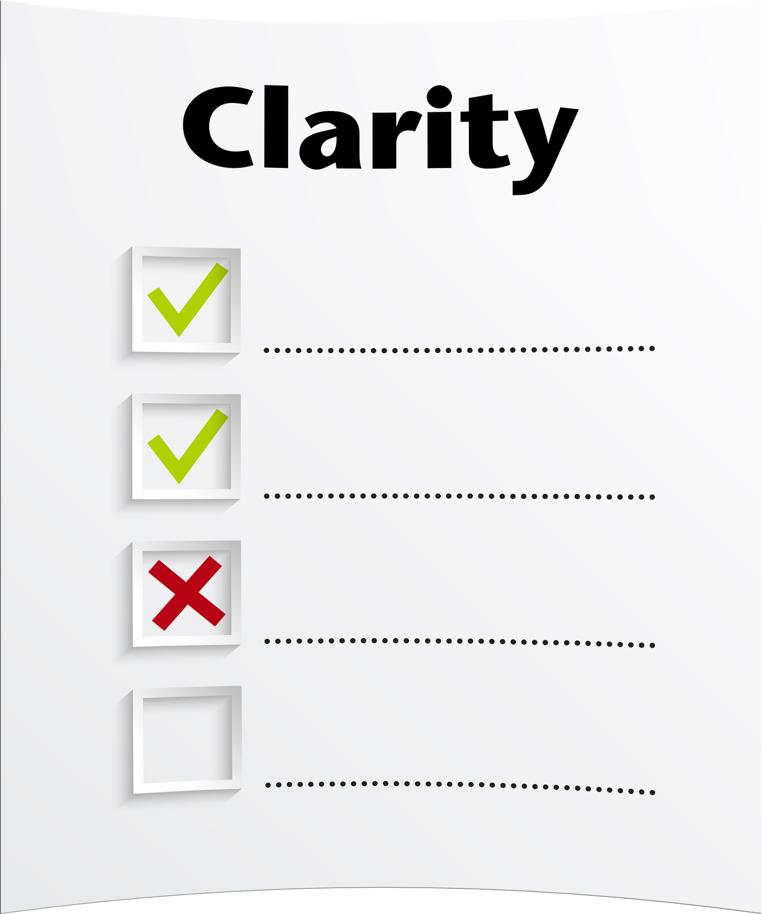

Improving Evaluation
of examination
UNIFYING
QUALITY REVIEW
to focus squarely on
correctness and clarity
BEFORE AFTER
Notes:
A before and after diagram of Improving Evaluation of examination is shown.
In the before portion of the diagram is a picture of many different evaluation methods used during the quality review process of an application.
In the after portion of the diagram is a picture of clarity and correctness evaluation methods used during the quality review process of an application which represents a unified quality review process which focuses squarely on correctness and clarity
We have developed some new quality control measures that we believe will make a big difference.
We focus to the same degree on correctness of a patentability decision and clarity of the record.
We did not capture our review results in a single database, making it very difficult to identify trouble spots.

Slide 11



Search and Training
Enhancements
New tools to
assist in identifying the
BEST PRIOR ART
BEFORE AFTER
Notes:
A before and after diagram of Search and Training enhancements are represented.
In the before portion of the diagram is a picture of many different prior art references in one large stack is shown.
In the after portion of the diagram is a picture of many different prior art references in a stack is shown with a magnify glass showing three references from the stack which represents the new tools being developed in the enhanced patent quality initiative to assist in identifying the best prior art.

Slide 12
Quality Enhancing Programs
Search & Training Enhancements
Prosecution Enhancements
Post-Examination Enhancements
Improving Evaluation of Examination

Slide 13
Quality Enhancing Programs:
I. Search & Training Enhancements
Maria Holtmann, Director of International Programs, Office of International Patent Cooperation (OIPC)
Don Hajec, Assistant Deputy Commissioner for Patent Operations

Slide 14
Search & Training Enhancements
Auto Pre-Examination Search
Collaborative Search Pilot (CSP)
Global Dossier
Science and Technical Information Center (STIC) Awareness Program
Technical and Legal Training

Slide 15
Automated Pre-Exam Search
Objective:
Leverage modern technologies to identify prior art for the examiner prior to examination
Optimize searching technology to keep pace with advancements in the field
Benefits:
To provide a useful prior art baseline that represents the current state of the technology in each patent application
Improve examination quality by providing that art to the examiners

Slide 16


Office of International Patent Cooperation (OIPC)
Improve the quality, efficiency and predictability of patent family prosecution, thereby improving the certainty of global patent rights
Improving Global Worksharing
Develop office processes to assist in global worksharing
Increase efficiency of applicant processes to improve global worksharing
Resolve legal issues hindering global worksharing
Provide IT solutions to enhance global worksharing
Notes:
Improving Global Worksharing shows improving the quality efficiency and predictability of patent family prosecution, thereby improvingthe certainty of global patent rights.
Develop office processes to assist in global worksharing
Increase efficiency of applicant processes to improve global worksharing
Resolve legal issues hindering global worksharing Provide IT solutions to enhance global worksharing

Slide 17
Collaborative Search Pilots (CSPs)
Cooperating with JPO and KIPO where search and examination results are shared prior to first action
  JPO: Search reports contain input from both offices
  KIPO: Search reports sent to applicant independently
Evaluating the difference between consolidating prior art and proposed rejections vs. sending independent views
Determining if examiners benefit from work products from the other offices

Slide 18
Collaborative Search Pilot: Overview
Based on the First Action Interview (FAI) program
  Claim limitations: 3 independent/20 total
  Claims must correspond
No cost for the petition to enter the pilots
Applications are made special and taken out of turn
Pilots run for 2 years, ending in 2017
Evaluation based on feedback from:
  Examiners – usability of the references
  Applicants – usefulness of the collaborative search

Slide 19
Collaborative Search Pilot: Potential Impacts
Improved information for decision-making earlier in prosecution:
  Applicants receive results of both searches conducted in the native language and prior art databases of each office
Greater consistency in examination across offices leading to more certainty of IP rights
Rapid acquisition of IP rights

Slide 20

Global Dossier
Global Dossier is a set of business services modernizing the global patent system and delivering benefits to all stakeholders
Five participating Offices
IP5
Notes:
Global Dossier is a set of business of business services modernizing the global patent system and delivering benefits to all stakeholders
The diagram shows the five participating IP% Offices - JPO, EPO, USPTO, SIPO and KIPO

Slide 21
Global Dossier Services
First Service: Dossier Access
One-stop access to a user-friendly interface into the dossiers of related applications filed at participating offices
Each participating office provides its own Global Dossier portal
Available to examiners and the public
Coming Soon
Expansion beyond the IP5
Automatic cross-filing of forms
And more …

Slide 22
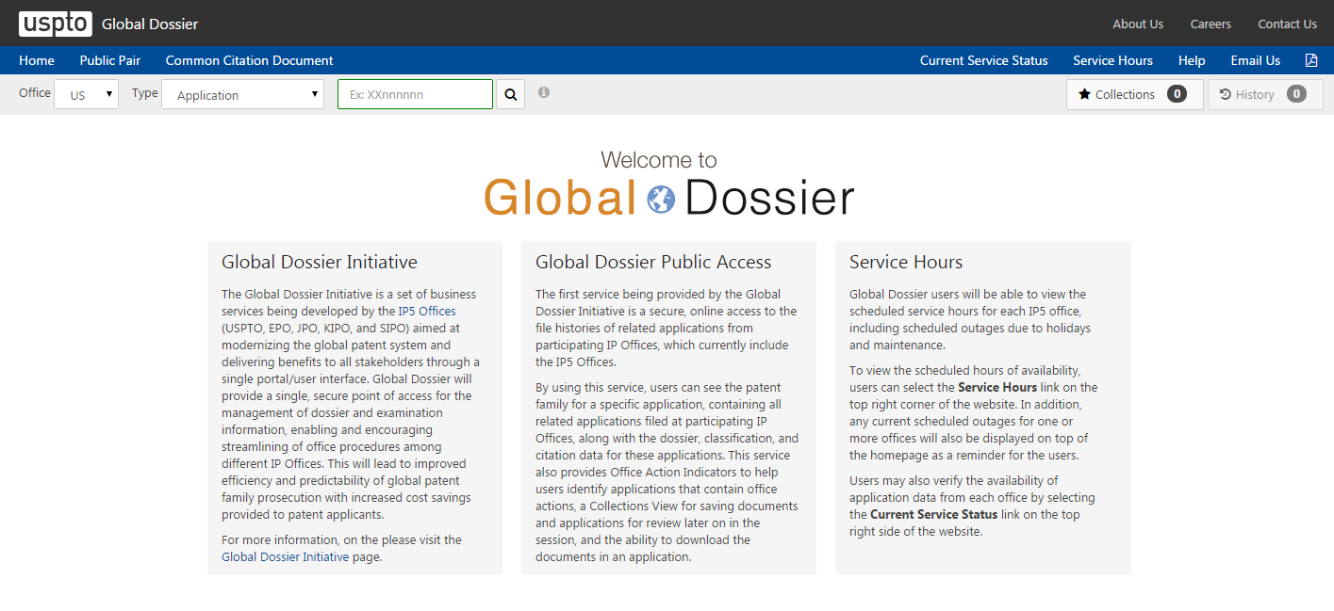
Global Dossier Public Access http://globaldossier.uspto.gov/#/
Notes:
Global Dossier Public Access online screenshot at http://globaldossier.uspto.gov/#/

Slide 23
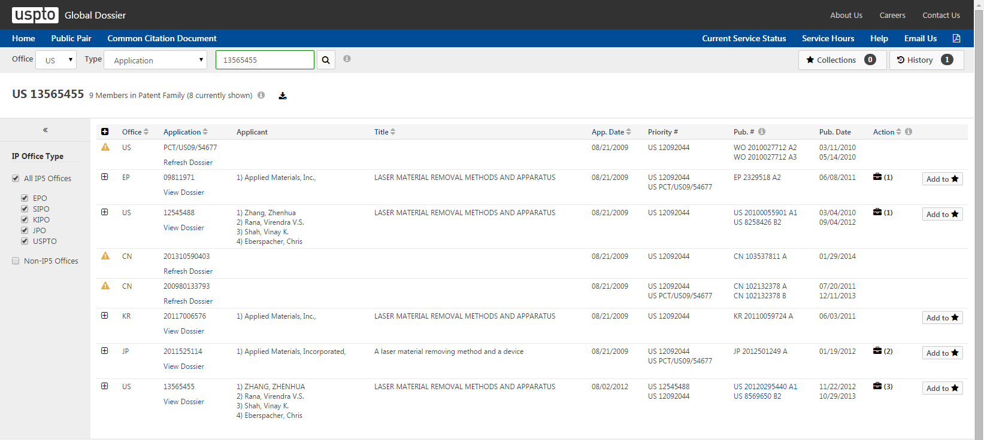
Global Dossier Public Access Service http://globaldossier.uspto.gov/#/
Notes:
Global Dossier Public Access Service online screenshot at http://globaldossier.uspto.gov/#/

Slide 24
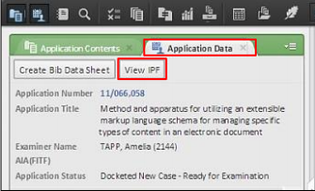
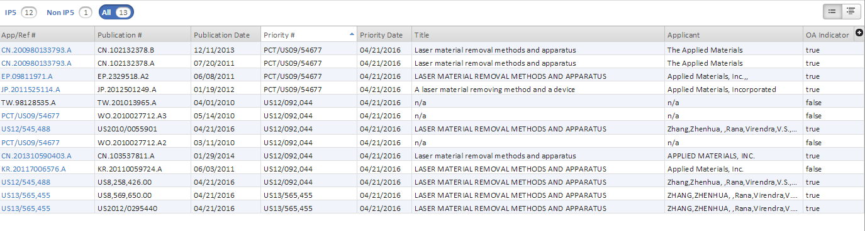
Global Dossier International Patent Family Service
Notes:
From an open application, select the Application Data tab and click View IPF. The IPF Application List window opens, with an International Patent Family List (IPF). The list contains applications that share a common priority to the US application, and includes publication numbers, publication dates, priority data, titles, applicant’s names, and Office Action availability status. Click an application in the list to view the dossier data of a specific application.

Slide 25
Global Dossier Potential Impacts
Access to prior art earlier in the examination process improving patent quality
Greater consistency in examination and prosecution across offices leading to more certainty of IP rights
Increased efficiency and cost savings

Slide 26
Contact Information
Collaborative Search Pilots
  E-mail: CSP@uspto.gov
  Website: http://www.uspto.gov/patents-getting-started/international-protection/collaborative-search-pilot-program-csp
Global Dossier
E-mail: GlobalDossier@uspto.gov
Website: http://globaldossier.uspto.gov/

Slide 27
Quality Enhancing Programs:
I. Search & Training Enhancements
Maria Holtmann, Director of International Programs, Office of International Patent Cooperation (OIPC)
Don Hajec, Assistant Deputy Commissioner for Patent Operations

Slide 28
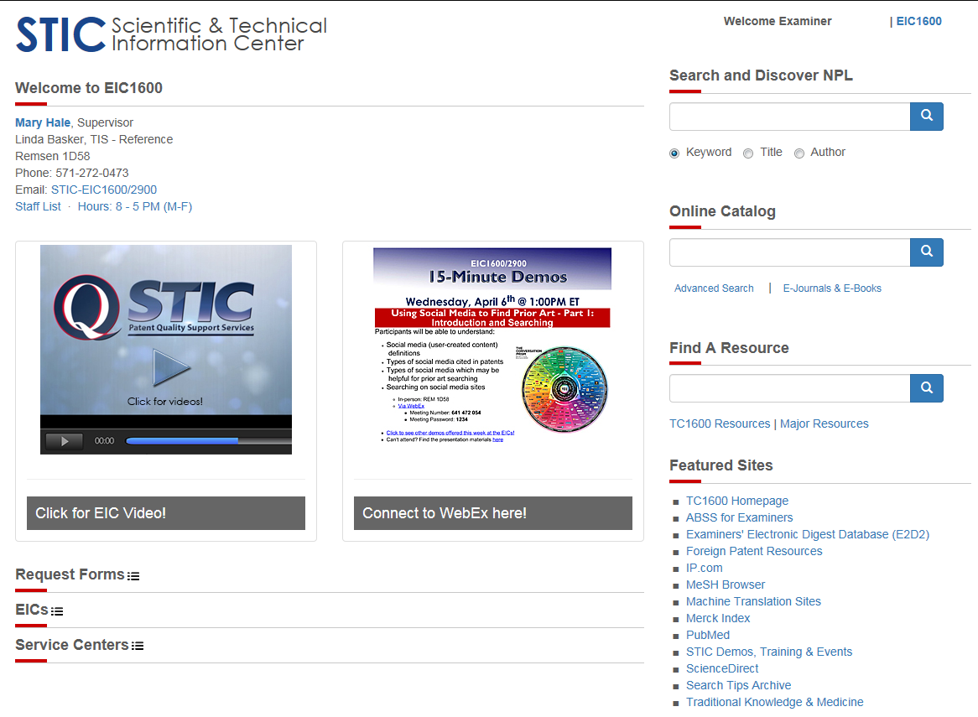
STIC Awareness Program
Notes:
Online screenshot of Scientific and Technical Information Center (STIC) resource page.
Search and Discover NPL
_online Catalog
Find a Reource
Featured Sites
15- Minute Demos

Slide 29
Scientific and Technical Information Center (STIC): Examiner Resources
Electronic Information Centers (EICs)
  Search Strategy Experts
  Non-Patent literature searchers and document delivery
  Copies of foreign patents, translations
  DNA/protein sequence searching systems
Non-Patent Literature (NPL) website
AskSTIC Group Chat
STIC 15-minute demos, CBTs

Slide 30
Technical and Legal Training
Patent Examiner Technical Training Program (PETTP)
Site Experience Education (SEE) Program
Non-duty Technical Training
Stakeholder Training on Examination Practice and Procedure (STEPP)
Improving Clarity and Reasoning in Office Actions (ICR) Training

Slide 31
Technical and Legal Training
Patent Examiner Technical Training Program (PETTP)
Site Experience Education (SEE) Program
Non-duty Technical Training
Stakeholder Training on Examination Practice and Procedure (STEPP)
Improving Clarity and Reasoning in Office Actions (ICR) Training

Slide 32
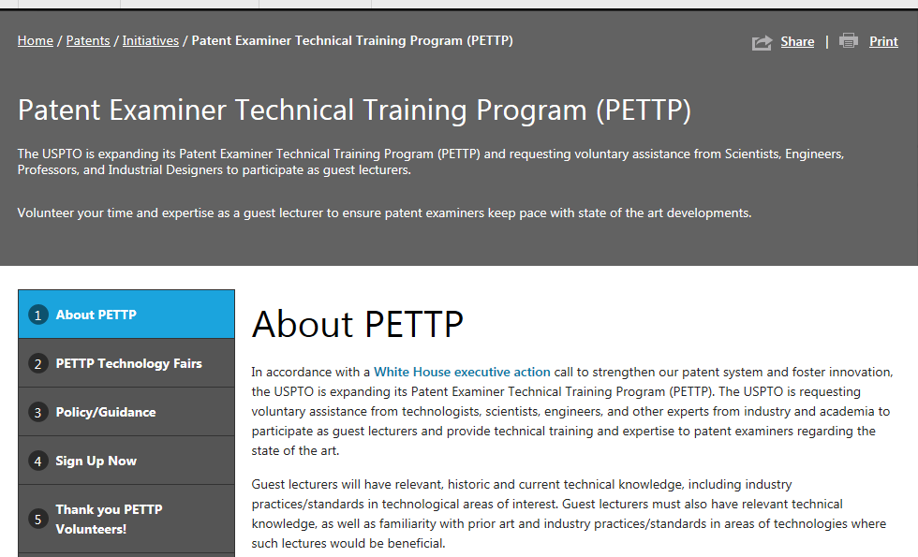
PETTP Website http://www.uspto.gov/patent/initiatives/patent-examiner-technical-training-program-pettp-0
Notes:
Patent Examiner Technical Training Program (PETTP) online screenshot at http://www.uspto.gov/patent/initiatives/patent-examiner-technical-training-program-pettp-0
The USPTO is expanding its Patent Examiner Technical Training program (PETTP) and requesting voluntary assistance from Scientists, Engineers, professors and industrial designers to participate as guest lecturers.

Slide 33
Technical and Legal Training
Patent Examiner Technical Training Program (PETTP)
Site Experience Education (SEE) Program
Non-duty Technical Training
Stakeholder Training on Examination Practice and Procedure (STEPP)
Improving Clarity and Reasoning in Office Actions (ICR) Training

Slide 34
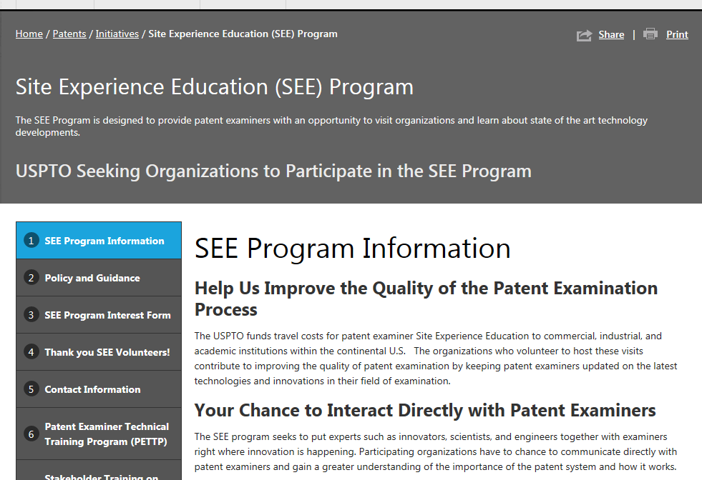
SEE Website http://www.uspto.gov/patent/initiatives/site-experience-education-see-program
Notes:
Site Experience Education (SEE) Program online screenshot at http://www.uspto.gov/patent/initiatives/site-experience-education-see-program
The See program is designe0 to provide patent examiners with an opportunity to visit organizations and learn about state of the art technology.

Slide 35
Technical and Legal Training
Patent Examiner Technical Training Program (PETTP)
Site Experience Education (SEE) Program
Non-duty Technical Training
Stakeholder Training on Examination Practice and Procedure (STEPP)
Improving Clarity and Reasoning in Office Actions (ICR) Training

Slide 36
Technical and Legal Training
Patent Examiner Technical Training Program (PETTP)
Site Experience Education (SEE) Program
Non-duty Technical Training
Stakeholder Training on Examination Practice and Procedure (STEPP)
Improving Clarity and Reasoning in Office Actions (ICR) Training

Slide 37
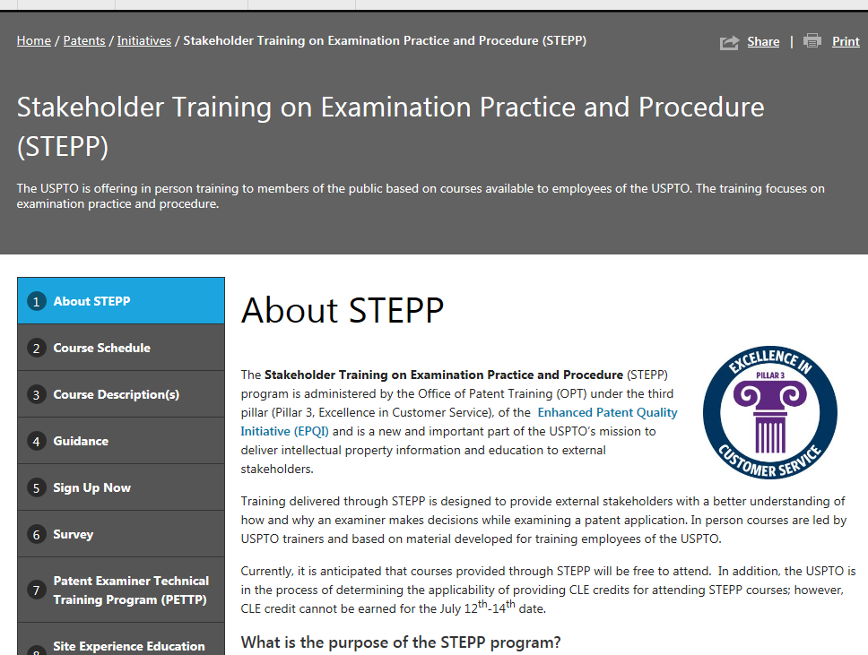
STEPP Website http://www.uspto.gov/patent/initiatives/stakeholder-training-examination-practice-and-procedure-stepp
Notes:
Stakeholder training on Examination Practice and Procedure (STEPP) online screenshot at http://www.uspto.gov/patent/initiatives/stakeholder-training-examination-practice-and-procedure-stepp
The USPTO is offering in person Training to members of the public based on courses available to employees of the USPTO. The training focuses on examination practice and procedure.

Slide 38
Technical and Legal Training
Patent Examiner Technical Training Program (PETTP)
Site Experience Education (SEE) Program
Non-duty Technical Training
Stakeholder Training on Examination Practice and Procedure (STEPP)
Improving Clarity and Reasoning in Office Actions (ICR) Training

Slide 39
Initial Focus: Functional Language Invoking 35 U.S.C. 112(f)
  35 U.S.C. 112(f): Identifying Limitations that Invoke § 112(f)
    Recognizing § 112(f) limitations that do not use classic “means for” phrasing
    Interpreting “generic placeholders” that serve as substitutes for means (e.g., unit, mechanism)
  35 U.S.C. 112(f): Making the Record Clear
  Clarifying the record to place remarks in the file regarding when § 112(f) is, or is not, invoked
  Establishing presumptions based on use of “means”
  Providing explanatory remarks when presumptions are rebutted

Slide 40
Initial Focus: Functional Language Invoking 35 U.S.C. 112(f) (cont.)
  35 U.S.C. 112(f): Broadest Reasonable Interpretation and Definiteness of § 112(f) Limitations
    How to interpret § 112(f) limitations under the broadest reasonable interpretation (BRI) standard
    Evaluating equivalents
    Determining whether a § 112(f) limitation is definite under § 112(b)
  35 U.S.C. 112(f): Evaluating § 112(f) Limitations in Software-Related Claims for Definiteness under 35 U.S.C. 112(b)
    Determining whether a sufficient algorithm is provided to support a software function

Slide 41
Reinforcing Claim Interpretation
  Broadest Reasonable Interpretation (BRI) and the Plain Meaning of Claim Terms
    Using plain meaning unless the application uses a special definition or disclaims scope
    Explaining claim interpretation on the record
  Examining Functional Claim Limitations: Focus on Computer/Software-related Claims
    Detailed guidance on addressing issues unique to functional claim language when § 112(f) is not invoked
    Clarifying the record by fully addressing functional claim language

Slide 42
Turning to Written Description and Enablement
  Examining Claims for Compliance with 35 U.S.C. 112(a): Part I Written Description
    Focus on Electrical/Mechanical and Computer/Software-related Claims
    Making the prosecution record clear regarding the adequacy of the application disclosure
  Examining Claims for Compliance with 35 U.S.C. 112(a): Part II – Enablement
    Focus on Electrical/Mechanical and Computer/Software-related Claims
    Determining whether the specification enables the full scope of claims with functional language
  35 U.S.C. 112(a): Written Description Workshop
    Used as a companion to the 35 U.S.C. 112(a) Written Description training module
    Reinforced the principles of the training

Slide 43
Utilizing 35 U.S.C. 112(b) to Clarify the Record
  § 112(b): Enhancing Clarity By Ensuring That Claims Are Definite Under 35 U.S.C. 112(b)
    Understand how enforcing the § 112(b) definiteness requirement enhances patent quality and clarity
    Identify the critical roles of examiners and applicants in enhancing clarity of the claims and the prosecution record
    Recognize the importance of explaining the grounds of rejection when the boundaries of the claim are unclear to provide a thorough written record

Slide 44
Focusing on Clarity in Subject Matter Eligibility Analysis
  2014 Interim Guidance on Patent Subject Matter Eligibility
    Focus on 2014 Interim Guidance on Patent Subject Matter Eligibility issued December 16, 2014
  Abstract Idea Example Workshops I & II
    Focus on identifying abstract ideas, evaluating additional elements, how to write a proper rejection, and identifying statutory subject matter

Slide 45
Highlighting Reasons for Allowance as a Tool for Clarity
  Enhancing Clarity By Ensuring Clear Reasoning of Allowance Under C.F.R. 1.104(e) and MPEP 1302.14
    Improve the quality and reliability of issued patents by providing a complete file history
    Facilitate the public’s evaluation of a patent’s scope and strength, as well as simplification of any potential patent litigation related thereto
    Remind examiners that reasons for allowance should be provided in an application when the examiner believes that the record as a whole does not make clear his/her reasons for allowing a claim or claims

Slide 46
Improving Clarity and Reasoning (ICR) Training: Impacts
After training, examiners are surveyed on the following
  Class format
  Course materials and/or examples
  Length of the training
More than 80% of those taking the survey agree that the format, materials, and length of the training was appropriate for their learning and retention

Slide 47
Upcoming Training Topics
  35 U.S.C. 101: Subject Matter Eligibility Workshop III: Formulating a Subject Matter Eligibility Rejection and Evaluating the Applicant’s Response to a Subject Matter Eligibility Rejection
    Designed to assist examiners in applying the 2014 Interim Guidance on Patent Subject Matter Eligibility (Interim Eligibility Guidance) and the July 2015 Update: Subject Matter Eligibility
    Focus on responding to applicant argument
  35 U.S.C. 112(b): Interpreting Functional Language and Evaluating Claim Boundaries - Workshop
    Examples from each discipline
    Focus on writing a complete explanation when the metes and bounds of certain language is unclear
    Tips on making suggestions for resolving issues of unclear boundaries

Slide 48
Improving Clarity and Reasoning (ICR) Training Resources
Examination Guidance and Training Materials
http://www.uspto.gov/patent/laws-and-regulations/examination-policy/examination-guidance-and-training-materials
White House Executive Actions: Executive Action 2: Clarity in Patent Claims
http://www.uspto.gov/patent/initiatives/uspto-led-executive-actions-high-tech-patent-issues
Software Partnership
http://www.uspto.gov/patent/initiatives/software-partnership

Slide 49
Quality Enhancing Programs
Search & Training Enhancements
Prosecution Enhancements
Post-Examination Enhancements
Improving Evaluation of Examination

Slide 50
Quality Enhancing Programs:
II. Prosecution Enhancements
Robin Evans, Director, Technology Center 2800

Slide 51
Prosecution Enhancements
After-final Consideration Pilot (AFCP) 2.0 and Pre-appeal Conference Re-evaluation
Patents Ombudsman
Interviews
Patents Petitions Timeline
Clarity of the Record Pilot

Slide 52
Prosecution Enhancements
After-final Consideration Pilot (AFCP) 2.0 and Pre-appeal Conference Re-evaluation
Patents Ombudsman
Interviews
Patents Petitions Timeline
Clarity of the Record Pilot

Slide 53
Prosecution Enhancements
After-final Consideration Pilot (AFCP) 2.0 and Pre-appeal Conference Re-evaluation
Patents Ombudsman
Interviews
Patents Petitions Timeline
Clarity of the Record Pilot

Slide 54
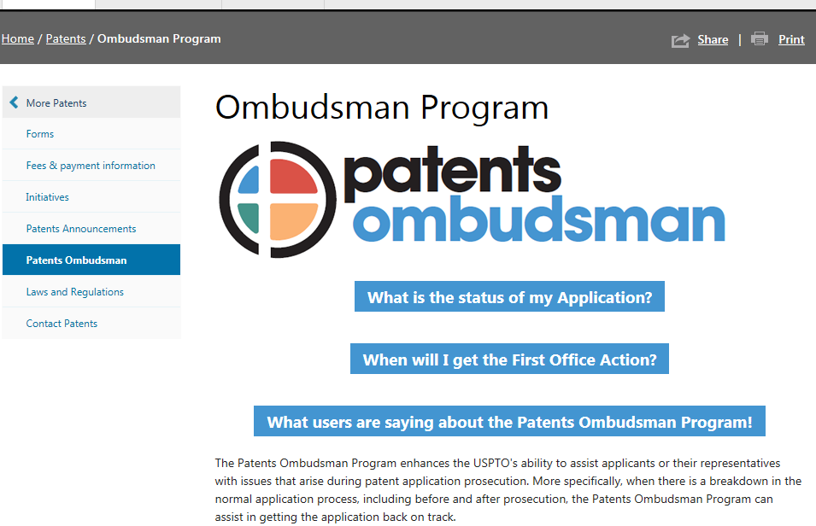
Patents Ombudsman website http://www.uspto.gov/patent/ombudsman-program
Notes:
Patents Ombudsman website on screenshot at http://www.uspto.gov/patent/ombudsman-program
The Patents Ombudsman program enhances the USPTO’s ability to assist applicants or their representatives with issues that arise during patent application prosecution. More specifically, when there is a breakdown in the normally application process, including before and after prosecution, the Patents Ombudsman Program can assist in getting the application back on track.

Slide 55
Prosecution Enhancements
After-final Consideration Pilot (AFCP) 2.0 and Pre-appeal Conference Re-evaluation
Patents Ombudsman
Interviews
Patents Petitions Timeline
Clarity of the Record Pilot

Slide 56
Interview Time FY 2008- 2015
Notes:
In FY08 Ave # of interview hrs per examiner was approximately 13 hrs
In FY 15, the average had increased to over 27 hrs per examiner

Slide 57
Percent of Disposals Having at Least One Interview
31.1% of Serial Disposals completed in September 2015 had at least one interview.
Notes:
31.1% percent of disposals completed in September 2015 had at least one interview.

Slide 58
TC Interview Specialists
Subject matter expert on interview practice and policy in each Technology Center
The list of TC Specialists can be found here:
  http://www.uspto.gov/patent/laws-and-regulations/interview-practice/interview-specialist
Specialists can provide One-on-One Training to help applicants utilize WebEx video conferencing tools (email your request to ExaminerInterviewPractice@uspto.gov)

Slide 59
Making Video Conferencing and Collaboration Easier
  Fully equipped video conference rooms are available for reservation on each USPTO campus
Internet Usage Policy has been updated to permit verbal authorization for video conferencing tools
  MPEP § 502.03 now allows a verbal request to authorize a video conferencing, instead of submitting a written request.
Examiners set up video conferencing for interview using WebEx, a web-based service that you can use it from any computer (Windows, Mac, Linux, or Solaris) with no software needed.

Slide 60
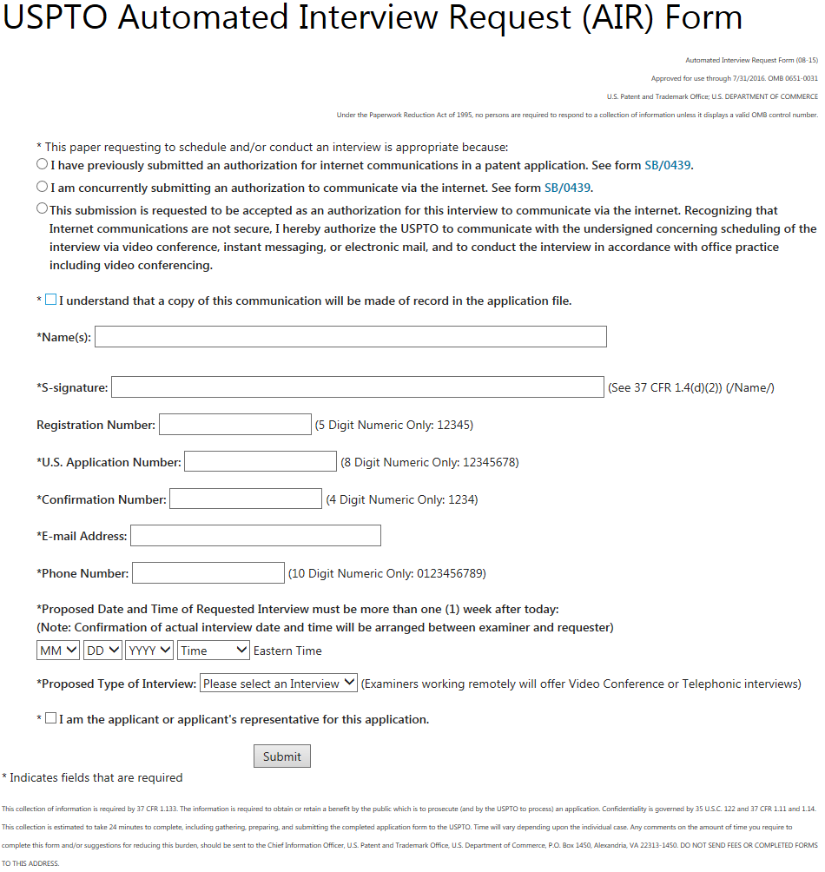
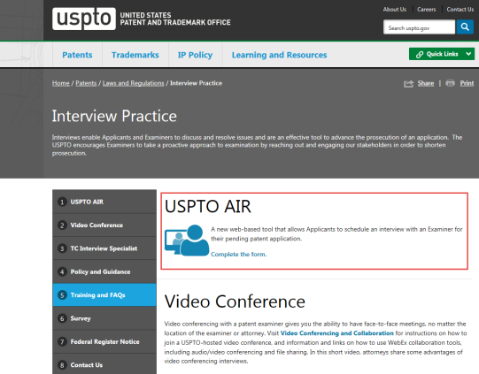
Interview Practice website http://www.uspto.gov/patent/laws-and-regulations/interview-practice
AIR form allows applicants to schedule an interview with an examiner for their pending patent application
Notes:
Interview Practice website screenshot at http://www.uspto.gov/patent/laws-and-regulations/interview-practice
USPTO Automated Interview Request (AIR) Form allows applicants to schedule aqn interview with an examiner for their pending patent application.

Slide 61
Prosecution Enhancements
After-final Consideration Pilot (AFCP) 2.0 and Pre-appeal Conference Re-evaluation
Patents Ombudsman
Interviews
Patents Petitions Timeline
Clarity of the Record Pilot

Slide 62
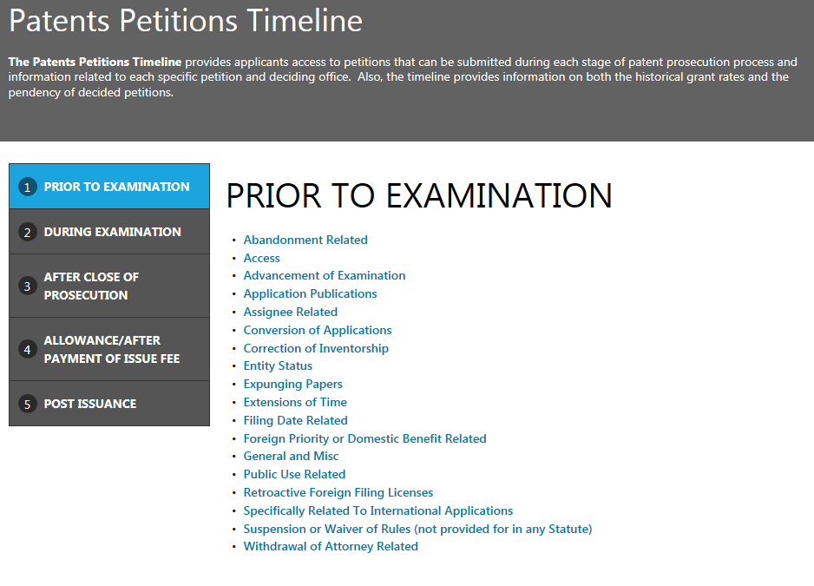
Patents Petitions Timeline http://www.uspto.gov/patents-application-process/petitions/timeline/patents-petitions-timeline#step1
Notes:
Patents Petitions Timeline online screenshot at http://www.uspto.gov/patents-application-process/petitions/timeline/patents-petitions-timeline#step1
Based on that input, USPTO has developed a new Patents Petitions Timeline that provides easy-to-use information in a single page on our website about petitions filed with the Office.
Petitions (for example, to revive an application, for correction of inventorship, or to file a Track 1 request) can be submitted during each stage of the patent prosecution process, and the timeline provides applicants with information on each specific petition. Specifically, the timeline provides information relating to the deciding office, as well as information on both the historical (12-month rolling average) grant rates and the pendency of decided petitions. The timeline also provides links to specific sections of the MPEP or other parts of the USPTO website that provide more detailed information on how to file each particular petition.

Slide 63
Patents Petitions Timeframes
Prior to Examination
During Examination
After Close of Prosecution
Allowance/After Payment of Issue Fee
Post Issuance

Slide 64
Patents Petitions Timeline Example 1
Notes:
Based on that input, USPTO has developed a new Patents Petitions Timeline that provides easy-to-use information in a single page on our website about petitions filed with the Office.
Petitions (for example, to revive an application, for correction of inventorship, or to file a Track 1 request) can be submitted during each stage of the patent prosecution process, and the timeline provides applicants with information on each specific petition. Specifically, the timeline provides information relating to the deciding office, as well as information on both the historical (12-month rolling average) grant rates and the pendency of decided petitions. The timeline also provides links to specific sections of the MPEP or other parts of the USPTO website that provide more detailed information on how to file each particular petition.
By providing as much detailed information as possible at every stage of the patent prosecution process, our customers will be able to make more informed decisions on when and how to file a petition and who to contact with questions. Accordingly, the Patents Petition Timeline supports the USPTO’s Enhanced Patent Quality Initiative of providing excellent customer service.
And it also furthers the USPTO’s Open Data initiative by taking another step towards increasing the transparency of the USPTO and making our data open and accessible to the public.
__________
Found under Patents: Application Process/Petitions…there’s the Patents Petitions Timeline
Identifies petitions available at various times during prosecution:
Prior to examination

Slide 65
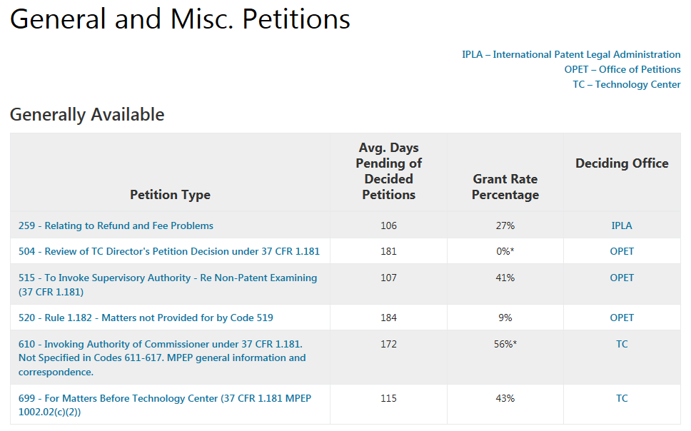
Patents Petitions Timeline Example 1 from Prior to Examination choices
Notes:
The ePetition option is currently available for 12 petitions types. ePetitions are completely filled out online and decisions are instantaneous.

Slide 66
Patents Petitions Timeline Example 2
Notes:
Based on that input, USPTO has developed a new Patents Petitions Timeline that provides easy-to-use information in a single page on our website about petitions filed with the Office.
Petitions (for example, to revive an application, for correction of inventorship, or to file a Track 1 request) can be submitted during each stage of the patent prosecution process, and the timeline provides applicants with information on each specific petition. Specifically, the timeline provides information relating to the deciding office, as well as information on both the historical (12-month rolling average) grant rates and the pendency of decided petitions. The timeline also provides links to specific sections of the MPEP or other parts of the USPTO website that provide more detailed information on how to file each particular petition.
By providing as much detailed information as possible at every stage of the patent prosecution process, our customers will be able to make more informed decisions on when and how to file a petition and who to contact with questions. Accordingly, the Patents Petition Timeline supports the USPTO’s Enhanced Patent Quality Initiative of providing excellent customer service.
And it also furthers the USPTO’s Open Data initiative by taking another step towards increasing the transparency of the USPTO and making our data open and accessible to the public.
__________
Found under Patents: Application Process/Petitions…there’s the Patents Petitions Timeline
Identifies petitions available at various times during prosecution:
Prior to examination

Slide 67
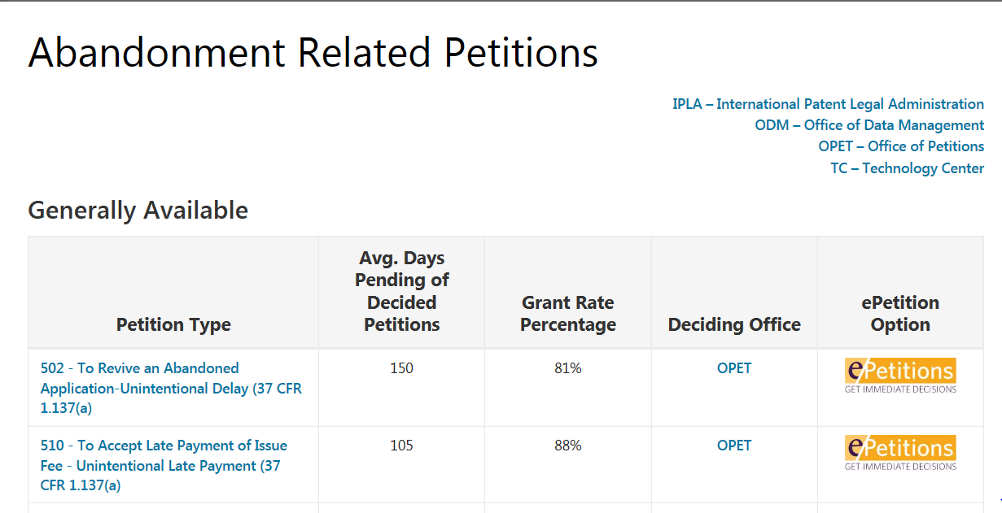
Patents Petitions Timeline Example 2 from Prior to Examination choices
Notes:
The ePetition option is currently available for 12 petitions types. ePetitions are completely filled out online and decisions are instantaneous.

Slide 68
Prosecution Enhancements
After-final Consideration Pilot (AFCP) 2.0 and Pre-appeal Conference Re-evaluation
Patents Ombudsman
Interviews
Patents Petitions Timeline
Clarity of the Record Pilot

Slide 69
Clarity of the Record Pilot: Purpose
This program is to develop best examiner practices for enhancing the clarity of various aspects of the prosecution record and then to study the impact on the examination process of implementing these best practices.

Slide 70
Clarity of the Record Pilot: Short-Range Goals
Enhancing the clarity of the prosecution record
Providing a deeper understanding of the Office’s positions leading to more efficient prosecution of patent applications
Affording greater certainty in the scope of protection granted by the patent

Slide 71
Clarity of the Record Pilot: Long-Range Goals
Identify best practices
Find the correct balance for appropriate recordation
Use data/feedback to assist other quality-enhancing programs, such as:
  in the refinement of Clarity and Correctness Data Capture known as the Master Review Form (MRF)
  for use in conjunction with the Post Grant Outcomes Program

Slide 72
Clarity of the Record Pilot:
Program Overview
Collaborated with examiners to develop a Pilot
Pilot runs for 12 bi-weeks (~6 months)
  March 6 – August 20, 2016
Enhancing recordation in the examination process

Slide 73
Clarity of the Record Pilot:
Areas of Focus
Enhanced documentation of claim interpretation
More precise reasons for allowance
More detailed interview summaries
Pre-search interview at the examiner’s option

Slide 74
Clarity of the Record Pilot:
Current Participants
Examiners
  Approximately 130 participants
  GS 11-15, with at least two years of experience
  Randomly selected individuals, who met the requirements for participation, were invited to volunteer for the pilot
Supervisors (SPEs)
  Approximately 45 participants

Slide 75
Clarity of the Record Pilot:
Examiner Participant Duties
  Attend Pilot-specific training and quality enhancement meetings (QEMs)
  Enhance clarity of Office actions for applications in the pilot
  Record amount of time spent enhancing clarity

Slide 76
Clarity of the Record Pilot:
Supervisor Participant Duties
  Manage Pilot-specific QEMs and group training
  Review Office actions using a pilot-modified Master Review Form (MRF)
  Provide individual feedback and assistance

Slide 77
Clarity of the Record Pilot: Evaluation
Anticipate to include at least 2,000 applications
  Over 650 interviews during the Pilot to date
  Over 700 allowances during the Pilot to date
Statistical data will be gathered from:
  Reviews of Pilot and control Office actions using the pilot-modified Master Review Form
  Amount of time recorded by examiners for enhancing clarity
  Surveys of Pilot examiners and supervisors

Slide 78
Clarity of the Record Pilot: Impact
  While examiner analysis of a patent application has not changed, recordation is being enhanced
  The training for the Pilot has increased examiner awareness among the participants on providing a clear record
  USPTO will evaluate the impact that the Pilot’s areas of focus have on achieving greater clarity of the record

Slide 79
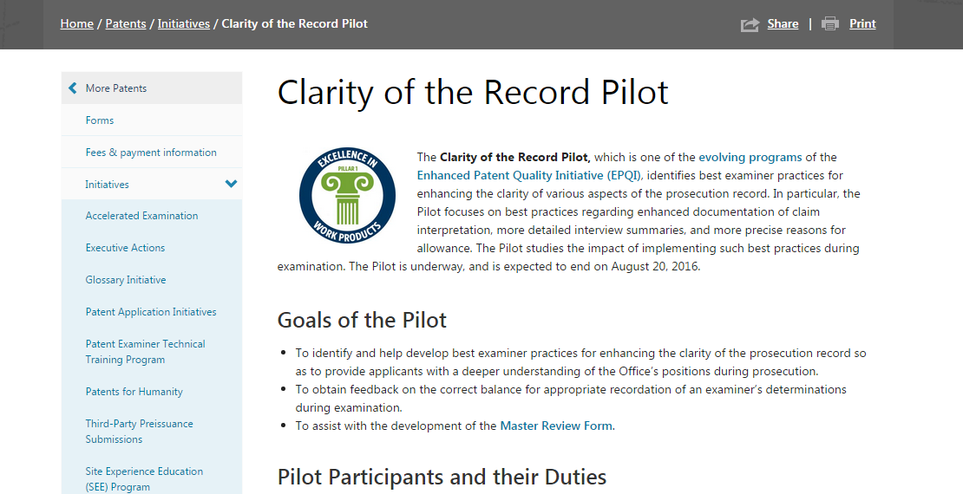
Clarity of the Record Pilot:
Additional Information http://www.uspto.gov/patent/initiatives/clarity-record-pilot
Notes:
For additional information on the Clarity of the Record Pilot, including training materials, please visit our public-facing webpage at http://www.uspto.gov/patent/initiatives/clarity-record-pilot

Slide 80

I. Search & Training Enhancements
Maria Holtmann
maria.holtmann@uspto.gov
Don Hajec
don.hajec@uspto.gov
II. Prosecution Enhancements
Robin Evans
robin.evans@uspto.gov

Slide 81
MORNING BREAK

Slide 82
Quality Enhancing Programs
Search & Training Enhancements
Prosecution Enhancements
Post-Examination Enhancements
Improving Evaluation of Examination

Slide 83
Quality Enhancing Programs:
III. Post-Examination Enhancements
Jack Harvey, Acting Assistant Deputy Commissioner for Patent Operations

Slide 84
Post-Examination Enhancements
Design Publication Quality
Post Grant Outcomes Program

Slide 85
Post Grant Outcomes Program
Purpose: to learn from all post grant proceedings and inform examiners of their outcomes
Three objectives to accomplish this:
  Enhanced Patentability Determinations in Related Child Cases
    Providing examiners with prior art submitted during (Patent Trial and Appeal Board (PTAB) post grant proceedings
  Targeted Examiner Training
    Data collected from the prior art submitted and examiner behavior will provide a feedback loop on best practices
  Examining Corps Education
    Provide examiners a periodic review of post grant outcomes focusing on technology sectors

Slide 86
  Objective 1 - Enhanced Patentability Determinations in Related Child Cases
Identify those patents being challenged at the PTAB under the AIA Trials that have pending, related applications in the Patent Corps
Provide the examiners of those pending, related applications access to the prior art submitted with the trial

Slide 87
  Objective 2 – Targeted Examiner Training
    Data collected from the prior art submitted and resulting examiner behavior will:
      provide a feedback loop on best practices
      help us educate examiners
        prior art search techniques
        sources of prior art beyond what is currently available
        claim interpretation

Slide 88
  Objective 3 – Examining Corps Education
Leverage results of all post grant proceedings to educate examiners on the process and results
  Provide examiners a periodic review of post grant outcomes focusing on technology sectors
  Utilize the proceedings to give examining corps a fuller appreciation for the process

Slide 89
  Post Grant Outcomes Summary
Learn from the results of post grant proceedings
Shine a spotlight on highly relevant prior art uncovered in post grant proceedings
Enhance patentability determination of pending, related applications
Build a bridge between PTAB and the examining corps

Slide 90
Post Grant Outcomes:
Next Steps
Pilot Launches April FY16
Send your feedback to: WorldClassPatentQuality@uspto.gov

Slide 91
Quality Enhancing Programs
Search & Training Enhancements
Prosecution Enhancements
Post-Examination Enhancements
Improving Evaluation of Examination

Slide 92
Quality Enhancing Programs:
IV. Improving Evaluation of Examination
Brian Hanlon, Director of the Office of Patent Legal Administration (OPLA)

Slide 93
Improving Evaluation of Examination
Quality Metrics
Clarity and Correctness Data Capture – utilizes a Master Review Form (MRF)
Topic Submission for Case Studies
Big Data - Open Data

Slide 94
Topic Submission for Case Studies: Pilot Summary
Federal Register Notice initiated the program on December 21, 2015
Submissions were accepted through February 12, 2016
USPTO invited stakeholders to submit patent quality-related topics for study

Slide 95
What is a Case Study?
Review of a single, quality-related issue
Tailored to the selected issue
Performed by USPTO
  Distinct from standard reviews completed by the Office of Patent Quality Assurance (OPQA)

Slide 96
Topic Submission for Case Studies: Program Goals
Use stakeholder experience to provide USPTO with a wider range of topics to consider for a case study
Use study results to better understand and enhance quality of USPTO work products and processes to:
  Identify quality issues and examples of examination best practices
  Reveal areas where further training may be needed

Slide 97
Topics Selected for Case Study
Compliance of rejections with 35 U.S.C. 101 Official Guidance
Consistency of application of 35 U.S.C. 101 across Art Units/Technology Centers
Use of compact prosecution when making 35 U.S.C. 101 rejections
Correctness and clarity of motivation statements in 35 U.S.C. 103 rejections
Enforcement of 35 U.S.C. 112(a) written description in continuing applications
Consistent treatment of claims after May 2014 35 U.S.C. 112(f) training

Slide 98
Topics Selected for Case Study
Compliance of rejections with 35 U.S.C. 101 Official Guidance
Consistency of application of 35 U.S.C. 101 across Art Units/Technology Centers
Use of compact prosecution when making 35 U.S.C. 101 rejections
Correctness and clarity of motivation statements in 35 U.S.C. 103 rejections
Enforcement of 35 U.S.C. 112(a) written description in continuing applications
Consistent treatment of claims after May 2014 35 U.S.C. 112(f) training

Slide 99
Topics Selected for Case Study
Compliance of rejections with 35 U.S.C. 101 Official Guidance
Consistency of application of 35 U.S.C. 101 across Art Units/Technology Centers
Use of compact prosecution when making 35 U.S.C. 101 rejections
Correctness and clarity of motivation statements in 35 U.S.C. 103 rejections
Enforcement of 35 U.S.C. 112(a) written description in continuing applications
Consistent treatment of claims after May 2014 35 U.S.C. 112(f) training

Slide 100
Topics Selected for Case Study
Compliance of rejections with 35 U.S.C. 101 Official Guidance
Consistency of application of 35 U.S.C. 101 across Art Units/Technology Centers
Use of compact prosecution when making 35 U.S.C. 101 rejections
Correctness and clarity of motivation statements in 35 U.S.C. 103 rejections
Enforcement of 35 U.S.C. 112(a) written description in continuing applications
Consistent treatment of claims after May 2014 35 U.S.C. 112(f) training

Slide 101
Topics Selected for Case Study
Compliance of rejections with 35 U.S.C. 101 Official Guidance
Consistency of application of 35 U.S.C. 101 across Art Units/Technology Centers
Use of compact prosecution when making 35 U.S.C. 101 rejections
Correctness and clarity of motivation statements in 35 U.S.C. 103 rejections
Enforcement of 35 U.S.C. 112(a) written description in continuing applications
Consistent treatment of claims after May 2014 35 U.S.C. 112(f) training

Slide 102
Topics Selected for Case Study
Compliance of rejections with 35 U.S.C. 101 Official Guidance
Consistency of application of 35 U.S.C. 101 across Art Units/Technology Centers
Use of compact prosecution when making 35 U.S.C. 101 rejections
Correctness and clarity of motivation statements in 35 U.S.C. 103 rejections
Enforcement of 35 U.S.C. 112(a) written description in continuing applications
Consistent treatment of claims after May 2014 35 U.S.C. 112(f) training

Slide 103
Topics Selected for Case Study
Compliance of rejections with 35 U.S.C. 101 Official Guidance
Consistency of application of 35 U.S.C. 101 across Art Units/Technology Centers
Use of compact prosecution when making 35 U.S.C. 101 rejections
Correctness and clarity of motivation statements in 35 U.S.C. 103 rejections
Enforcement of 35 U.S.C. 112(a) written description in continuing applications
Consistent treatment of claims after May 2014 35 U.S.C. 112(f) training

Slide 104
Topic Submission - Resources
Topic Submission for Case Studies Webpage: http://www.uspto.gov/patent/initiatives/topic-submission-case-studies-pilot-program
Enhanced Patent Quality Initiative Webpage: http://www.uspto.gov/patent/initiatives/enhanced-patent-quality-initiative
Contact us at TopicSubmissionForCaseStudies@uspto.gov

Slide 105
Quality Enhancing Programs:
IV. Improving Evaluation of Examination Open Data - Big Data
Russ Slifer, Deputy Under Secretary of Commerce for Intellectual Property and Deputy Director of the USPTO

Slide 106
Open Data - Big Data
Open data
  Publicly available, freely discoverable data that anyone can use, reuse or redistribute easily.
Big Data
  A collection of large volumes of data that can be mined for trends, patterns and analysis.

Slide 107
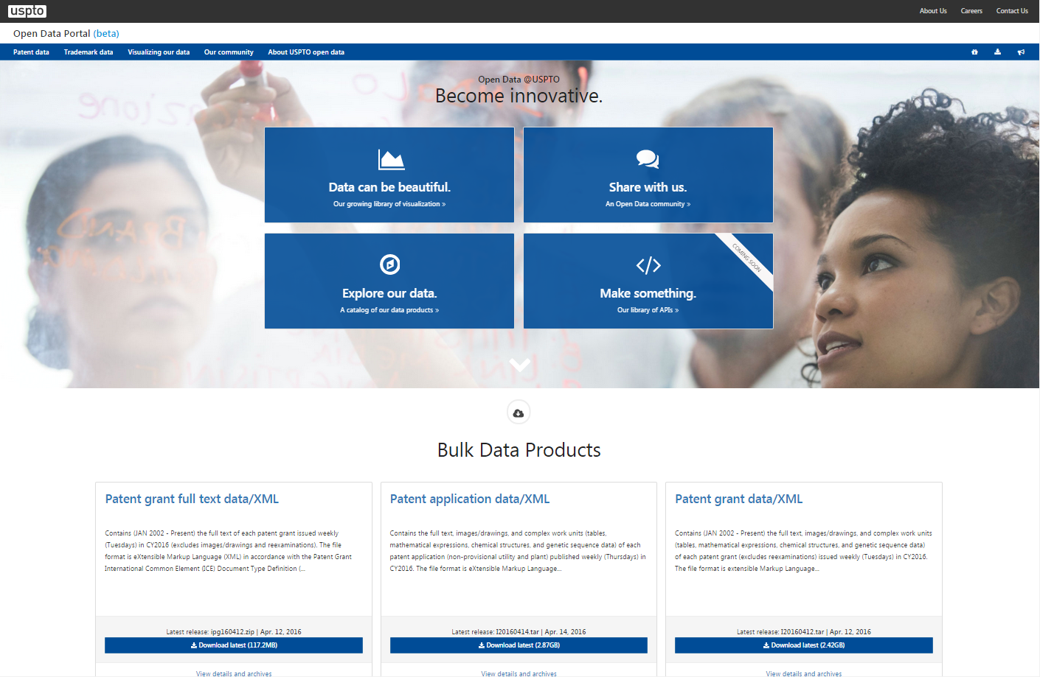
Open Data Portal:
Developer Hub USPTO
Notes:
Open Data Portal: Developer Hub USPTO - derive new and sustainable ways to expose data and provide a platform for to get data “faster and easier”

Slide 108
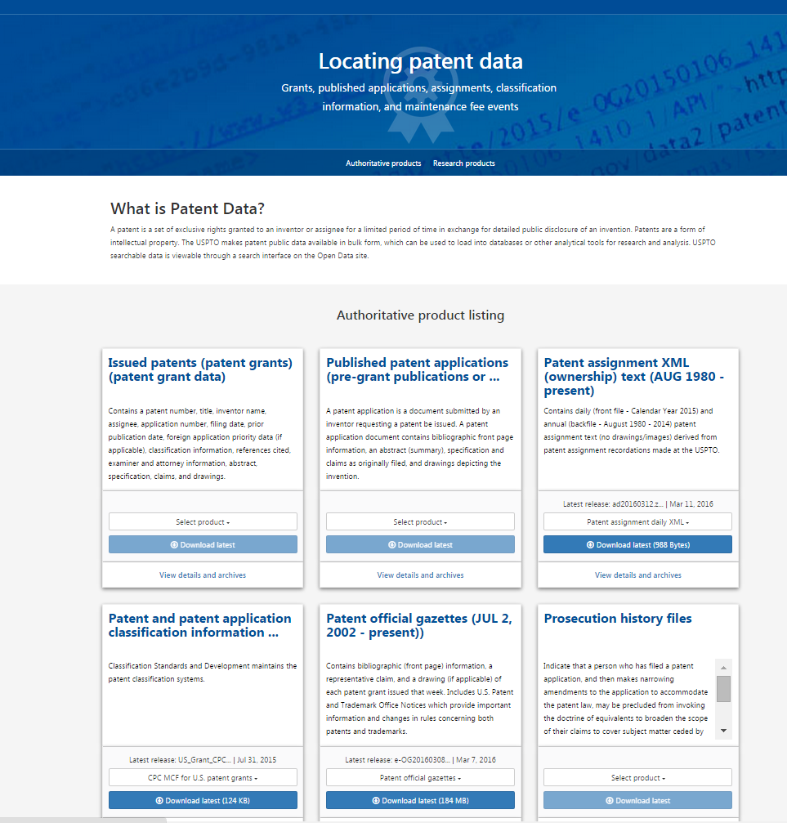
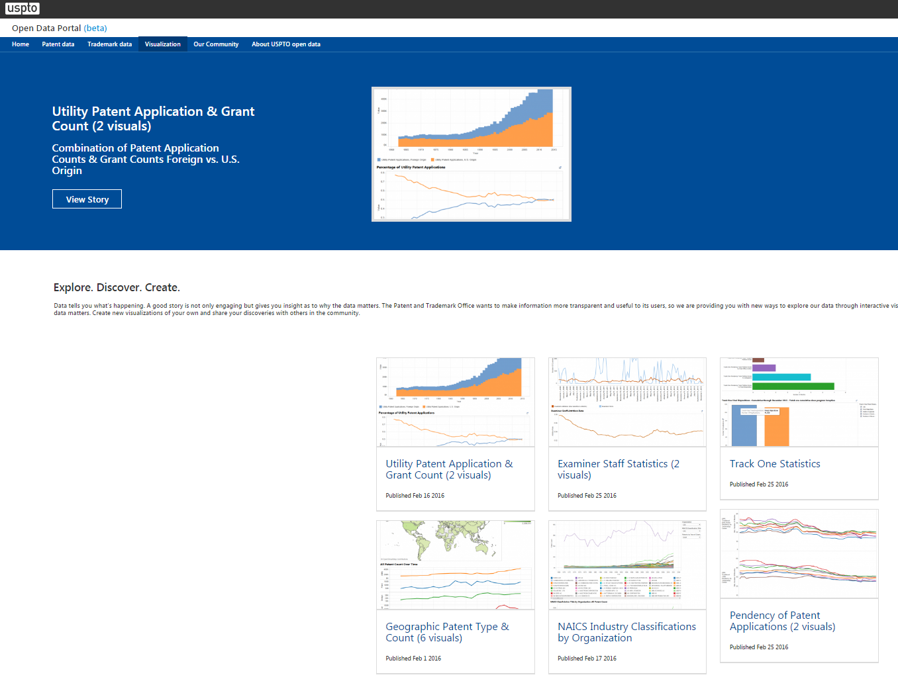
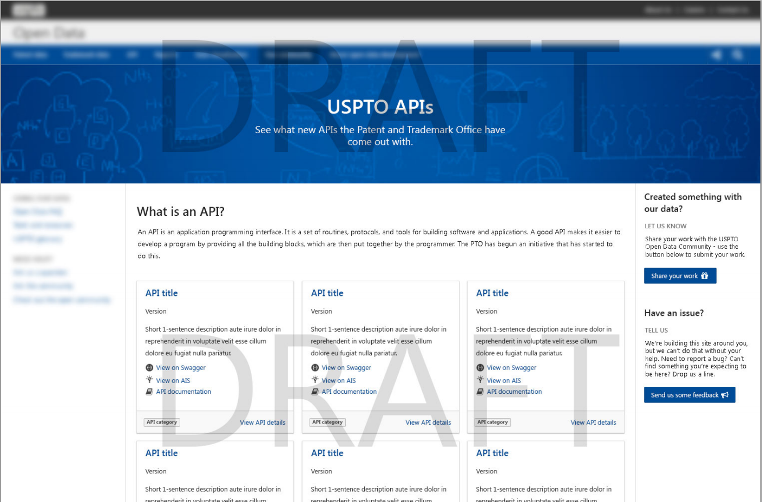
Locating Patent Data https://developer.uspto.gov/
Notes:
Locating Patent Data on data website screenshot at https://developer.uspto.gov/
Locating patent data
USPTO APIs
Utility Patent Applications & Grant Count

Slide 109
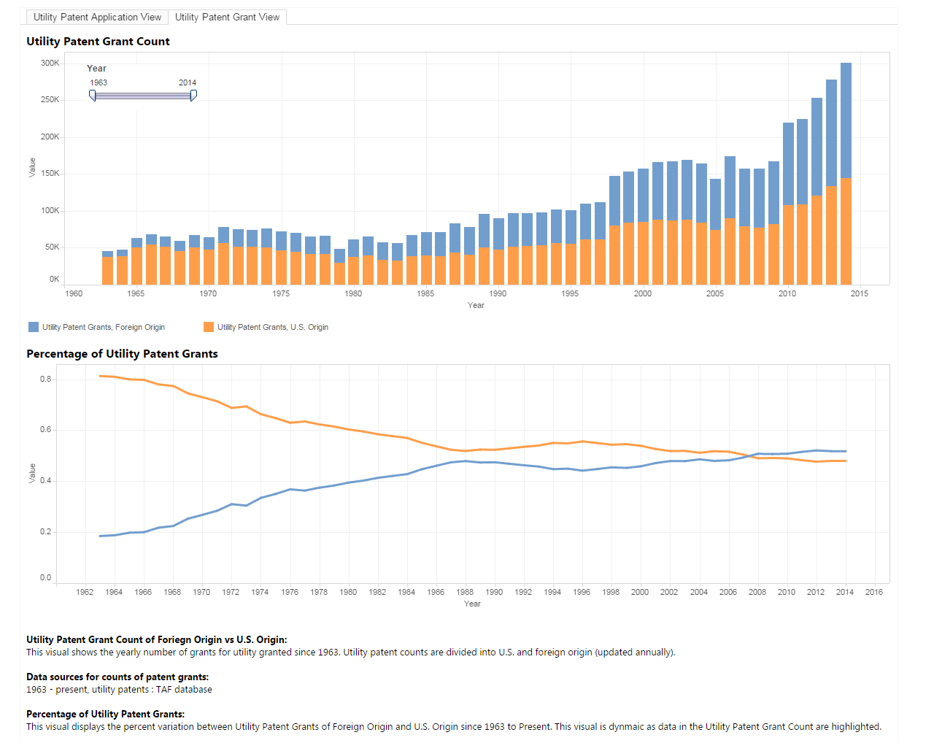
Patents Granted from Domestic Filers vs. Foreign Filers
Notes:
See the below link to download data.
https://developer.uspto.gov/visualization/utility-patent-application-grant-count-2-visuals

Slide 110
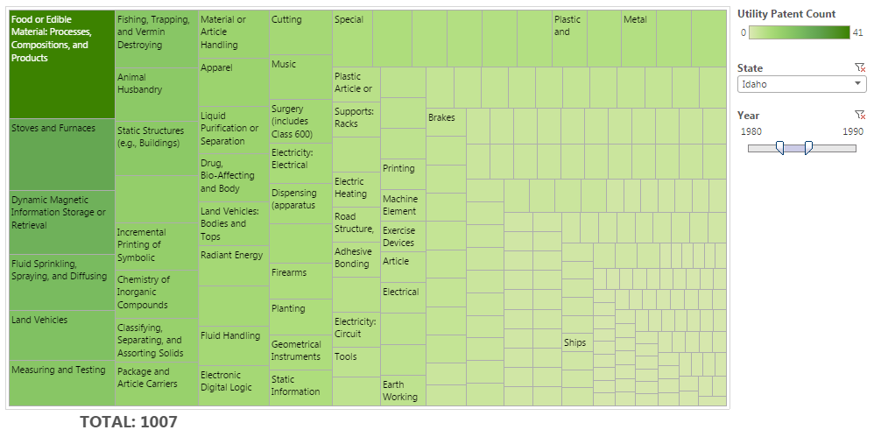
Top Technology Grants: Idaho
1980-1990: Food or Edible Products
Notes:
See the below link to download data.
https://developer.uspto.gov/visualization/technology-class-treemap-state

Slide 111
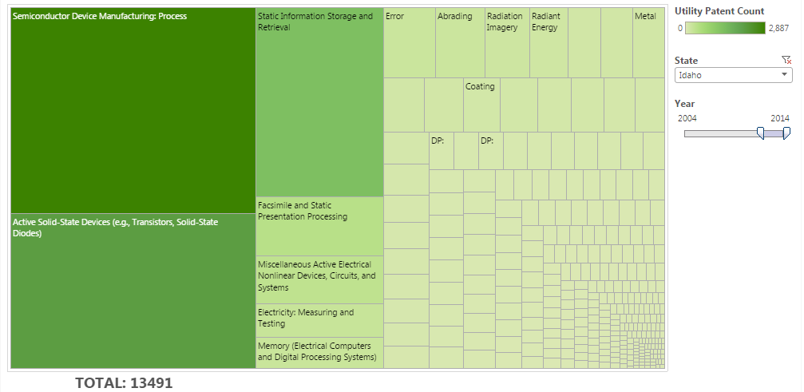
Top Technology Grants: Idaho
2004-2014: Semiconductors
Notes:
See the below link to download data.
https://developer.uspto.gov/visualization/technology-class-treemap-state

Slide 112

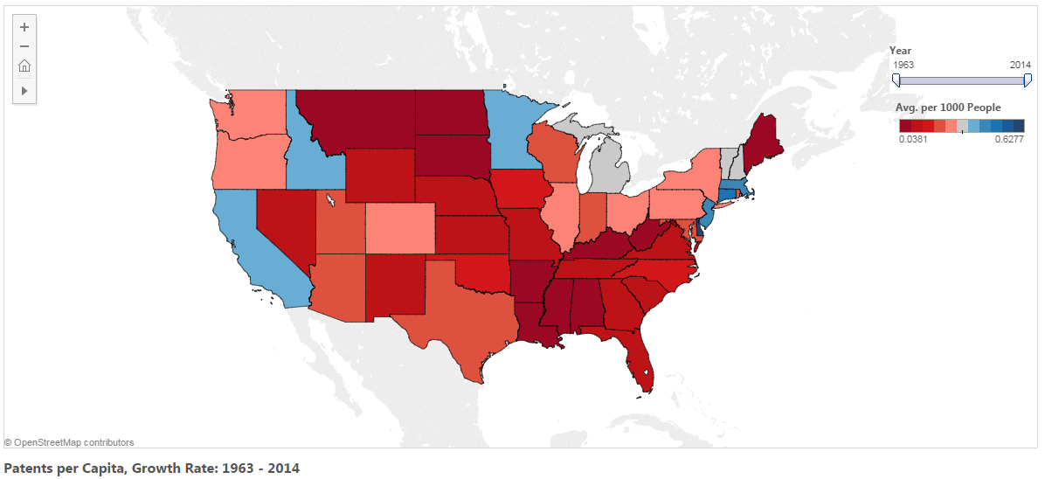
Utility Patents per Capita: Historic Growth Rate
Notes:
See the below link to download data.
https://developer.uspto.gov/visualization/utility-patents-state-over-time

Slide 113
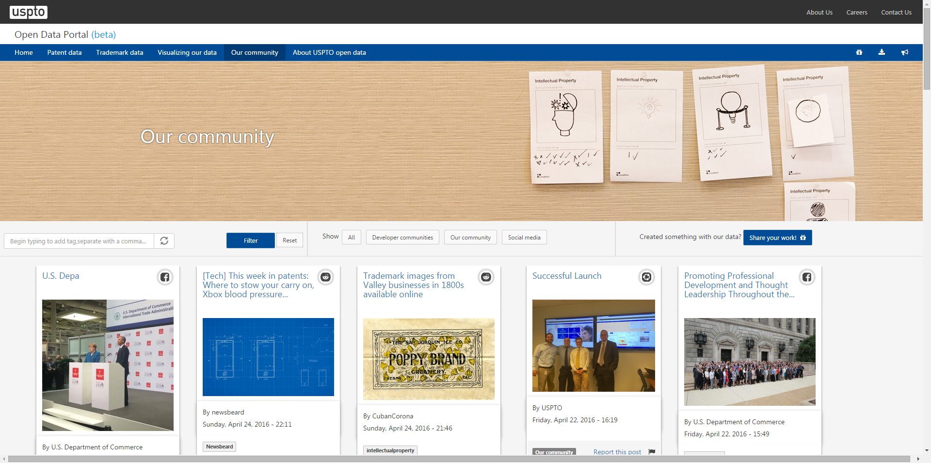
Data Community Café https://developer.uspto.gov/community
Notes:
Data Community Café website - https://developer.uspto.gov/community

Slide 114

Big Data: Improving Quality
In what ways can we use Big Data to improve Patent Quality?
  Detect anomalies (inconsistencies)
  Identify and prevent problems early
  Measure training impact
  Validate assumptions
PATENT QUALITY IS A PRIORITY
HOW DOES DATA SCIENCE HELP?

Slide 115
III. Post-Examination Enhancements
Jack Harvey
jack.harvey@uspto.gov
IV. Improving Evaluation of Examination
Brian Hanlon
brian.hanlon@uspto.gov
Russ Slifer
Russell.slifer@uspto.gov

Slide 116
LUNCH BREAK

Slide 117
Quality Metrics
Marty Rater, Chief Statistician
Office of Patent Quality Assurance (OPQA)

Slide 118
Quality Metrics Redefined
FY 2011 - FY 2015
FY 2016
Final Disposition Compliance
In-Process Compliance
First Action (FAOM) Review
Search Review
Quality Index Reporting (QIR)
External Quality Survey
Internal Quality Survey
Composite Score
Product Indicators Master Review Form Capturing both correctness and clarity of examiners’ final work product using uniform criteria gathered in a single database
Process Indicators Transactional QIR Tracking the efficiency and consistency of our processes (for example, to identify “churning”)
Perception Indicators Survey Results Continuing to internally and externally poll perceptions of patent quality
Notes:
Quality Metrics Redefined
Product Indicators – Master Review Rom – Capturing both correctness and clarity of examiners’ final work product using uniform criteria gathered in a singe database.
Final Disposition Compliance
In-Process Compliance
First Action (FAOM) Review
Search Review
Process Indicators – Transactional QIR – Tracking the efficiency and ciosistency of our processes (for example, to identify “churning”)
Quality Index Reporting (QIR)
Perception Indicators - Survey Results – Continuing to internally externally poll perceptions of patent Quality
External quality Survey
Internal Quality Survey
Discontinue the Composite Score

Slide 119
Quality Metric Data Source: Product Indicators
FY 2016
FY 2016 Key Product Metrics
Product Indicators
Master Review Form
Capturing both correctness and clarity of examiners’ final work product using uniform criteria gathered in a single database
Correctness
Clarity
Process Indicators
Transactional QIR
Tracking the efficiency and consistency of our processes
(for example, to identify “churning”)
Perception Indicators
Survey Results
Continuing to internally and externally poll
perceptions of patent quality
Notes:
FY 2016 Quality Metric Data Source: Product Indicators – Master Review Form
Correctness
Clarity
FY16 Process Indicators – Transactional QIR
FY 16 Perception Indicators – Survey Reults

Slide 120
Quality Metric Data Source:
Process Indicators
FY 2016
Product Indicators
Master Review Form
Capturing both correctness and clarity of examiners’ final work product using uniform criteria gathered in a single database
FY 2016 Key Process Indicators
Process Indicators
Transactional QIR
Tracking the efficiency and consistency of our processes
(for example, to identify “churning”)
Reopening Prevention
Rework Reduction
Consistency of Decision-Making
Perception Indicators
Survey Results
Continuing to internally and externally poll
perceptions of patent quality
Notes:
Process Indicators – Transactional QIR
Reopening Prevention
Rework Reduction
Consistency of Decision - Making

Slide 121
Quality Metric Data Source:
Perception Survey Results
FY 2016
Product Indicators
Master Review Form
Capturing both correctness and clarity of examiners’ final work product using uniform criteria gathered in a single database
Process Indicators
Transactional QIR
Tracking the efficiency and consistency of our processes
(for example, to identify “churning”)
FY 2016 Vital Perception Indicators
Perception Indicators
Survey Results
Continuing to internally and externally poll
perceptions of patent quality
Root Cause Analysis
Validation/Verification
Notes:
FY 2016 Perception Indicators – Survey Results
Root Cause Analysis
Validation/Verification

Slide 122
Quality Metrics
Federal Register Notice published on March 25, with comments due May 24
  Requesting feedback on:
    Decision to replace Composite Quality Score with individual metrics
    How to objectively measure patent examination quality
    Standardized Master Review Form
    Quality Metrics website: http://www.uspto.gov/patent/initiatives/quality-metrics
    Contact Us: QualityMetrics2017@uspto.gov

Slide 123
External Quality Survey (EQS)
Conducted semi-annually since 2006
  Most recent survey Q1 in FY16
Surveys 3,000 frequent-filing customers with each survey
Has been included in Patent Quality Composite (FY2011-15)
Continues to be a vital quality indicator as we transition to new quality metrics in FY17

Slide 124
Perception of Product: Quality of Rejections Made
Q6: Frequency of Technically, Legally, and Logically Sound Rejections
(Percent reporting “Most of the time” or “All of the time” of the time)
Rejections under
335 U.S.C. 112(b)
5 U.S.C. 102
35 U.S.C. 112(a)
35 U.S.C. 101
35 U.S.C. 103
Notes:
Perception of Product: Consistency (Question: In the past 3 months, have you experienced problems with the consistency of examination quality from one examiner to another?)
Between FY15-quarter 3 and FY16 –quarter 1, the percentage of customers who reported experiencing problems with the consistency of examination quality to “a large degree” decreased slightly.

Slide 125
Perception of Product and Process: Advancing Prosecution
Q10: In your experience, what have examiners done that has helped advance prosecution?
Notes:
Perception of Product and Process: Advancing Prosecution (Question: In your experience, what have examiners done that has helped advance prosecution?”
This bar graph shows that Examiners that are willing to conduct interviews at all stages of the approval process help to advance prosecution. (192 comments in this category.)
Examiners that take the initiative to contact the customer and raise issues for discussion. Examiner-initiated telephone calls were mentioned in particular. (151 comments in this category.)
Examiners that were willing to discuss issues over the telephone or through email correspondence helped advance prosecution. (146 comments in this category.)
Examiners that are thoroughly prepared before meetings with the customer and had taken the time to gain a good understanding of the invention, and had conducted thorough art searches and found all relevant references were helpful in advancing prosecution. (117 comments in this category).
Examiners who provided a clear rationale and explanation to customers for their decisions and responses to arguments, including well written responses, helped to advance prosecution. (108 comments in this category.)

Slide 126
Perception of Product: Consistency
Q9: In the past 3 months, have you experienced problems with the consistency of examination quality from one examiner to another?
Notes:
Perception of Product: Consistency (Question: In the past 3 months, have you experienced problems with the consistency of examination quality from one examiner to another?)
Between FY15-quarter 3 and FY16 –quarter 1, the percentage of customers who reported experiencing problems with the consistency of examination quality to “a large degree” decreased slightly.

Slide 127
Perception of Overall Quality
Q7: Percent Positive and Negative Ratings of Overall Examination Quality in Past 3 Months
Notes:
Perception of Overall Quality (Question: Percent positive and Negative Ratings of Overall Examination Quality in Past 3 months.)
The percentage of customers reporting that overall examination quality was “good” or “excellent” increased from 47% to 54%.

Slide 128
Link between Perception of Consistency and Overall Quality
Overall Quality Perception
Notes:
Link between perception of consistency and Overall quality Examination Quality (Q7) by Inconsistency in Examination Quality
The bar graph shows a that the level of degree of inconsistency has decreased from 75% to 27%
We’re on the right track with consistency driving overall quality perception

Slide 129
Using EQS for Validating the Quality Metric
Utilize the External Quality Survey as a snapshot of stakeholders’ perceptions
Assure alignment of the quality data underlying our metrics and our external stakeholders’ perceptions
Exploit the flexibility of the Master Review Form to capture data points that reflect patent quality
Notes:
Today: Master Review Form Workshop
Familiarize yourself with structure/direction
Does it lend itself to answering your quality questions?
Tomorrow: Federal Register Notice
Tell us how to improve the Master Review Form
Suggest metrics that you can use and provide feedback on past metrics

Slide 130
Quality Metrics
Marty Rater
Martin.rater@uspto.gov

Slide 131
Master Review Form (MRF)
Hands-On Workshop
Sandie Spyrou, Supervisory Review Quality Assurance Specialist
Office of Patent Quality Assurance (OPQA)
Kathleen Bragdon, Senior Advisor to the
Deputy Commissioner for Patent Quality

Slide 132
Clarity and Correctness Data Capture (CCDC) Program
Designed to improve the data capture system to enable all reviewers to
  Consistently document quality review data
  Access quality review data using the same tool
Uses a tool called the Master Review Form or MRF

Slide 133
Master Review Form: Goals
To create a single, comprehensive tool that can be used by all areas of the Office to consistently review final work product
To better collect information on the clarity and correctness of Office actions
To collect review results into a single data warehouse for more robust analysis

Slide 134
Master Review Form
VIEW THE Integrated Quality System (IQS)

Slide 135
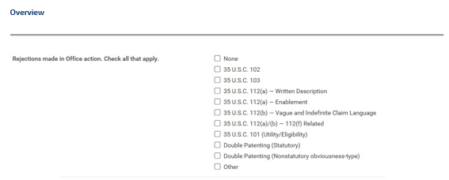
Master Review Form: Overview Rejections Made
Notes:
The form begins with the reviewer, any reviewer, checking off all sections that would apply based on the Office action rejections made.

Slide 136
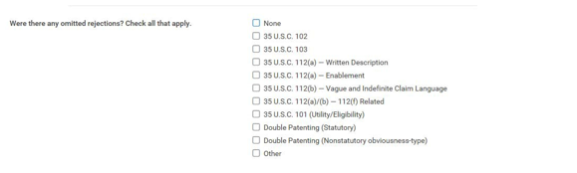
Master Review Form: Overview Rejections Omitted
Notes:
Then the form asks about rejections omitted. Now, when reviewing, it’s not enough to say something was omitted. You must explain the omitted rejection. That is – provide the art. Write out the rationale for a 112 rejection. Provide the conflicting patents in a missed double patenting rejection. These are extensive sections that we won’t take much more time with today. They focus on correctness inasmuch as a rejection was missed. Moreover, the reviewer is expected to be clear in their write-up.
The form then goes on to ask specific questions about the quality of the search. Again,

Slide 137
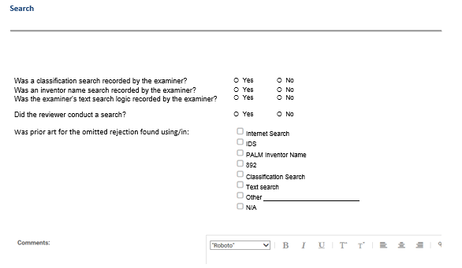
Master Review Form: Search
Notes:
The form then goes on to ask specific questions about the quality of the search.
Now I want to draw your attention to the Comments box at the bottom. This additional field exists at the end of each section in the form.
These comment boxes are meant to allow the reviewer to explain more about issues raise above in a radial button, or perhaps address something that there is no radial button provides for. However, we wanted to draw to your attention that comments in the box will be “lost” to big data mining. Though useful on an individual basis to the examiner when provided as feedback via their supervisor, these comments will likely die there.
Only items reflected in a radial button can be mass-tabulated and used to direct overall training, best practices, and quality metrics.
So this is important as we go through the workshop today – with our goal of evaluating the form.

Slide 138
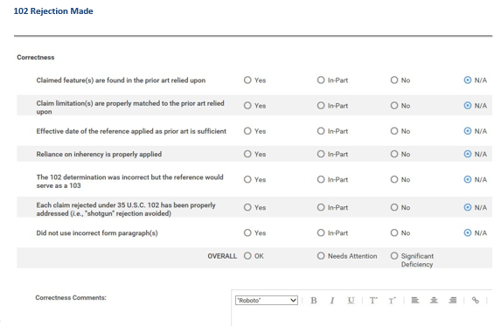
Master Review Form: 102 Rejection Made - Correctness
Notes:
Then we look at correctness and clarity sections

Slide 139
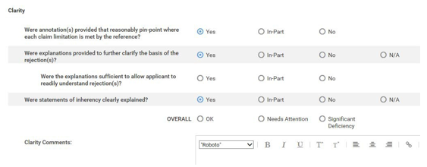
Master Review Form: 102 Rejection Made - Clarity
Notes:
Then we look at correctness and clarity sections

Slide 140
MRF Hands-On Workshop: In Two Parts
Be a reviewer for a mock Office action using excerpts from the MRF
Brainstorm about how the MRF can be most effective to enhance patent quality

Slide 141
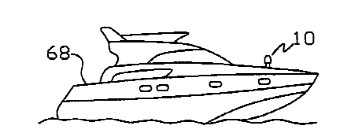
MRF Hands-On Workshop: Part 1 Materials - Application
Application 01/345,678
is drawn to a Boat Tracker System
Claims
1. A system for monitoring the position of a marine vessel comprising:
a marine vessel;
an article for monitoring the position of the marine vessel in remote areas; and,
a nautically themed simulated object disposed on the marine vessel and adapted to house the article for monitoring therein.
2. The system according to claim 1 wherein the article for monitoring comprises:
a mobile device comprising a GPS receiver,
display,
microprocessor, and
a wireless communication transceiver.
Notes:
Image of Boat Tracker System

Slide 142
MRF Hands-On Workshop: Part 1 Materials – Office action
Office action to be reviewed identifies four rejections:
112(a) rejection for lacking written description because the specification does not demonstrate that the inventor was in possession of the claimed article for monitoring the position (i.e., the GPS unit) having special programming required to perform the function
112(b) rejection because the specification fails to adequately provide structure after invoking 112(f)
112(b) rejection because of the vague term “nautically themed”
103 rejection because the claims are unpatentable over Mills in view of Rayne

Slide 143
MRF Hands-On Workshop: Part 1 Materials – MRF Excerpts
Provided are excerpts from the MRF that correspond to the sections where you, the reviewer, would note the correctness and clarity of the four rejections in the Office action:
112(a)/(b), 112(f)-Related Rejection Made
112(a) Rejection Made
112(b) Rejection Made
103 Rejection Made

Slide 144
MRF Hands-On Workshop: Part 1 Review Instructions
(20 min)
Read through the Office action, in view of the specification, and make your individual assessment about the correctness and clarity of each rejection
Use the MRF and complete the review
    REMEMBER: we are assessing the MRF’s ability to accurately reflect quality work and NOT your ability to accurately review an Office action

Slide 145
MASTER REVIEW FORM (MRF) HANDS-ON WORKSHOP
IN PROGRESS please visit the USPTO’s website on the MRF http://www.uspto.gov/patent/clarity-and-correctness-data-capture and send your feedback in to the Symposium via email at PatentQualityEventParticipationBox@uspto.gov

Slide 146
MRF Hands-On Workshop: Part 2 Brainstorming Instructions (30 min)
Each table has been given a subset of the sections from the MRF to focus on:
  Subset 1: 102 and 103 Rejections Made (Prior Art), Reply to Applicant, and Other
  Subset 2: 112 Rejections Made (description, enablement, definiteness, and those rejections related to functional claiming)
  Subset 3: 101 and Double Patenting Rejections Made
(for your reference, a single copy of the complete MRF is provided in a binder on the table)
Read through your MRF subset pages and consider the brainstorming questions, making notes on your flipcharts to report out

Slide 147
MRF Hands-On Workshop: Brainstorming Questions (30 min)
Consider these questions from different perspectives, such as examiners, prosecutors, litigators, inventors, and more:
What additional questions should we be capturing on the MRF?
  For any additional questions, should they be captured quantitatively (radio button) or qualitatively (comment box)?
The USPTO will be reporting out Quality Metrics representative of clarity, correctness and consistency. Which MRF questions should be featured in such metrics?
B.

Slide 148
MASTER REVIEW FORM (MRF) HANDS-ON WORKSHOP
IN PROGRESS please visit the USPTO’s website on the MRF http://www.uspto.gov/patent/clarity-and-correctness-data-capture and send your feedback in to the Symposium via email at PatentQualityEventParticipationBox@uspto.gov

Slide 149
MRF Hands-On Workshop
REPORT OUT
send your feedback in to the Symposium via email at PatentQualityEventParticipationBox@uspto.gov

Slide 150
AFTERNOON BREAK

Slide 151
PANEL DISCUSSION:
How Can Applicants File and Prosecute a Quality Application
Moderated by Russ Slifer, Deputy Under Secretary of Commerce for Intellectual Property and Deputy Director of the USPTO

Slide 152
PANEL DISCUSSION
Moderated by Russ Slifer
Rick Nydegger, Workman Nydegger
Kevin Noonan, MBHB
Bill Bunker, Knobbe Martens
Laura Sheridan, Google
Tim Wilson, SAS

Slide 153
PANEL Q&A
Moderated by Russ Slifer
Rick Nydegger, Workman Nydegger
Kevin Noonan, MBHB
Bill Bunker, Knobbe Martens
Laura Sheridan, Google
Tim Wilson, SAS
send your questions and comments in to the Symposium via email at PatentQualityEventParticipationBox@uspto.gov

Slide 154
CLOSING REMARKS
Drew Hirshfeld
Commissioner for Patents
United States Patent and Trademark Office

Slide 155
Long-term Commitment to Enhancing Patent Quality
Enhanced Patent Quality Initiative
http://www.uspto.gov/patent/initiatives/enhanced-patent-quality-initiative-0
Patents Initiatives
http://www.uspto.gov/patent/initiatives
Contact Us
WorldClassPatentQuality@uspto.gov

