Slide 1
AIA Trial Roundtables

Slide 2
Welcome

Slide 3
Agenda
Time | Topic
1:00 PM | Welcome
1:10 PM | Presentation Overview of trials, statistics, and lessons learned (30 minutes) Audience Questions/Comments (20 minutes)
2:00 PM | Mock Conference Call Topics include motion to amend and motion for additional discovery (30 minutes) Audience Questions/Comments (20 minutes)
2:50 PM | BREAK (10 minutes)
3:00 PM | Panel Discussion
5:00 PM | Closing Remarks

Slide 4
Roundtable Materials
Available at:
http://www.uspto.gov/ip/boards/bpai/ptab_aia_trial_roundtables_2014.jsp

Slide 5
PTAB Presentation

Slide 6
Overview
AIA Trials
  Statistics
  Lessons Learned
Administrative Patent Judges
PTAB Website Tour

Slide 7
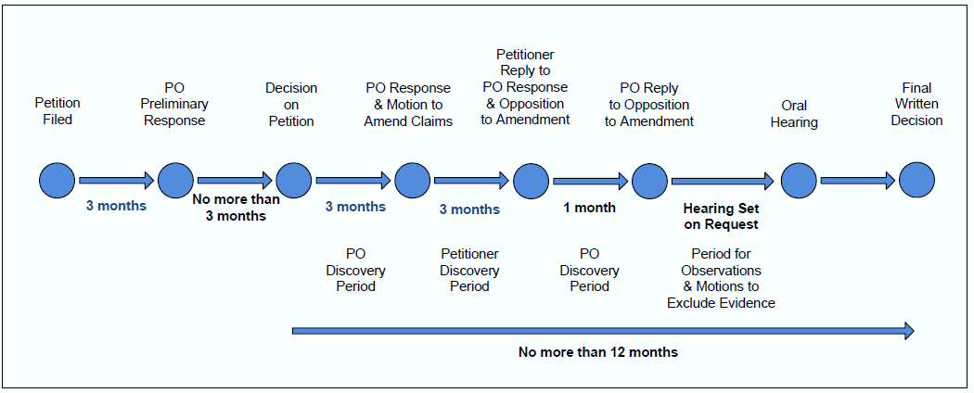
Trial Proceeding Timeline

Slide 8
Inter Partes Review Petitions Terminated to Date (As of 4/2/2014)
167 Patents Petitioned
63 Patents Not Instituted
104 Patents Instituted
76 Patents
Settled / Dismissed / Request for Adverse Judgment
28 Patents
Reached Final Written Decisions
19 Patents
All Instituted Claims Unpatentable
(11% of Total Patents Petitioned)
9 Patents
Some Instituted Claims Unpatentable
(5% of Total Patents Petitioned)

Slide 9
Inter Partes Review Petitions Terminated to Date (As of 4/2/2014)
5,458 Claims in 167 Patents Petitioned
2,113 Claims Challenged
(167 Patents)
3,345 Claims Not Challenged
1,277 Claims Instituted
(60% of Claims Challenged)
(104 Patents)
836 Claims Challenged but Not Instituted
(40% of Claims Challenged)
327 Claims Found Unpatentable
(26% of Claims Instituted,
15% of Claims Challenged)
(28 Patents)
245 Claims Cancelled or Disclaimed (Non-PTAB)
(19% of Claims Instituted, 12% of Claims Challenged)
705 Claims Patentable
(55% of Claims Instituted, 33% of Claims Challenged)

Slide 10
Petition Filing

Slide 11
AIA Petitions
(Cumulative Number as of 4/2/2014)

Slide 12
AIA Petitions
(Technology Breakdown as of 4/2/14)

Slide 13
Petition Challenges
(As of 4/2/2014)
CBM
IPR

Slide 14
§101 and § 112 Grounds Raised in CBM Petitions Only (As of 4/2/2014)
101 Grounds
112 Grounds

Slide 15
Lessons Learned: Petitions
Conclusions need to be supported by:
  Sound legal analysis; and
  Citations to evidentiary record
Analysis needs to appear in petition itself (no incorporation by reference from declaration)
Better to provide detailed analysis for limited number of challenges than identify large number of challenges for which little analysis is provided
See Wowza Media v. Adobe, IPR2013-00054
(Paper 12)(denying petition)

Slide 16
Lessons Learned: Claim Charts
Use standard two-column format. See FAQ D13
Claim charts are not sufficient by themselves; they must be explained.
Claim charts should contain pinpoint references to the supporting evidence. See FAQ D12

Slide 17
Lessons Learned: Claim Construction
Claim constructions should be supported by citations to the record that justify the proffered construction and analysis provided as to why the claim construction is the broadest reasonable construction. 37 C.F.R. § 42.104(b)(3).
An example of a failure to provide a sufficient claim construction occurs where claim terms are open to interpretation, but party merely restates claim construction standard to be used, e.g.,
  A claim subject to inter partes review receives the “broadest reasonable construction in light of the specification of the patent in which it appears.” 37 C.F.R. § 42.100(b)

Slide 18
Lessons Learned: Experts
Tutorials are helpful especially for complex technologies
Expert testimony without underlying facts or data is entitled to little or no weight. 37 C.F.R. § 42.65(a). See Monsanto Co. v. Pioneer Hi-Breed Int’l, IPR2013-00022, Paper 43 (denying petition)
Avoid merely “expertizing” your claim charts

Slide 19
Lessons Learned: Obviousness
Question of obviousness is resolved based on underlying factual determinations identified in Graham
  Includes addressing differences between claimed subject matter and the prior art
Address the specific teachings of the art relied upon rather than rely upon what others have said (e.g., examiners)
  Parties are to address whether there is a reason to combine art (KSR) and avoid conclusory statements
See Veeam Software v. Symantec, IPR2013-00145
(Paper 12); Heart Failure Tech. v. CardioKinetix, IPR2013-00183 (Paper 12) (denying petition)

Slide 20
Patent Owner Preliminary Response

Slide 21
Patent Owner Preliminary Responses (As of 4/2/14)
 | Filed | Not Filed or Waived
IPR | 55% | 45%
CBM | 57% | 43%

Slide 22
Lessons Learned: Patent Owner Preliminary Response
Clearly identify procedural and substantive reasons to deny petition, e.g.,
  Statutory bar under 35 U.S.C. § 315 or § 325?
  Failure to identify real parties-in-interest/privies?
  Weaknesses in Petitioner’s case?
    Petitioner’s claim construction is improper
    Cited references are not, in fact, prior art
    Cited references lack material element(s)
Cannot present new testimonial evidence
  BUT can cite existing testimony and reports

Slide 23
Decision on Petition

Slide 24
Institutions (As of 4/2/2014)
CBM
IPR

Slide 25
Institutions (As of 4/2/2014)
CBM
IPR

Slide 26
Petition Dispositions (As of 4/2/14)
 | Total No. of Decisions on Institution | Trials Instituted | Joinders | Denials | Percent Instituted
IPR | 506 | 405 | 11+ | 90 | 80%
CBM | 62 | 52 | - | 10 | 84%
+11 cases joined to 10 base trials for a total of 21 cases involved in joinder.

Slide 27
Joinder

Slide 28
Joinders (As of 4/2/14)
 | Trials Instituted | Joinders
IPR | 405 | 11+
CBM | 52 | -
+11 cases joined to 10 base trials for a total of 21 cases involved in joinder.

Slide 29
Lessons Learned: Joinder
Must be a like review proceeding
Requires filing a motion and petition
File within one month of institution
Impact on schedule important
Dell v. Network-1, IPR2013-00385 (Paper 17)(joinder granted)
Sony v. Network-1, IPR2013-00386 (Paper 16)(joinder denied)

Slide 30
Discovery
Discovery Period

Slide 31
Types of Discovery
Initial disclosures (Trial Practice Guide, 77 Fed. Reg. 48756, 48761-62 (Aug. 14, 2012)
Routine Discovery
  Cited exhibits
  Cross-examination of witnesses
  Inconsistent information
Additional Discovery

Slide 32
Lessons Learned: Additional Discovery
Five factor test used in evaluating additional discovery requests (IPR2012-00001, Garmin v. Cuozzo (Paper 26)):
  More than a possibility and mere allegation must exist that something useful might be found.
  Is the request merely seeking early identification of opponent’s litigation position?
  Can party requesting discovery generate the information?
  Interrogatory questions must be clear.
  Are requests overly burdensome to answer?
Requests for specific documents with a sufficient showing of relevance are more likely to be granted whereas requests for general classes of documents are typically denied

Slide 33
Lessons Learned: Depositions
Federal Rules of Evidence apply
Objections to admissibility waived
Follow the Testimony Guidelines (Practice Guide Appendix D)
  No “speaking” objections or coaching
  Instructions not to answer are limited
Foreign language/country. See Ariosa v. Isis, IPR2013-00022 (Papers 55, 67)

Slide 34
Motion to Amend
Motion to Amend

Slide 35
Motions to Amend
Board conference required
Normally one-for-one claim substitution
Must narrow scope
Need to show patentable distinction
Clearly state the contingency of substitution
See Idle Free v. Bergstrom, IPR2012-00027 (Paper 26)

Slide 36
Motions to Amend
Unlike during examination, PTAB does not “examine” amended claims during an AIA proceeding
  No search is conducted
  No claim rejections made
Burden is on the movant (i.e., the patent owner) to show the patentable distinction of the proposed amended claim

Slide 37
Oral Hearing

Slide 38
Lessons Learned: Oral Hearing
Attorneys should bear in mind that:
  Panel may have more than three judges;
  Some panel members may participate by video; and
  All questions from the judges are based on the written record, including arguments made in the parties’ briefs and expert testimony filed in support of the parties’ briefs
Attorneys should be prepared to answer questions about the entire record, including claim construction, motion to amend, priority, secondary consideration and swearing-behind issues
  Have sufficient familiarity with the record to answer questions effectively; and
  Be ready to deviate from a prepared presentation to answer questions

Slide 39
Lessons Learned: Oral Hearing
Attorneys should focus on the best argument and not try to cover every argument made during the course of the trial
No new evidence or argument is permitted
Demonstrative exhibits should serve merely as visual aids
  Pages of the record, with appropriate highlighting (e.g., highlighted figures), are effective and could be very helpful
  When referring to slides, identify the number of the slide rather than say “this slide” or “next slide”

Slide 40
Settlement and Termination
Settlement and Termination

Slide 41
Settlements* (As of 4/2/2014)
CBM
IPR
* Pool is taken from 128 cases that have settled since inception.

Slide 42
Settlements and Adverse Judgments (As of 4/2/14)
 | Settlements | Adverse Judgments
IPR | 117 | 20
CBM | 11 | 0

Slide 43
Lessons Learned: Settlement
Parties may file a joint motion to terminate a proceeding on the basis of settlement
  Preauthorization is required; and
  May be filed at any stage of the proceeding, even before institution
    If the proceeding is terminated before institution, petitioner may file a request for refund of post-institution fee
Board has discretion to proceed to final written decision, especially at an advanced stage when all briefing is complete
Board is more likely to grant early motions to terminate

Slide 44
Lessons Learned: Settlement
When there are multiple petitioners, proceeding may be terminated with respect to one petitioner when that petitioner settles with patent owner
Joint motion to terminate must be accompanied by a true copy of the settlement agreement; a redacted version is not permitted
Parties may request that the settlement agreement be treated as business confidential information
  See § 42.74(c) and FAQ G2

Slide 45
Final Written Decision

Slide 46
Inter Partes Review Petitions Terminated to Date (As of 4/2/2014)
5,458 Claims in 167 Patents Petitioned
2,113 Claims Challenged
(167 Patents)
3,345 Claims Not Challenged
1,277 Claims Instituted
(60% of Claims Challenged)
(104 Patents)
836 Claims Challenged but Not Instituted
(40% of Claims Challenged)
327 Claims Found Unpatentable
(26% of Claims Instituted,
15% of Claims Challenged)
(28 Patents)
245 Claims Cancelled or Disclaimed (Non-PTAB)
(19% of Claims Instituted, 12% of Claims Challenged)
705 Claims Patentable
(55% of Claims Instituted, 33% of Claims Challenged)
28 Patents

Slide 47
Final Written Decisions in IPRs (As of 4/2/2014)
*IPR (28 patents involved in 29 Final Written Decisions)

Slide 48
Final Written Decisions in CBMs (As of 4/2/2014)
*CBM (10 Final Written Decisions)

Slide 49
Final Written Decisions:
Basis for Unpatentability (As of 4/2/2014)
CBM (10 decisions)
IPR (29 decisions)
* Multiple bases can be reported for a single Final Written Decision

Slide 50
Interesting Recent Final Decisions (Issued 4/11/14)
ABB Inc. v. Roy-G-Biv Corp., IPR 2013-00062 & IPR 2013-00282, Paper 84 (petitioner did not meet burden to prove any of the challenged claims unpatentable)
ABB Inc. v. Roy-G-Biv Corp., IPR 2013-00074 & IPR 2013-00286, Paper 80 (petitioner did not meet burden to prove any of the challenged claims unpatentable)

Slide 51
Administrative Patent Judges

Slide 52
Allocation of Judges
* As of April 15, 2014 (183 judges)

Slide 53
Board Hiring
Goal is to add 52 judges by October
Opportunities exist at Alexandria and at the Detroit/Denver/Dallas/Silicon Valley Satellite Offices
Current job posting on USAJOBS
  https://www.usajobs.gov/GetJob/ViewDetails/367273800

Slide 54
PTAB Website Tour

Slide 55
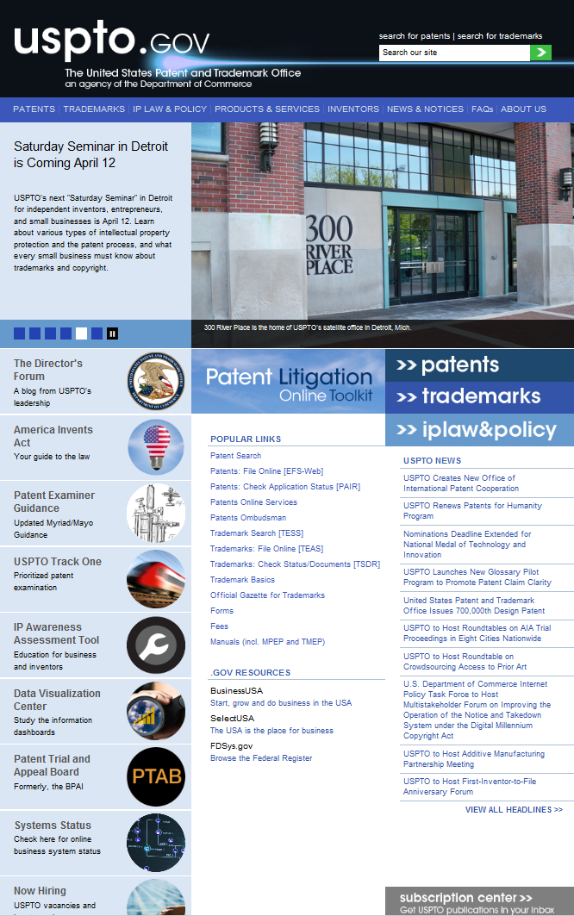
PTAB Website: From USPTO Home Page

Slide 56

PTAB Website: Landing Page (top half)

Slide 57
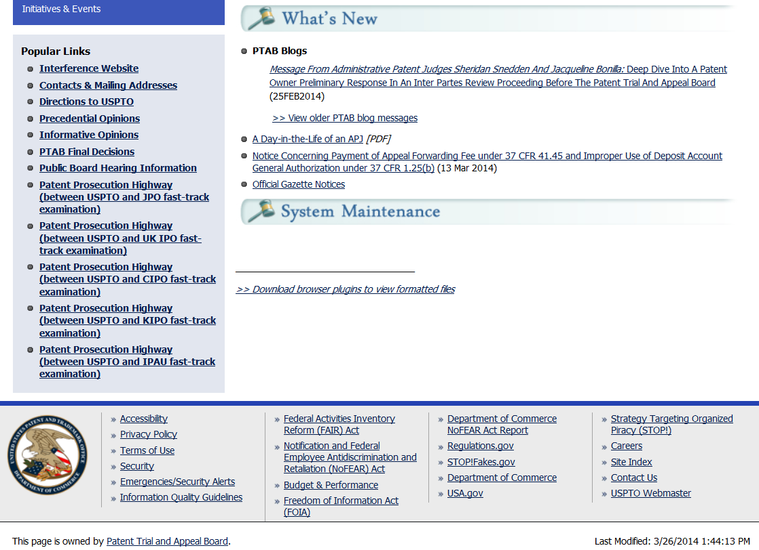
PTAB Website: Landing Page (bottom half)

Slide 58

PTAB Website: Blogs

Slide 59
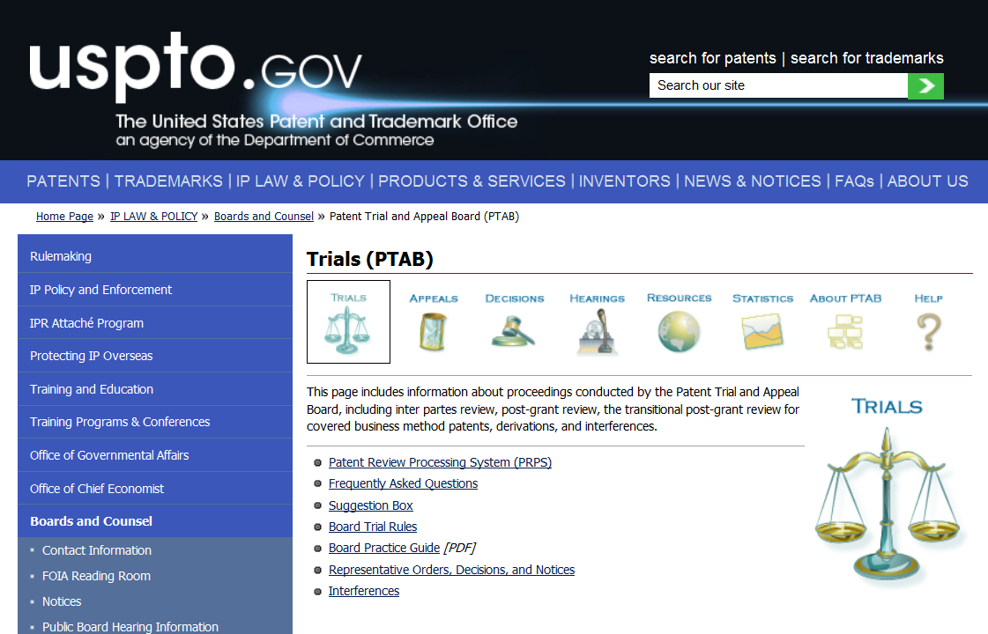
PTAB Website: Trials Page

Slide 60
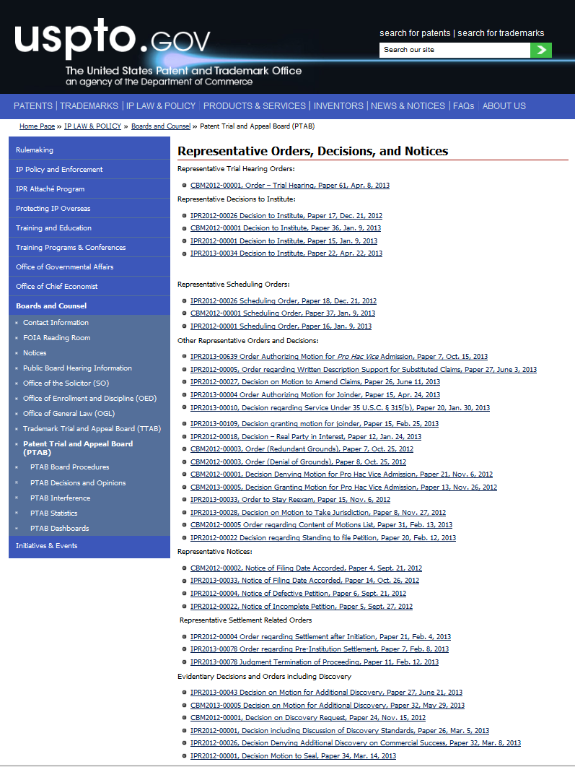
PTAB Website: Representative Decisions, Orders, and Notices

Slide 61
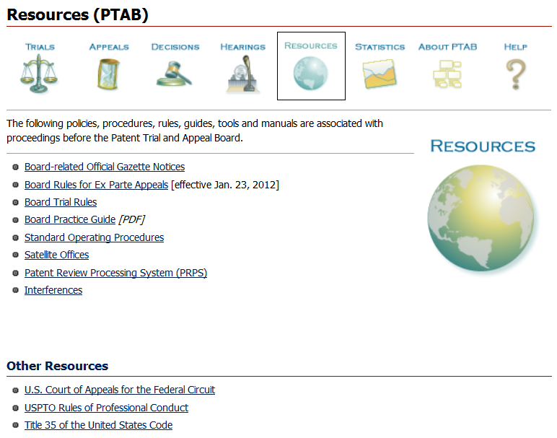
PTAB Website: Resources Page

Slide 62
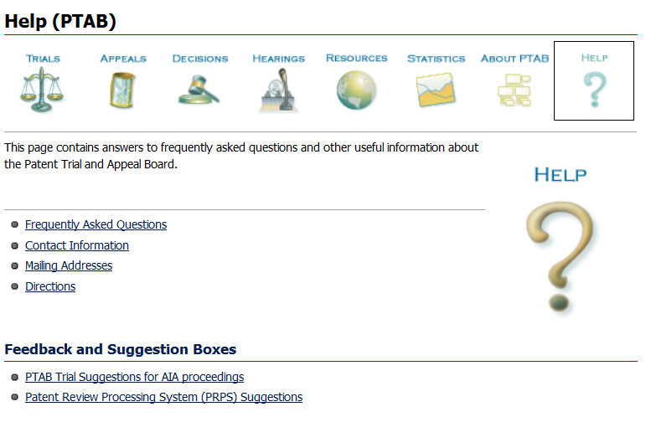
PTAB Website: Help Page

Slide 63
PTAB Subscription Center

Slide 64
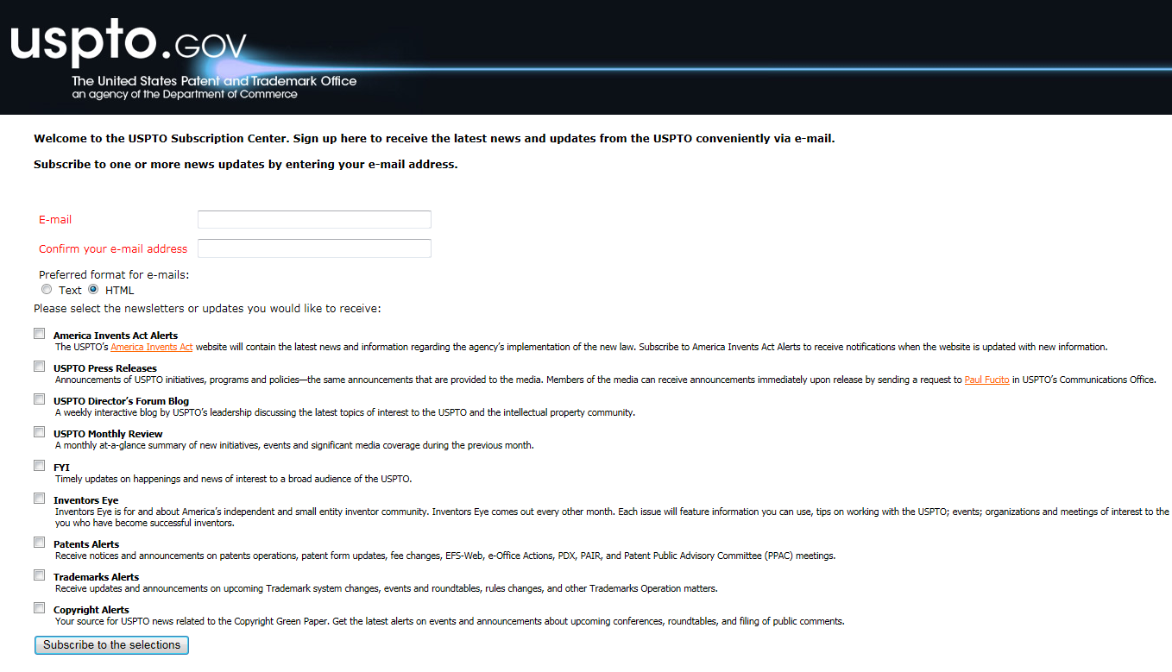
PTAB Subscription Center: Coming Soon

Slide 65
Thank You

Slide 66
Mock Conference Call

Slide 67
Motion to Amend: Fact Pattern
IPR instituted against claims 1-5
  Claims 1, 4, and 5 are independent
  Claims 2 and 3 depend from claim 1
Before telephone conference, Patent Owner contemplates filing a motion to amend that will:
  Replace claim 1 with substitute claim 1;
  Replace claim 4 with substitute claims 6-10; and
  Cancel claim 5

Slide 68
Motion to Amend: Fact Pattern
After teleconference, Patent Owner intends to file a motion to amend that will:
  Replace claim 1 with substitute claim 6;
  Replace claim 4 with substitute claim 7; and
  Cancel claim 5

Slide 69
Lessons Learned: Motion to Amend
Motion to amend may request cancellation or substitution of an original claim
  Wholesale addition of new claims generally is not allowed
A substitute claim generally should contain all of the limitations of the original claim that it replaces
A substitute claim should add one or more features that respond to the grounds of unpatentability at issue in the trial
Each original claim that changes in scope as a result of the amendment should be presented as a substitute claim with a unique claim number
  Applies to claims that change in scope only by virtue of their dependence on a substitute claim too

Slide 70
Motion to Amend: Lessons Learned
AIA trial is not a patent examination
  Board does not conduct a prior art search or enter rejections
If a motion to amend is granted, the substitute claim is added to an issued patent without any Office search or examination
Patent Owner “moves” to amend; no amendment of right
As the party requesting relief, Patent Owner bears the burden of establishing the patentability of proposed substitute claims
In general, the Board takes up a motion to amend only if the original claim is cancelled or found unpatentable, so no gloss of patentability transfers from original claim to substitute claim

Slide 71
Lessons Learned: Motion to Amend
An inventory that catalogues the individual disclosures of each prior art reference may not be helpful or the best use of the 15 pages allowed for motions
Provide a narrative that explains what the Patent Owner knows about the state of the prior art as it relates to the feature added by amendment
  Focus on why adding that feature to the combined elements of the original claim would not have been obvious
Patent Owner may support that narrative with an expert declaration, citations to textbooks, or evidence of conventional practices relevant to the added feature

Slide 72
Motion to Amend: Some Interesting Cases
Idle Free Systems, Inc. v. Bergstrom, Inc., IPR2012-00027,
Papers 26, 66 (setting forth requirements for meeting burden of proof on a motion to amend).
Corning Gilbert, Inc. v. PPC Broadband, Inc., IPR2013-00347, Paper 20 (discussing the burden regarding the state of the prior art and level of ordinary skill in the art with respect to features added by amendment).
Toyota Motor Corp. v. American Vehicular Sciences LLC,
IPR2013-00419, Paper 32 (providing guidance on mechanics and substance of a motion to amend).
Nichia Corp. v. Emcore Corp., IPR2012-00005, Paper 27 (motion to amend should adequately establish written description support for substitute claims based on the original disclosure of the application).

Slide 73
Motion for Additional
Discovery: Fact Pattern
Before the telephone conference call, Patent Owner seeks pre-authorization to file a motion for additional discovery requesting 2 categories of documents:
  All sales and pricing documents relating to Petitioner’s products that are at issue in a district court infringement action; and
  All documents regarding the relationship between Petitioner and two non-parties:
      Acme = Petitioner’s customer; and
      Universal = a company recently acquired by Petitioner

Slide 74
Motion for Additional
Discovery: Fact Pattern
After the telephone conference, the Board authorizes Patent Owner to file a motion for additional discovery directed to the following documents:
  A summary document that reflects sales and pricing data for the products manufactured by Petitioner that are accused of infringement in district court. Counsel for Petitioner admitted that a summary document already exists, so compiling a summary is not required; and
  A customer sales agreement between Acme and Petitioner, as well as an acquisition agreement between Universal and Petitioner. Counsel for Petitioner admitted that these documents exist and are easily accessible

Slide 75
Lessons Learned: Motion for Additional Discovery
The discovery permitted in an AIA trial is more limited than the discovery available in a district court
Party seeking discovery that exceeds the scope of routine discovery must ask the Board for authorization to file a motion for additional discovery
Motion must show that a grant of the additional discovery will serve the interests of justice (for an IPR) or is supported by good cause (for a CBM or PGR)

Slide 76
Lessons Learned: Motion for Additional Discovery
Motion must do more than target information that is likely to be useful. Motion must show that the requested documents likely exist and will be useful in making out an element of the requesting party’s case
Requests seeking “any” or “all” documents in a broad category may be viewed as speculative
Board will consider whether the discovery request would unduly burden the producing party or can be obtained from other sources, such as the Internet
Expect the Board to encourage reasonable compromise

Slide 77
Motion for Additional Discovery: Some Interesting Cases
Garmin Int’l v. Cuozzo Speed Techs., IPR2012-00001,
Paper 26 (enumerating the “Garmin factors”)
Corning, Inc. v. DSM IP Assets B.V., IPR2013-00043,
Paper 27 (granting additional discovery request for laboratory notebooks)
RPX Corp. v. Virnetx Inc., IPR2014-00171, Paper 25 (granting additional discovery regarding real-party-in-interest and privity issues after identifying a limited set of relevant documents)
Apple Inc. v. Achates Ref. Publ., Inc., IPR2013-00080,
Paper 66 (granting additional discovery of email communications exchanged directly between patent owner’s two experts)

Slide 78
Thank You

Slide 79
Break

Slide 80
Fact Pattern: Patents
Patent Owner is assigned two patents:
  ‘001 Patent
    has 100 claims; and
    was issued in 2000
  ‘002 Patent
    has 5 claims;
    was issued in 2014; and
    and is subject to the first-inventor-to-file provisions of the America Invents Act

Slide 81
Fact Pattern: District Court Litigation
Patent Owner has sued Petitioner for infringement of certain claims in the ‘001 Patent in District Court
Patent Owner is considering suing the Petitioner for infringement of certain claims in the ‘002 Patent in District Court too

Slide 82
Fact Pattern: AIA Trial
Petitioner wants to file one or more AIA trial proceedings against the ‘001 Patent and the ‘002 Patent because it believes:
  certain claims in the ‘001 Patent are anticipated and obvious as well as unpatentable under § 101 and § 112; and
  certain claims of the '002 Patent are obvious

Slide 83
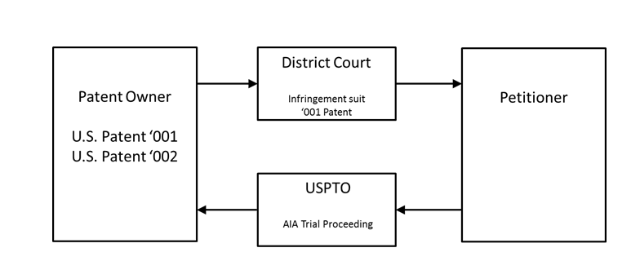
Fact Pattern: Graphic

Slide 84
Trial Proceeding Timeline

Slide 85
Thank You

Slide 86
Closing Remarks

Slide 87
PTAB Website: From USPTO Home Page

Slide 88
PTAB Subscription Center: Sign Up

Slide 89
Thank You

